Slide 1
Press Release
2017-10-02
The Nobel Assembly at Karolinska Institutet has today decided to award
the 2017 Nobel Prize in Physiology or Medicine
jointly to
Jeffrey C. Hall, Michael Rosbash and Michael W. Young
„for their discoveries of molecular mechanisms controlling the circadian rhythm”
Biológiai óra (cirkadián ritmus)

Slide 2
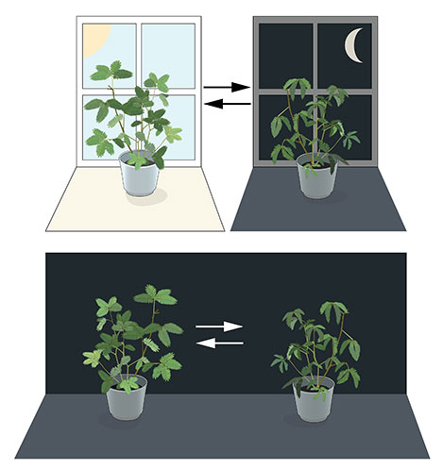
A biológiai folyamatok napi ritmusa
„With exquisite precision, our inner clock adapts our physiology to the dramatically different phases of the day. The clock regulates critical functions such as behavior, hormone levels, sleep, body temperature and metabolism.”
Pl. „jet leg”

Slide 3
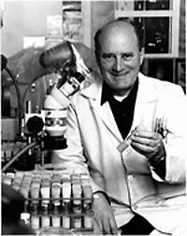
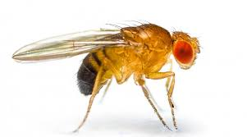
Seymour Benzer (1970 évek)
Period mutáns izolálása
Rosbash és Hall klónozta a period gént.

Slide 4
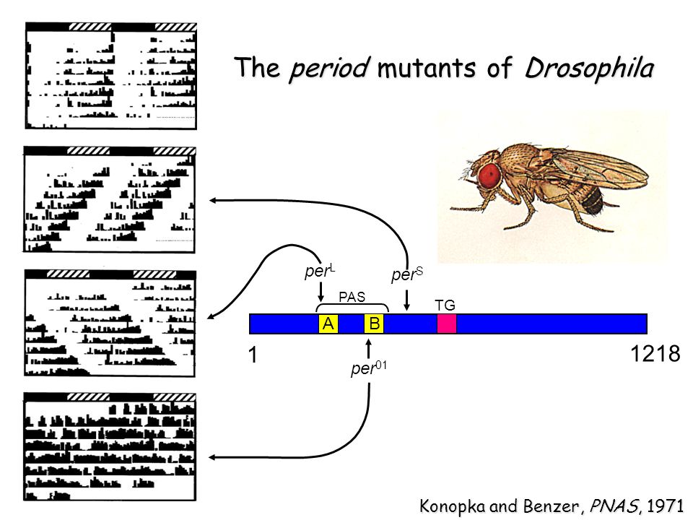

Slide 6
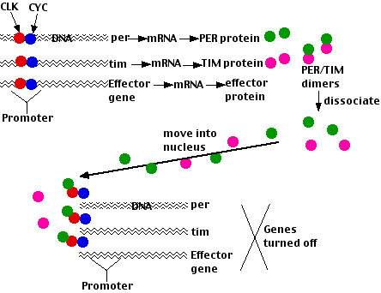
éjszaka
nappal

Slide 7
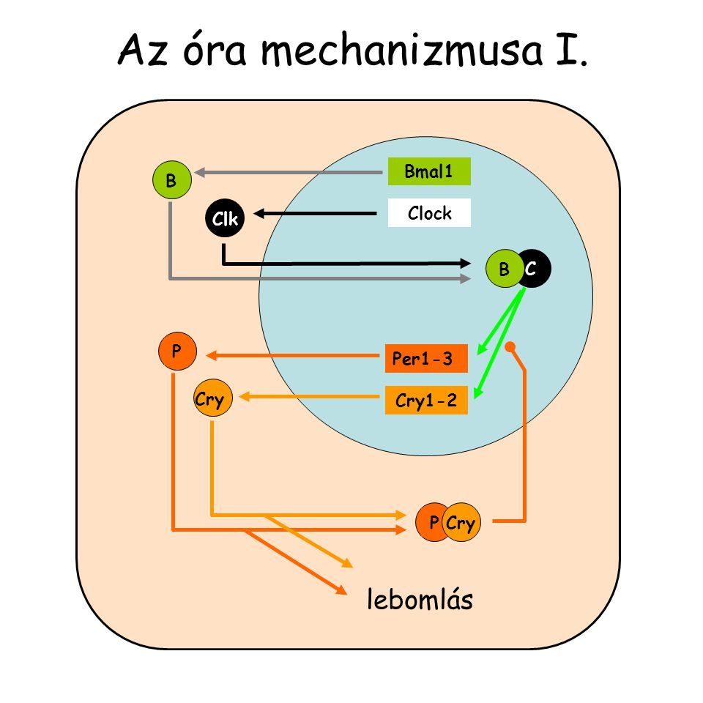

Slide 8
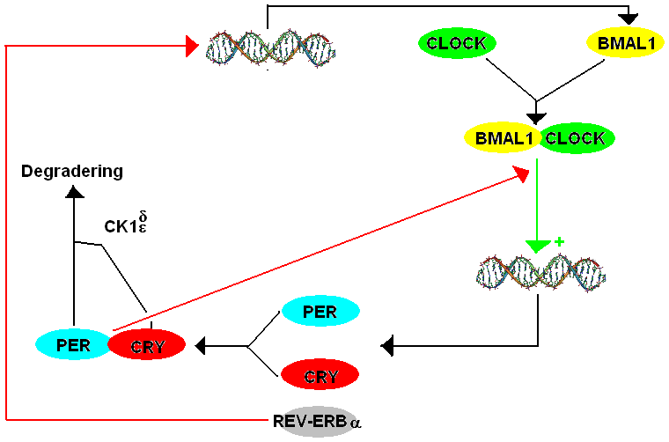
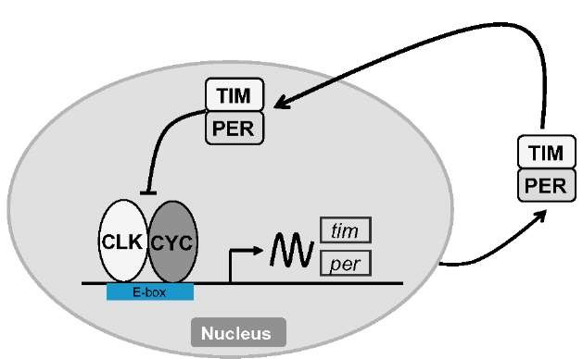

Slide 9
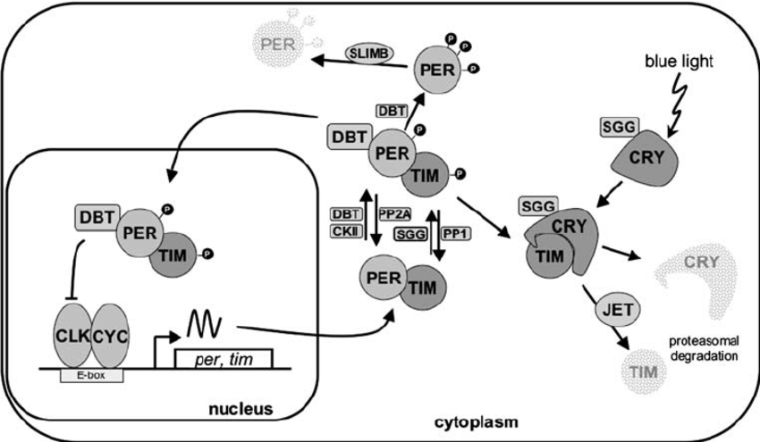

Slide 10
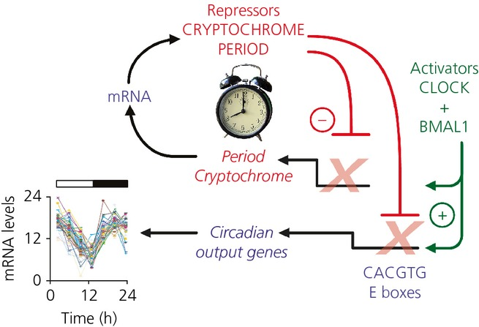
Emlősökben

Slide 11
