Slide 1


The ENCODE project:
ENCyclopedia Of DNA Elements (2012)
To gain insight into how genomic information is translated into cellular and developmental programs.
2016.11.21

Slide 2
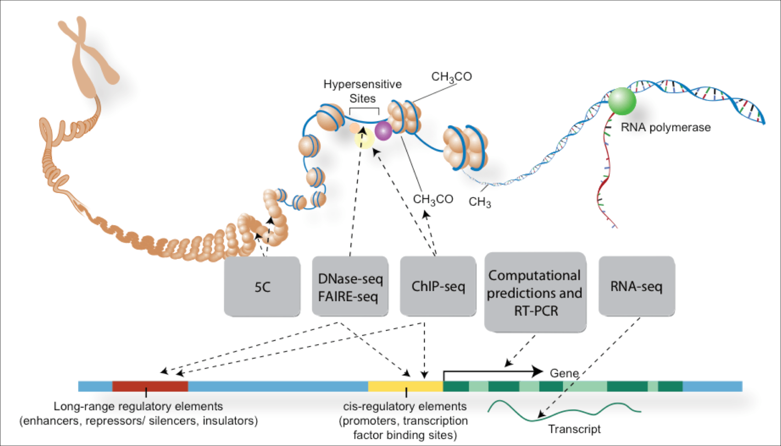
Funkcionális DNS szakaszok meghatározása genomi szinten

Slide 3
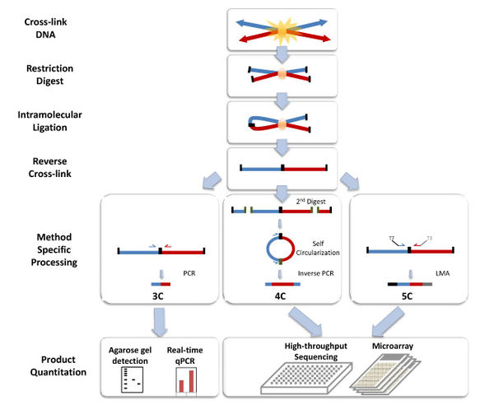
Chromosome conformation capture techniques (often abbreviated to 3C technologies or 3C-based methods) are a set of molecular biology methods used to analyze the organization of chromatin in a cell. They quantify the number of interactions between genomic loci that are nearby in 3-D space, but may be separated by many nucleotides in the linear genome.

Slide 4
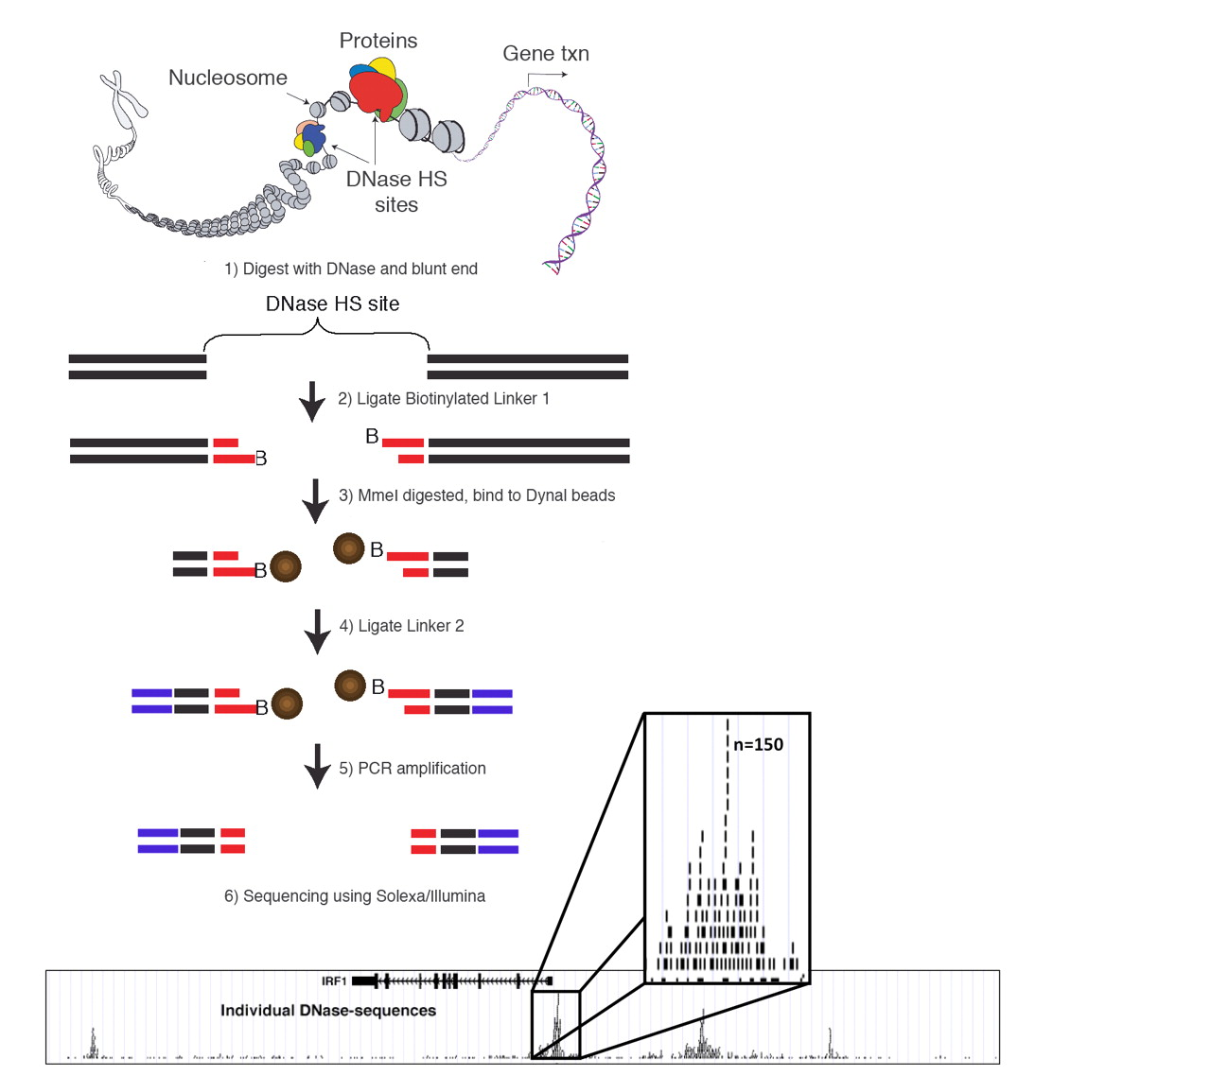
DNase-seq (DNase I hypersensitive sites sequencing) is a method used to identify the location of regulatory regions, based on the genome-wide sequencing of regions sensitive to cleavage by DNase I. FAIRE-Seq (Formaldehyde-Assisted Isolation of Regulatory Elements) is a successor of DNase-seq for the genome-wide identification of accessible DNA regions in the genome.

Slide 5
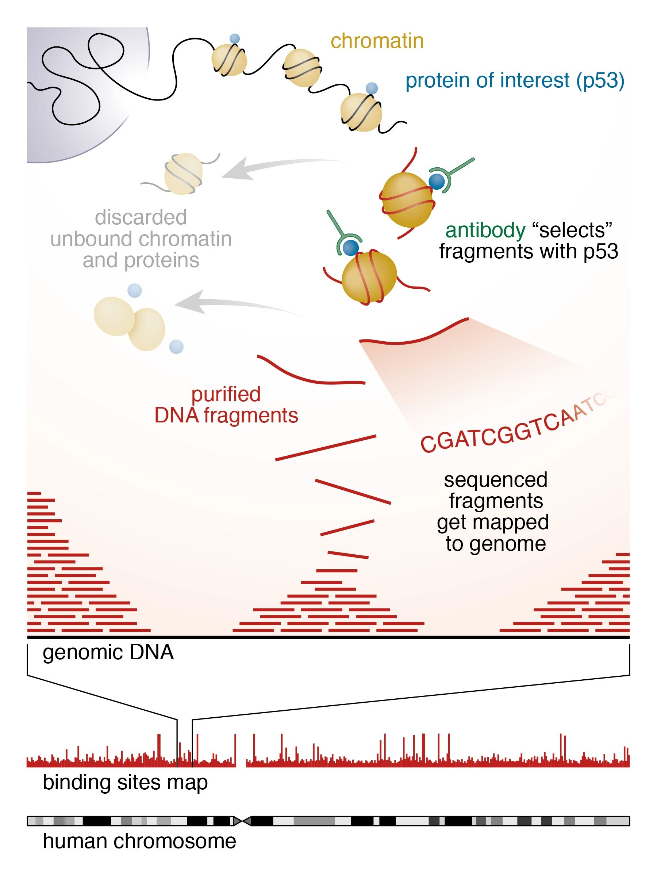
ChIP-sequencing, also known as ChIP-seq, is a method used to analyze protein interactions with DNA. ChIP-seq combines chromatin immunoprecipitation (ChIP) with massively parallel DNA sequencing to identify the binding sites of DNA-associated proteins.

Slide 6
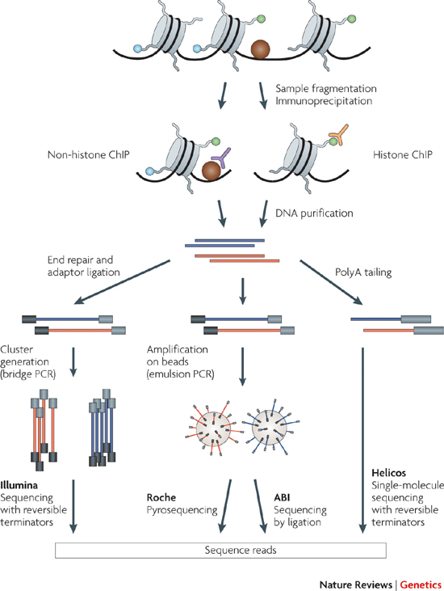

Slide 7
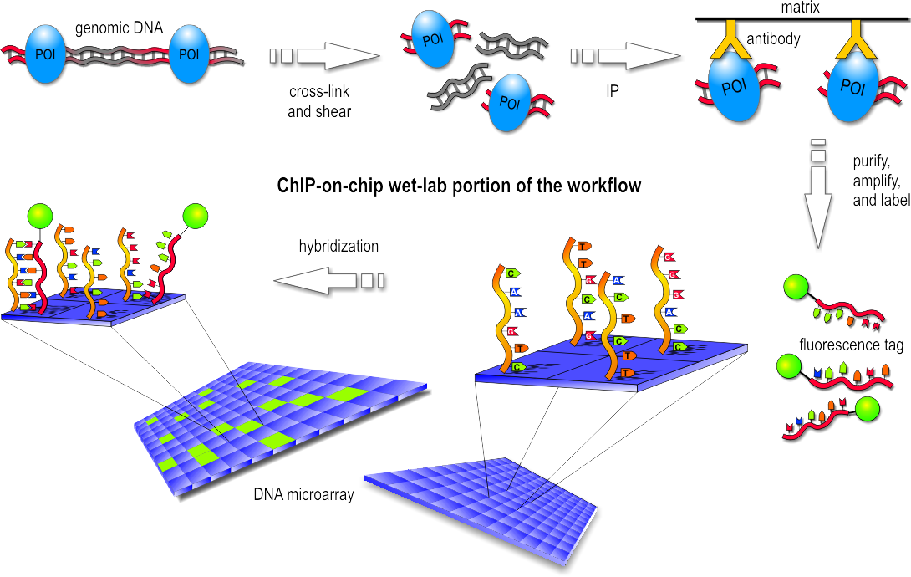
ChIP-on-chip

Slide 8
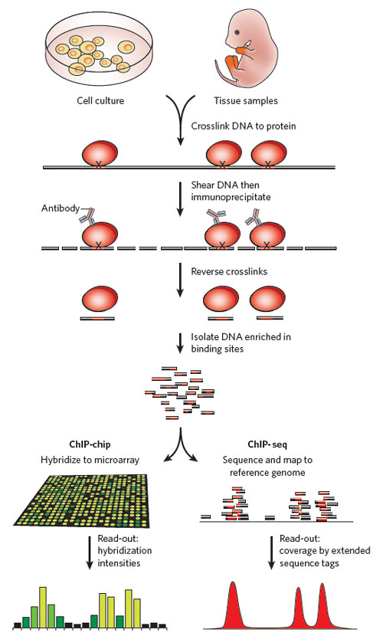

Slide 9
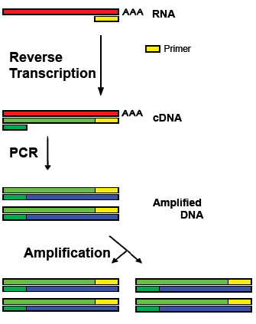
Reverse transcription polymerase chain reaction (RT-PCR), a variant of polymerase chain reaction (PCR), is a technique commonly used to detect RNA expression.

Slide 10
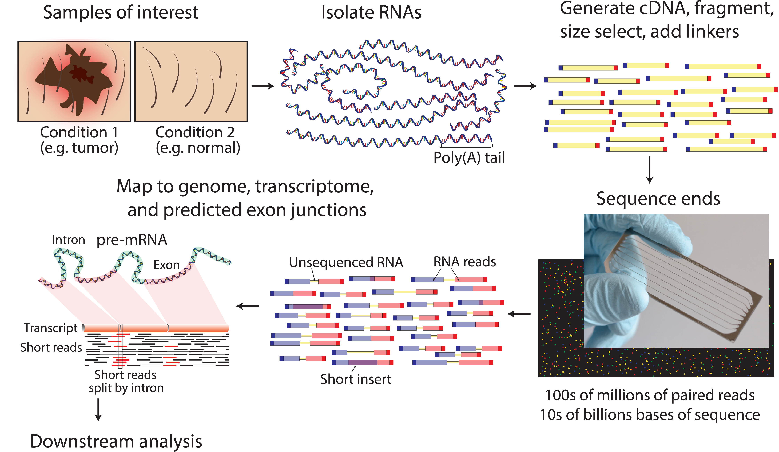
RNA-Seq (RNA sequencing), also called whole transcriptome shotgun sequencing, uses next-generation sequencing to reveal the presence and quantity of RNA in a biological sample at a given moment in time.

Slide 11
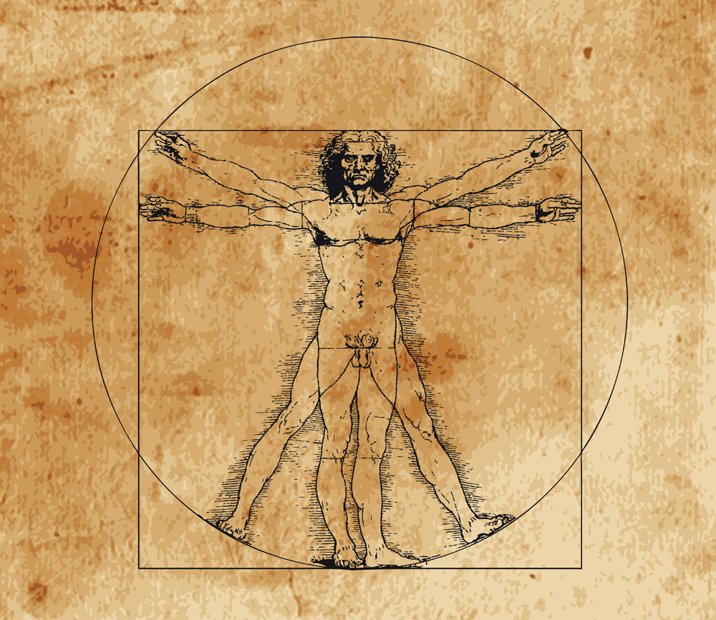
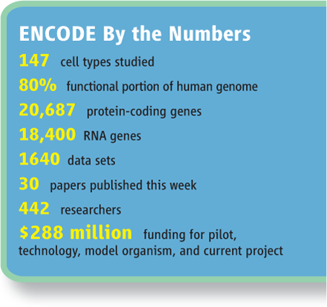

The ENCODE Consortium is an international collaboration of research groups funded by the National Human Genome Research Institute (NHGRI).
The goal of ENCODE is to build a comprehensive list of functional elements in the human genome, including elements that act at the protein and RNA levels, and regulatory elements that control cells and circumstances in which a gene is active.
ENCODE data are now available for the entire human genome (from 2012).
All ENCODE data are free:
http://genome-mirror.duhs.duke.edu/ENCODE/

Slide 12

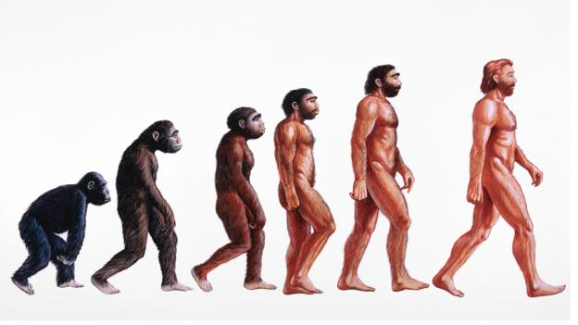
To complement the human ENCODE data, Mouse ENCODE experiments are currently underway. Early access to this data is available on the Mouse mm9/NCBI37 browser at the UCSC preview site.
The Mouse ENCODE Data Summary lists experiments that are planned or in progress.

Slide 13
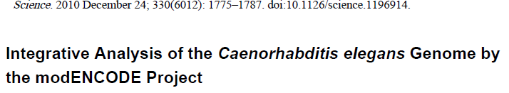
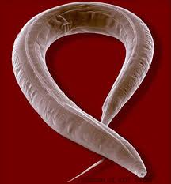

modENCODE
(Model Organism Encyclopedia of DNA Elements)
alternative exon usage of let-2 across stages

Slide 14
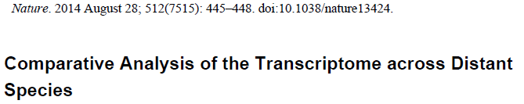
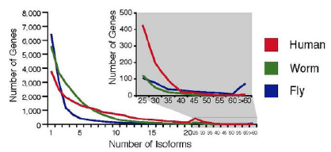
Analysis of alternative splicing

Slide 15
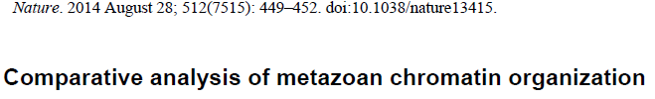
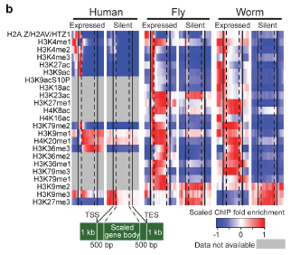
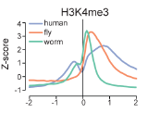
Promoter architecture at Transcription Start Sites (TSS)

Slide 16
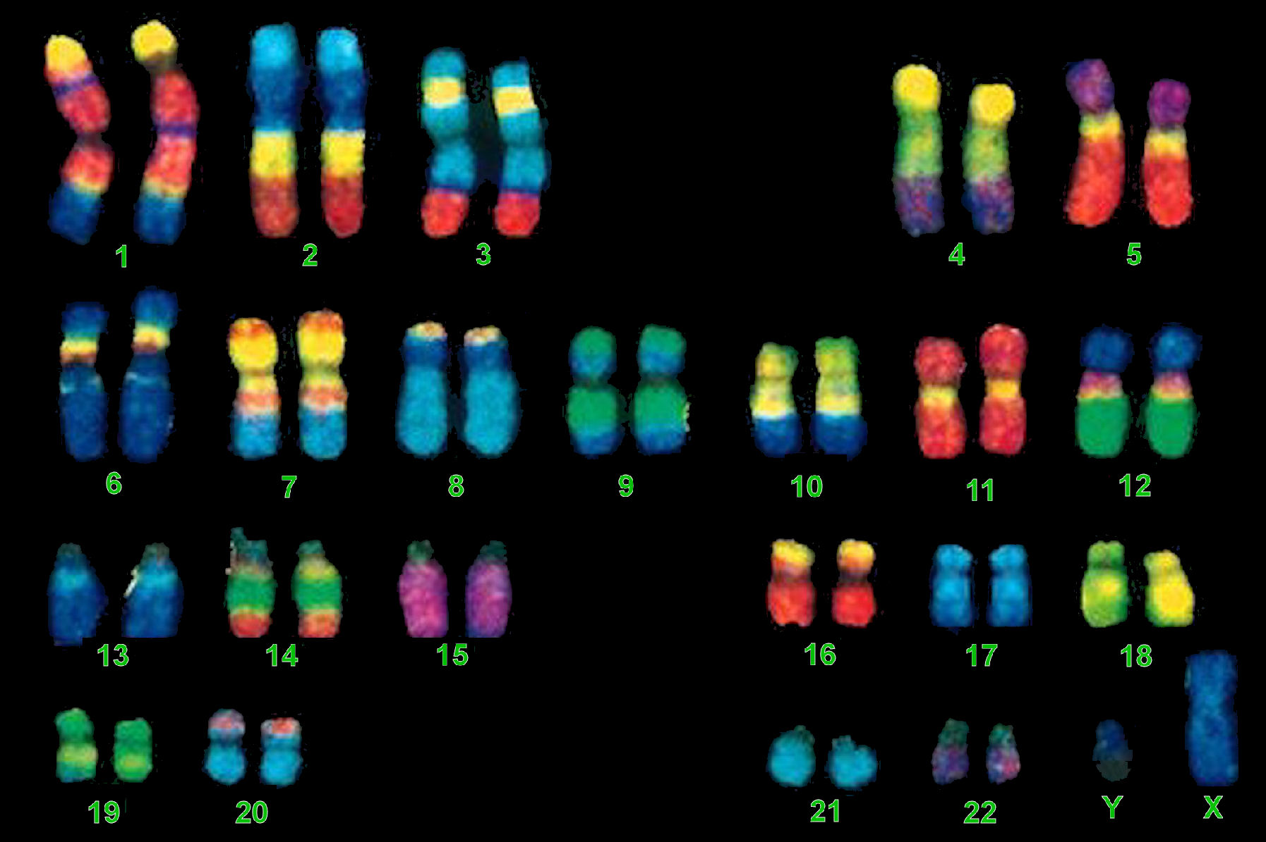
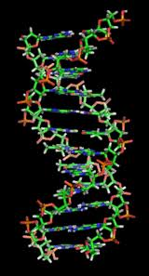
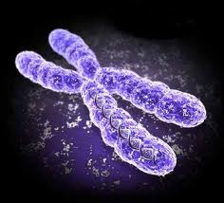
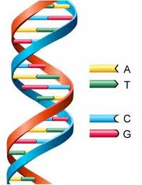
Human (male) chromosome set
Organization of the genetic material
Emberi (férfi) kromoszóma szett
DNA – the molecule of life
chromosome

Slide 17
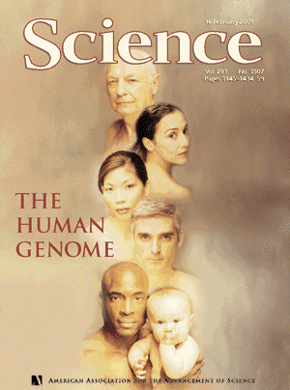
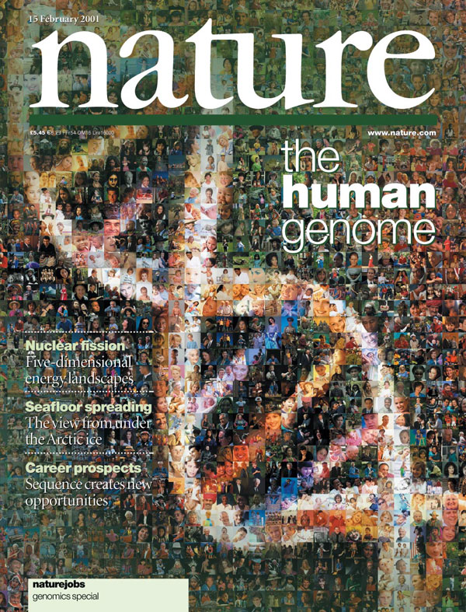
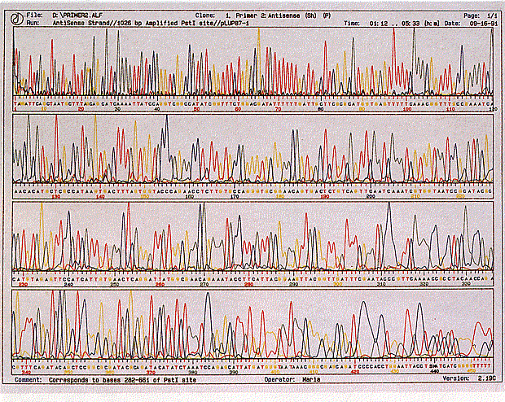
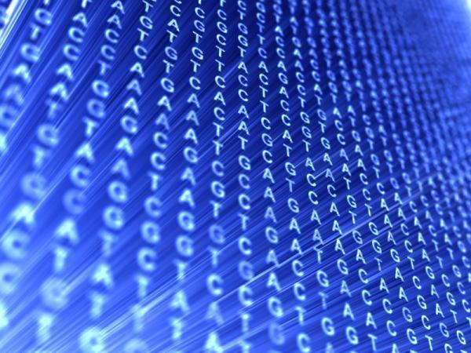
From the 90’s: The era of genomics
Genome sequencing – the human genome consists of 3 billions of base pairs

Slide 18
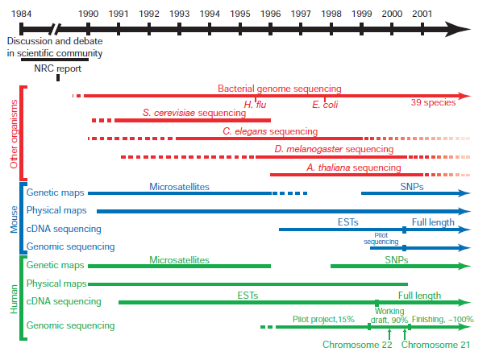

Slide 19
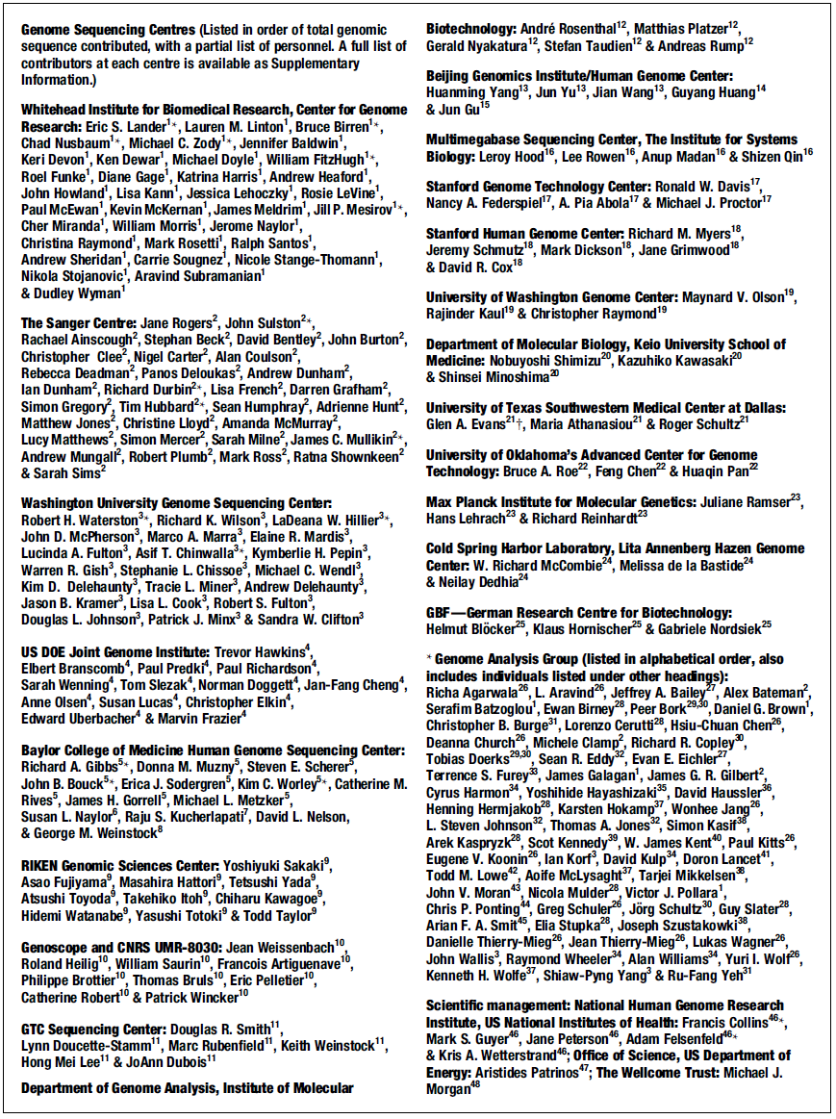
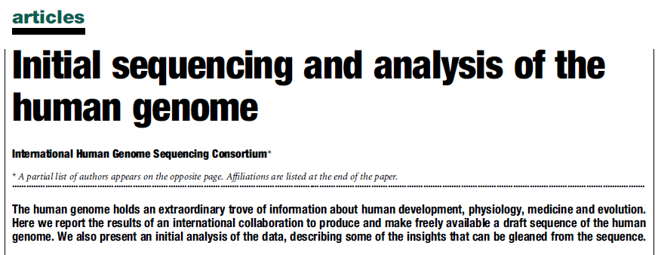

Slide 20
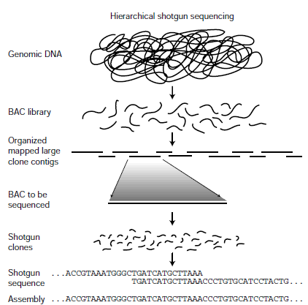
BAC (bacterial artificial chromosome) Sequencing …

Slide 21
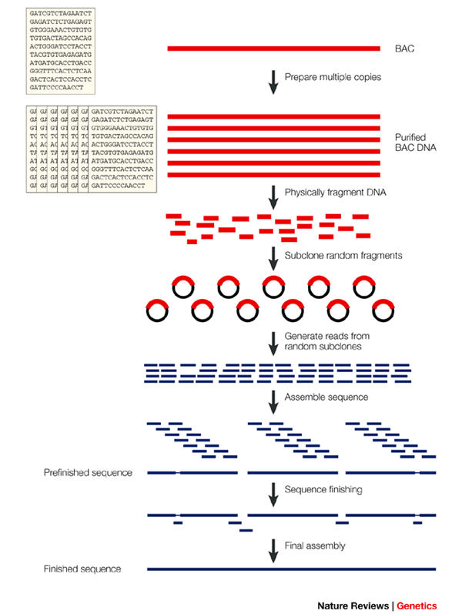
BAC (bacterial artificial chromosome) Sequencing …

Slide 22
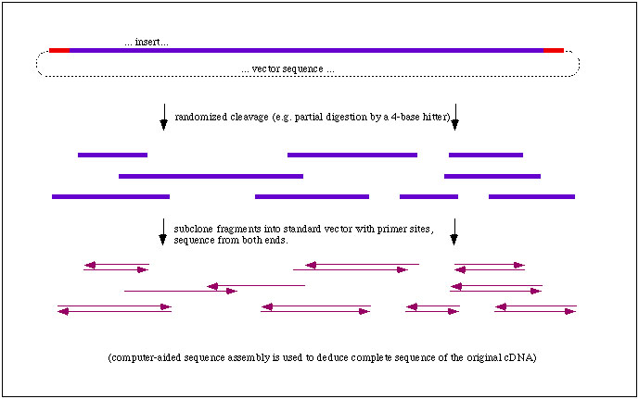
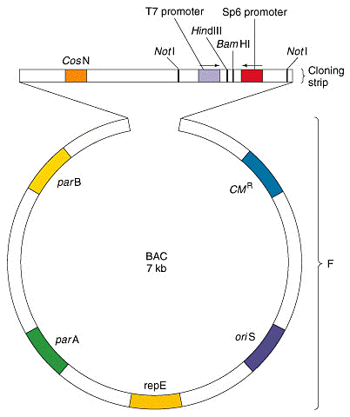
BAC

Slide 23
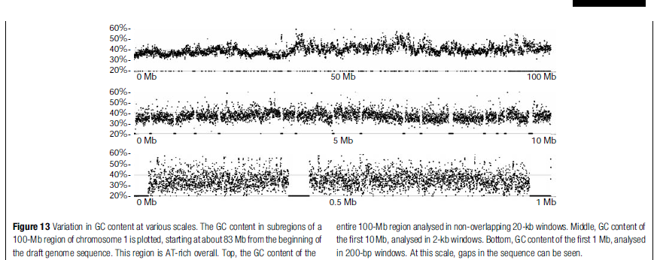
Outcome: average CG content

Slide 24
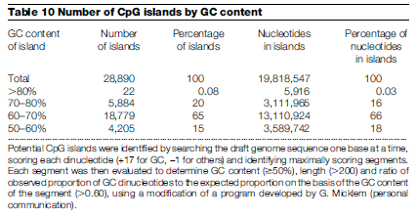
Outcome: CpG islands

Slide 25
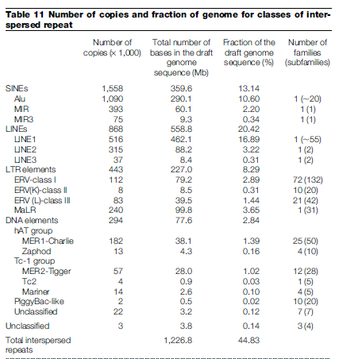
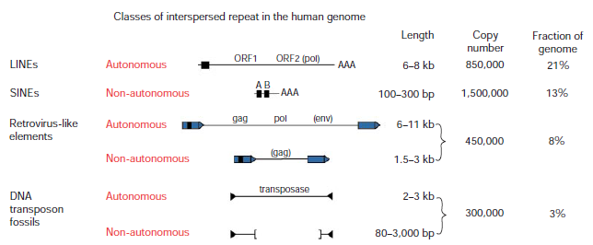
Outcome: repetitive elements

Slide 26
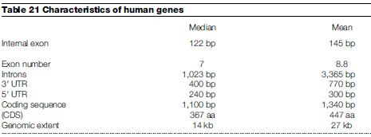
Outcome: genes

Slide 27
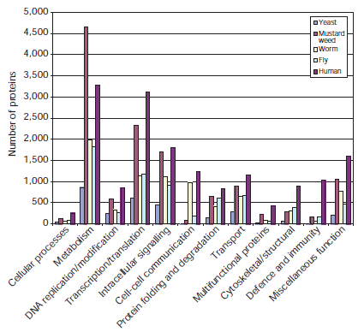
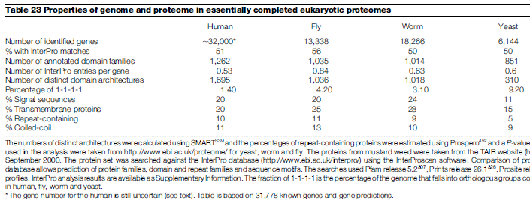
Outcome: genes (coding sequences)

Slide 28
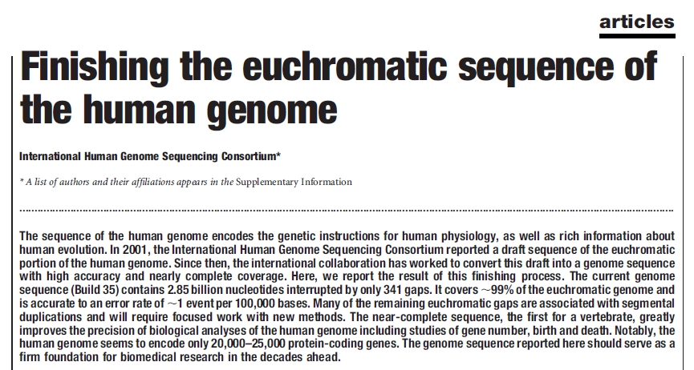
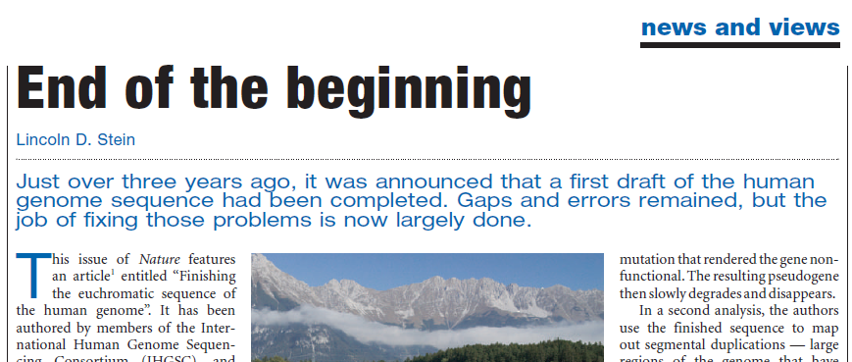

Slide 29
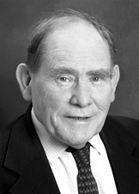
The sequence is not the end of the project, rather it is the beginning of the project
PERSPECTIVE GENOMICS
„The End of the Beginning”
Sydney Brenner, 2000

Slide 30

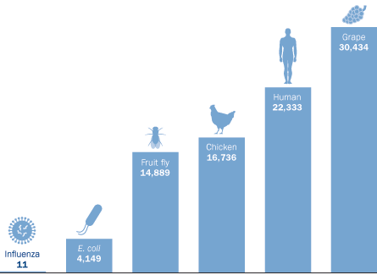
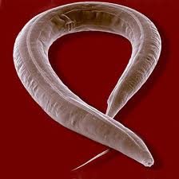
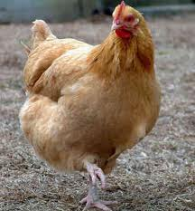

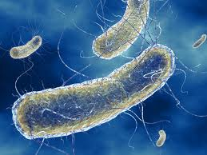
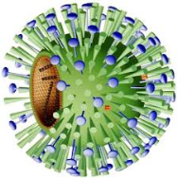
Meglepően kevés a humán gének száma
Caenorhabditis elegans (1 mm)
19.700 gén („majdnem humán”)

Slide 31
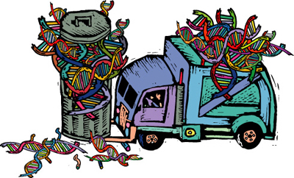
Korábbi hiedelem:
A humán genom jelentős része „szemét”
(„junk DNA”)
Csupán a genom 1%-a kódol (gének) vagy szabályoz (szabályozó régiók).

Slide 32


A humán genom közel felét (47%) MOBILIS szekvenciák (transposable elements) alkotják! – ezek is protein kódoló gének !!!
Retrotr.
Retrotr.
DNS tr.
Mozog a genom!!!

Slide 33
Az evidencia hiánya nem a hiány evidenciája !!!

Slide 34


2010:
beginnings
methodology

Slide 35
Goal
Comprehensively mapping transcripts, histone modifications, chromosomal proteins, transcription factors, replication proteins, and nucleosome properties accross a developmental time in multiple cell lines.
Discovering protein-coding, non-coding, RNA regulatory, replication and chromatin elements.

Slide 36
Generation of large-scale data sets:
transcriptome profiling across a developmental time course
genome-wide identification of transcription factor–binding sites
maps of chromatin organization

Slide 37
Methods (genome-wide)
Experimental assays include:
high-throughput RNA sequencing (RNA-seq)
capturing small and large RNAs and splice variants
chromatine immunoprecipitation (ChIP)
ChIP followed by high throughput sequencing (ChIP-seq)
profiling chromosomal and RNA binding or processing proteins
tiling-arrays

Slide 38


RNA-seq
exon
intron
exon
intron
exon

Slide 39

Transcription factor complexes

Slide 40

ChIP
(formaldehyde)

Slide 41



ChIP-seq: immunoprecipitation of a protein-DNA complex
Formaldehyde – UV light; sonication
Protein-specific
antibody

Slide 42

ChIP-on-chip

Slide 43

Tiling array: is a subtype of microarray chips.
Digest chromatin with DNaseI
(Genome array)

Slide 44

Stages at which samples should be taken

Slide 45

Chromatin-based annotation of functional elements
Example of a transcript predicted by chromatin signatures associated with promoter (red trace) and gene bodies (blue box) and supported by cDNA evidence.

Slide 46
Intergenic H3K36me1 chromatin signatures predict replication activity.
Enrichment of multiple chromatin marks were used to identify putative large (>10 kbp) intergenic H3K36me1/H3K18ac domains located outside of annotated genes.

Slide 47


Slide 48


Slide 49


Slide 50


Slide 51

CAGE
MmeI: cuts DNA 20 bases from its recognition sequence and modifies just one DNA strand for host protection

Slide 52

RNA-PET

Slide 53


Slide 54

FAIRE-seq
Formaldehyde-Associated Isolation of Regulatory Elements

Slide 55
RRBS
MspI: When the external C in the sequence CCGG is methylated, MspI cannot cleave. However, MspI can cleave the sequence when the internal C residue is methylated.

Slide 56

Bisulfite (bisulphite) sequencing is the use of bisulfite treatment of DNA to determine its pattern of methylation.

Slide 57


Slide 58

GENECODE gene annotation
Collection and interpretaqtion of different results

Slide 59

Experimental validation: how a newly identified coding region works in vivo
mouse
fish

Slide 60


DNA variation: Allele-specific ENCODE elements

Slide 61



Slide 62

Chromosome
Conformation
Capture

Slide 63

5C: chromosome conformation carbon capture copy
ChIA-PET

Slide 64

ChIA-PET
Chromatin Interaction Analysis by Paired-End Tag Sequencing (ChIA-PET) is a technique that incorporates chromatin immunoprecipitation (ChIP)-based enrichment, chromatin proximity ligation,Paired-End Tags, and High-throughput sequencing to determine de novo long-range chromatininteractions genome-wide (Fullwood & Yijun, 2009).

Slide 65

TSS: transcriptional start site

Slide 66


Slide 67


Slide 68


Slide 69


Slide 70


Slide 71




Slide 72


Slide 73



Slide 74

TF: transcription factor

Slide 75




Slide 76



A C. elegans example

Slide 77

1 2 3 4 5 6 7 8 9 10 11
Lines:
front control (goa-1 oligo)
xol-1 oligo (reticulocyta lysate)
xol-1 oligo + TRA-1 (positive control)
goa-1 oligo
goa-1 oligo + TRA-1
mut goa-1 oligo
mut goa-1 oligo + TRA-1
gpa-16 oligo
gpa-16 oligo + TRA-1
rest gpa-16 oligo
rest gpa-16 oligo + TRA-1
TRA-1
lysate
1 2 3 4 5 6 7 8 9 10 11

Slide 78


