Slide 1

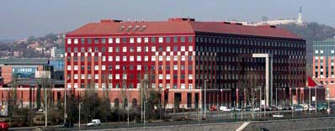
The regulation and mechanism of aging
Budapest, 2022.03.17.

Slide 2
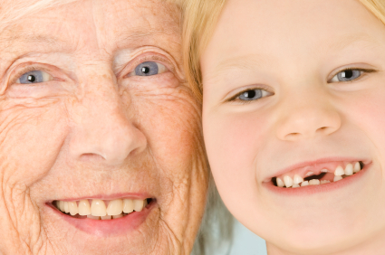
The manifestation of aging
Evolutionary significance:it decreases the competition within species by eliminating the post-reproductive individuals, thereby increasing the stable, long-term maintainence of species under conditions of limited resources. The evolution of „aging” genes.

Slide 3
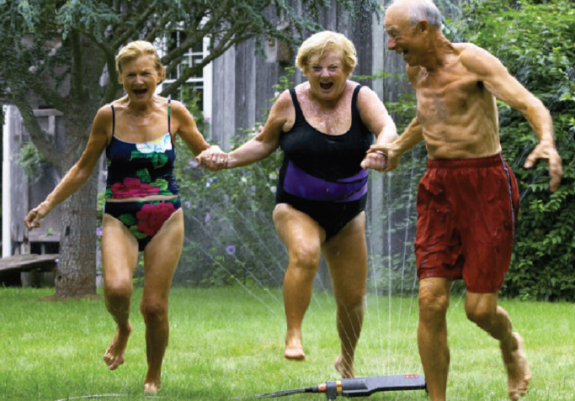
Social significance of aging
In the developed word, lifespan expectancy exceeds 75-80 years. Social, medical and economic significances.
Abbott (Nature 428:116, 2004):
Across the developed world, birth rates are falling and people are living longer. This requires a new focus on research to promote healthy ageing, rather than simply treating the diseases of old age.
122 years
Lifespan expectance has became double during the last 200 years.
Jean Calmet

Slide 4
The aging process
Aging: „a natural decline in the fitness (general physiology) of an organism over time as the result of the accumulation of unrepaired cellular damage.” Kirkwood T. Nature 451:644-7 (2008).
Cellular damage cell death massive levels of cell death
tissue/organ dysfunction (age-related disease) organismal death
Cellular damage:
defolded, oxidized, aggregated proteins
non-functional organelles
...
Causes of cellular damage:
ROS, mutation, high temperatures, high O₂ levels,
...
Notes:
ageing in diverse eukaryotic organisms is driven by the
progressive accumulation of damaged macromolecules and
organelles [1,2]. Such types of damage appear as oxidized,
misfolded, cross-linked or aggregated macromolecules that
are structurally abnormal and therefore cannot function
properly. In addition, damaged macromolecules and organelles,
or their aggregates, can actively compromise cellular
function, presumably by interfering with signaling
pathways, by acting as sinks for binding proteins, or by
sending erroneous signals.
Cellular damage
is generated continuously during the entire life of an
organism. For example, ionizing radiation, endogenous
factors including specific enzymes, and mitochondrial production
of reactive oxygen species (ROS) that can oxidize
macromolecules, all engender abnormal macromolecular
function

Slide 5
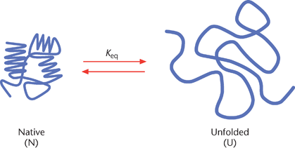
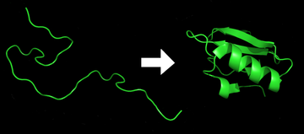
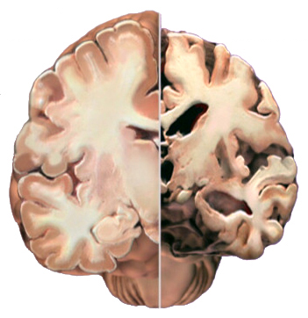
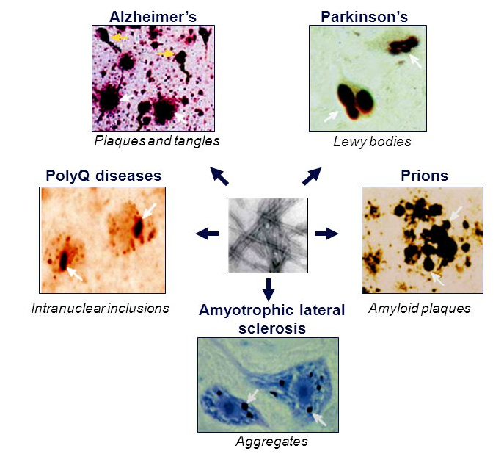
Cellular damage (e.g., defolded proteins)
amyloide
α-synuclein
normal
AD
natív protein
defolded protein
Htt
Various proteins

Slide 6
„… aging is a collection of mostly independent degenerative processes leading to disease and, ultimately, death.”
„If a cancer cure were to be found that, for example, efficiently killed abnormally proliferating cells, it would only increase the risk of an individual to acquire another type of pathology.”
Hekimi and Guarente, Science 299:1351, 2003.
The aging process and aging-related pathologies – a common molecular mechanism!!!
Decreasing the rate of aging simultaneuously delays the incidence of age-associated diseases (healthy aging).

Slide 7
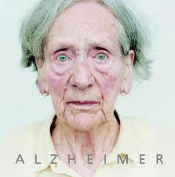
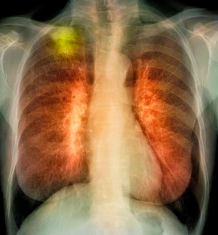
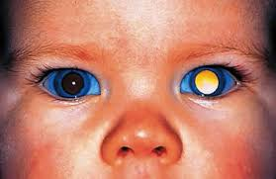
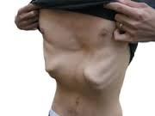
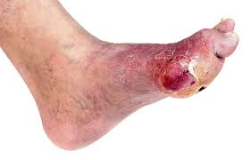
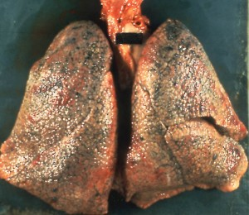
Age-related degenerative pathologies
Neuronal degeneration
cancer
cancer
sarcopenia
diabetes
(immundeficiency)
fibrosis

Slide 8
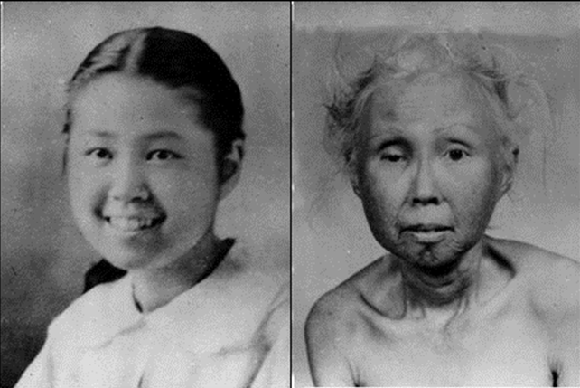
The regulation of aging
Werner syndrome – the effect of individual genes
(progeria – a fast aging rate)
RecQ helicase
(Wrn) deficiency
15 years 48 years

Slide 9
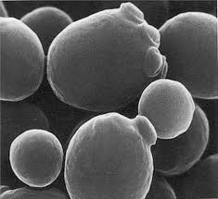
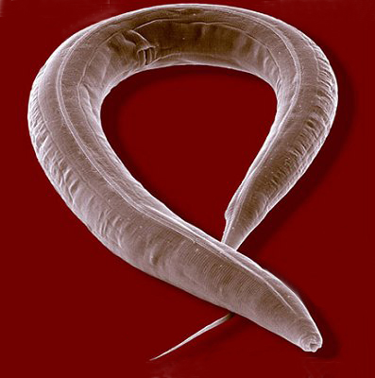
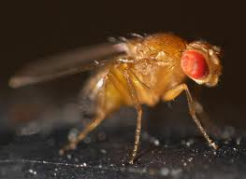
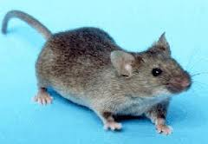
Aging models –
Isolation of lng-lived mutant strains
(short lifespan)
The yeast
Saccharmoces cerevisiae
(1 month)
The nematode
Caenorhabditis elegans
(2 weeks)
The fruit fly (insect)
Drosophila melanogaster
(2 months)
The mouse (mammal)
Mus musculus
(2 years)

Slide 10

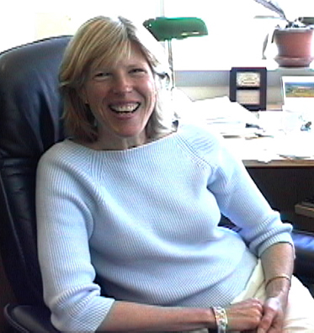

daf-2(-) mutant nematodes live two times longer than the wild type
daf-2(-) mutant
Wild-type
Age (days)
Kenyon C, et al. Nature 366:461-4 (1993).
Cytnhia Kenyon

Slide 11
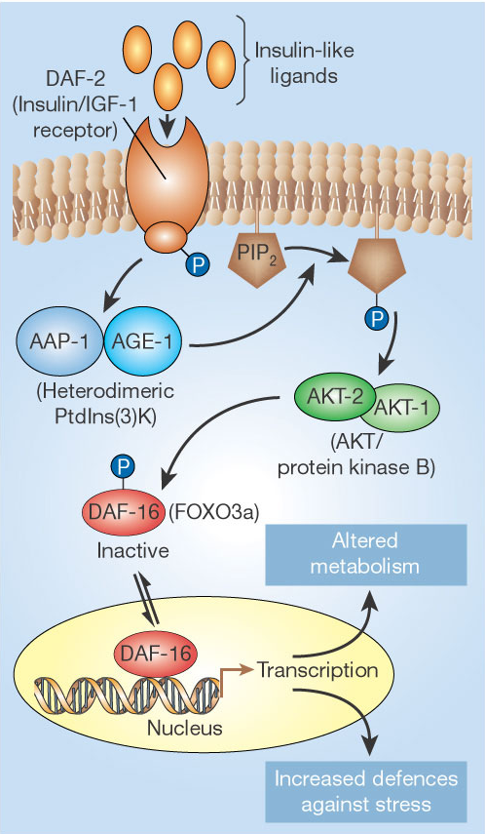
DAF-2:
insulin/IGF-1 receptor
Insulin/IGF1 signaling:
the hormonal (neuroendocrine) regulation of aging
IGF: insulin-like growth factor

Slide 12
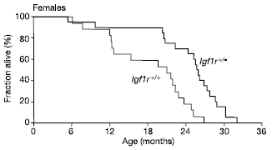
The insulin/IGF-1 signaling pathway:
an evolutionarly conserved regulatory system of aging
Inhibition of insulin/IGF-1 receptor in Drosophila doubles lifespan
(Tatar et al., Science 292: 107, 2001).
Inhibition of insulin/IGF-1 receptor in female mice extends lifespan by 60%
(Holzenberger et al., Nature 421: 125, 2003).

Slide 13
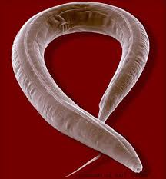
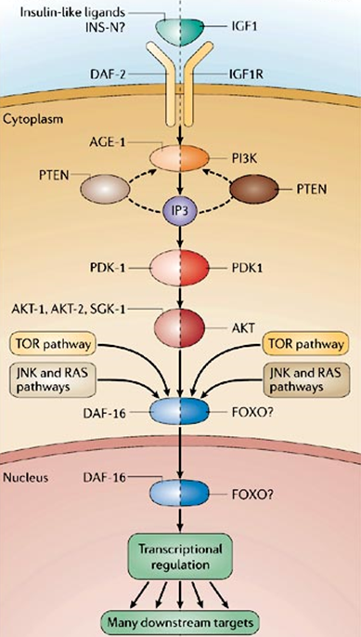

C. elegans
human
the insulin/IGF-1 signaling pathway regulates aging in an evolutionarily conserved way.

Slide 14
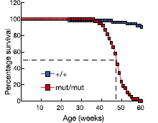
Mutant nematodes with a decreased rate of mitochondrial respiration are long-lived
nuo-2: a component of complex I (NADH/ubiquinone oxidoreductase)
cyc-1: a component of complex III (cytochrome c reductase)
atp-3: ATP synthase
Polg1
Age (in days)
Dillin et al., Science 298: 2398, 2002
Lee et al., Nat. Genet. 33: 40, 2003
Polg1: mtDNA polymease
Trifunovic et al., Nature 428: 417, 2004

Slide 15
Genetic interactions between insulin/IGF-1 signaling (daf-2) and the mitochondrial respiratory chain (nuo-1)
mutation mean lifespan (at 25°C) phenotype
wild-type 10 days normal
daf-2(-) 20 days long-lived
nuo-1(-) 20 days long-lived
daf-2(-), nuo-1(-) 40 days extra long-lived
Additive effects: the two systems act parallel in aging control.
insulin/IGF-1 signalling pathway
the rate of ageing
Mitochondrial respiratory chain

Slide 16
Longevity pathways:
az öregedés egy soktényezős (bonyolult) folyamat
Jelátviteli rendszerek: insulin/IGF-1, TOR, JNK, TGF-β, Ras
Regulatory proteins: sirtuins, p53, HSF1, FoxA
Mitochondrial respiratory chain
Translational system
Degradative pathways (autophagy, the proteasome system, ...)
...
Environmental factors: nutrient level, O₂-level, temperature,
chemical agents (e.g., resveratrol)
aging genes

Slide 17
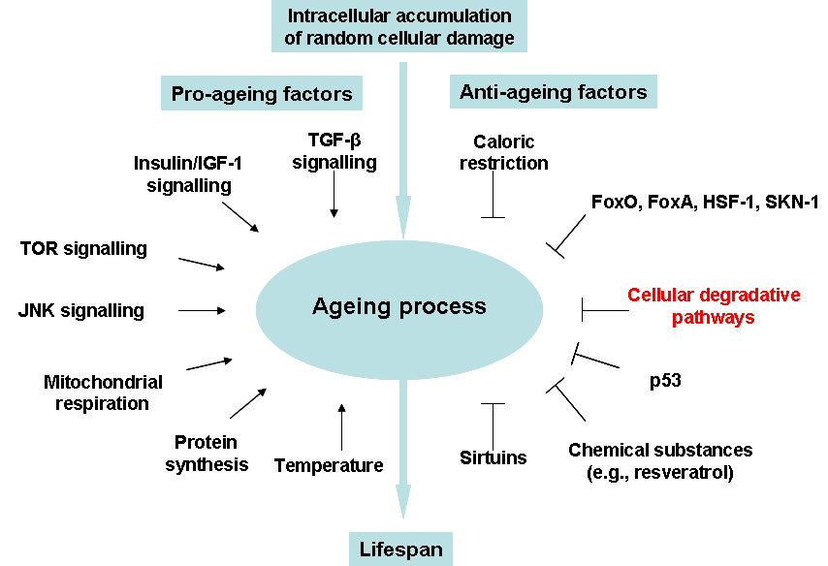
Aging is a complicated process ….

Slide 18
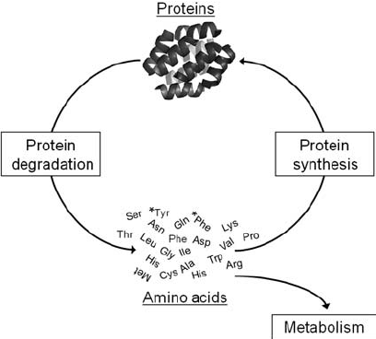
Protein homeostasis: szintézis – degradáció (turnover) egyensúlya
Rejuvenation of cellular materials
protein
Autophagy
Protein degradation
Protein synthesis
Amino acids
metabolism

Slide 19
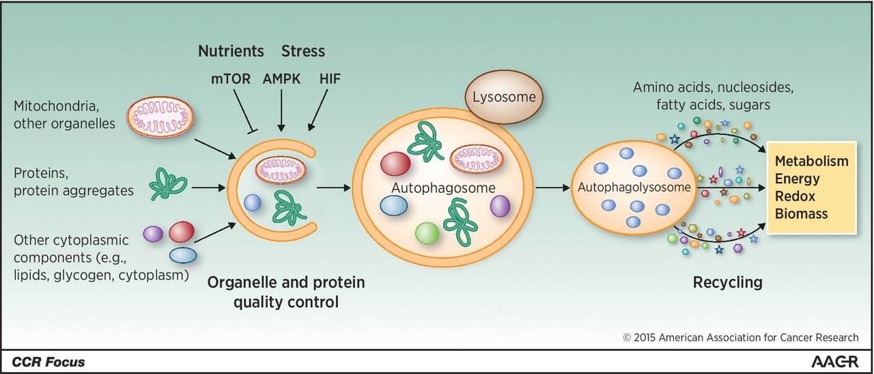
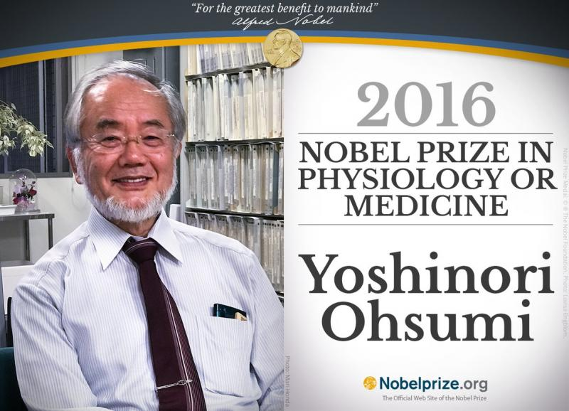
Autophagy – bulk degradation of cellular damage
Degradation of cellular damage: rejuvenation cellular materials

Slide 20
Autophagy is required for longevity in daf-2(-) mutants
Wild-type
daf-2(-)
atg-6(RNAi)
daf-2(-); atg-6(RNAi)
atg-6: autophagy gene 6
Meléndez A, et al., Science 301:1387 (2003).
daf-2 atg-6

Slide 21
Longevity pathways converge on autophagy genes to control aging
Autophagy is a central regulatory mechanism of aging!

Slide 22
Nutrients, Growth factors, Mitogens
Nutrients, Growth factors, Mitogens
Temperature,
Oxygen level
Cell membrane
PI(3,4,5)P₃
PI(4,5)P₂
RTK
AAT
PDK
PI3K (I)
IGF-1
TGF-β
Cellular energy
PTEN
Smad
RAS
Resveratrol
Akt/PKB
FoxA
LKB1
Sirt1/2
RAF1
TSC1/2
NRF1
FoxO
cAMP
AMPK
JNK1
MEK
Rheb
HSF-1
PKA
eE2F
CaN
p53
Bcl-2
ERK1/2
TOR
eIF4E
S6K
mitochondrion
AUTOPHAGIC MACHINERY
(elimination of cellular damage)
ROS
cytoplasm
ageing rate

Slide 23
Enhancing autophagy activity
Decreasing the rate of aging simultaneously delays or inhibits the incidence of various age-related diseases

Slide 24
Increased expression of Atg8 genes in neurons extends lifespan by 50% in Drosophila
Autophagy defective
Autophagy hyperactive
Ubiquitinated (damaged) proteins

Slide 25
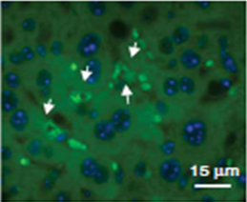
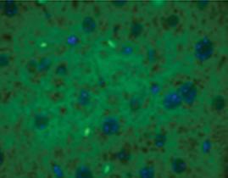
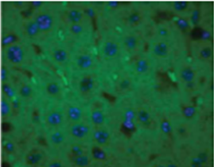
Enhanced autophagic activity delays the accumulation of damaged proteins in mouse hepatocite cells
6 months (control)
22 months (control)
Protein aggregates
22 months (autophagy hyperactive)
Zhang and Cuervo, Nat Med. 14:959 (2008)

Slide 26
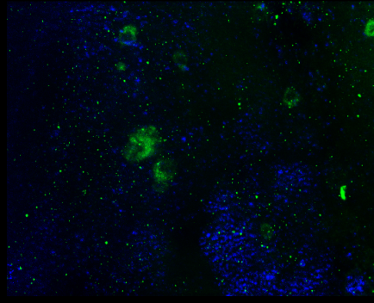
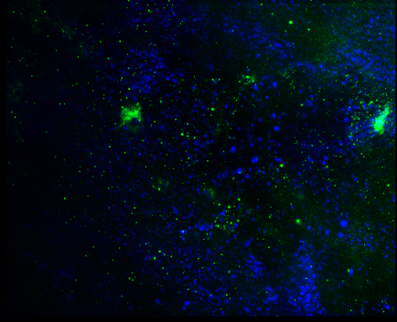
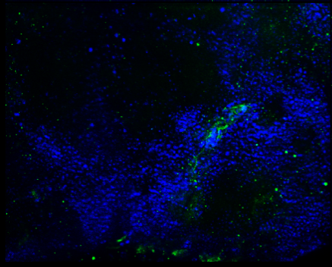
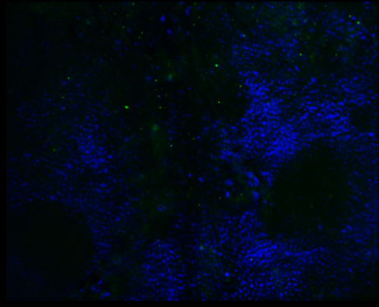
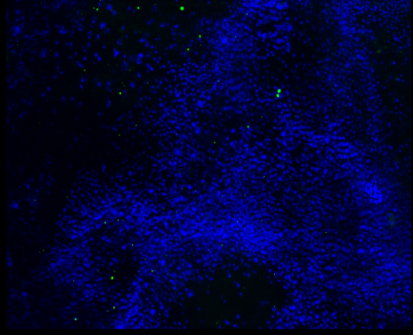
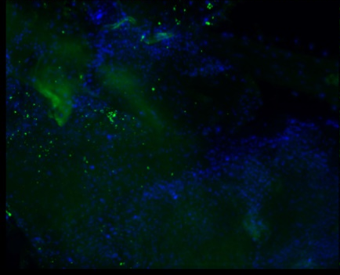
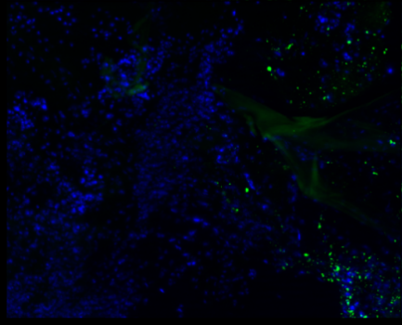
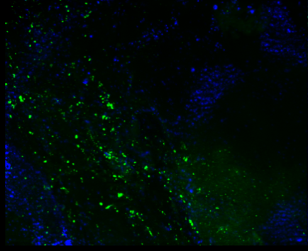
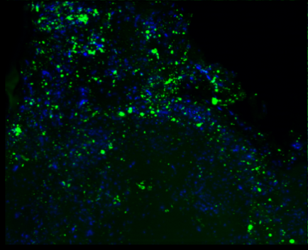
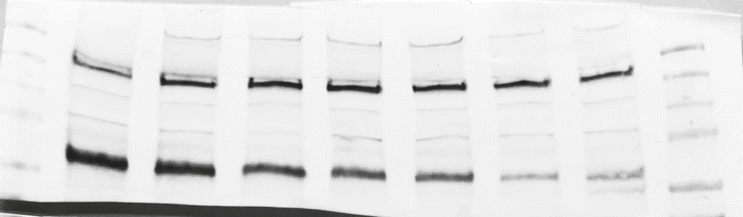

The capacity of autophagy in neurons decline with age in Drosophila
1 days
10 days
30 days
50 days
70 days
Atg5
Hoechst
2xFYVE-GFP Hoechst
Felnőtt
Adult lifespan
Ref(2)P/p62 Hoechst
day 1 10 20 30 40 50 60
100 kDa
p62/Ref(2)P
α-Tub84B
49.9 kDa
p62 – autofágia szubsztrát (autofágiával bomlik le – mennyisége fordítottan arányos az autofág aktivitással)

Slide 27
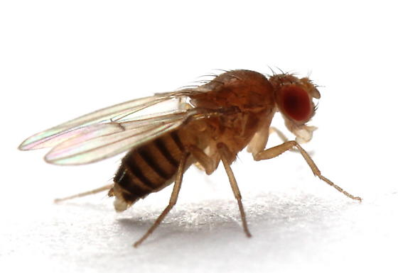
Atg5
PtdIns3K (2xFYVE)
day 1
day 1
day 10
coverage of
FYVE-GFP particles
day 10
day 30
day 30
day 50
day 50
day 70
day 70
p62/Ref(2)P
day 1
day 10
coverage of
Ref(2)P particles
day 30
day 50
day 70

Slide 28
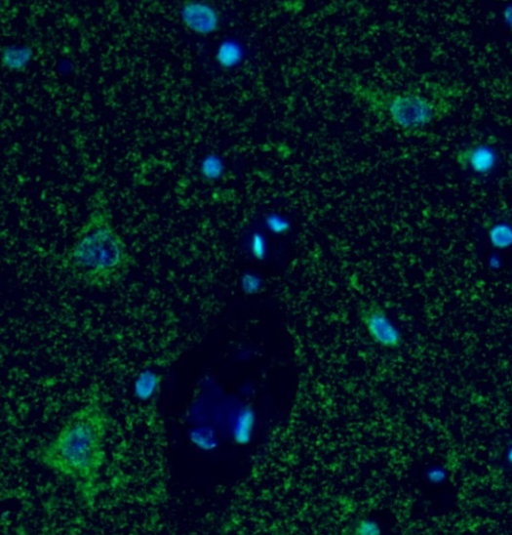
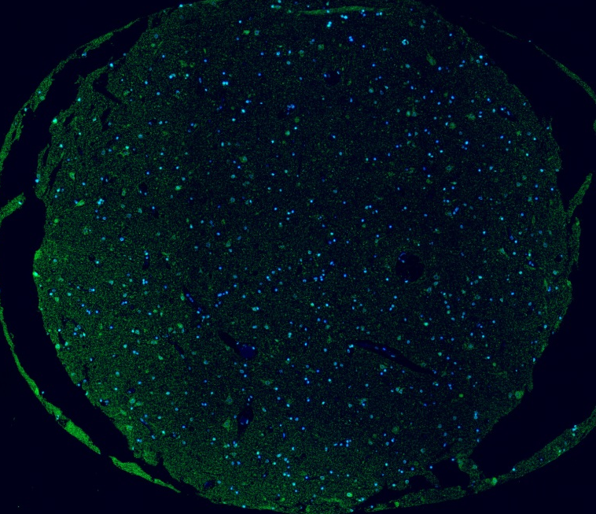
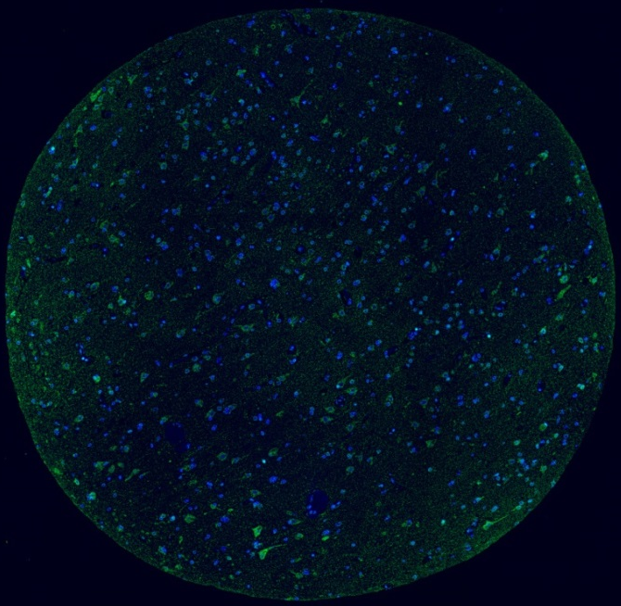
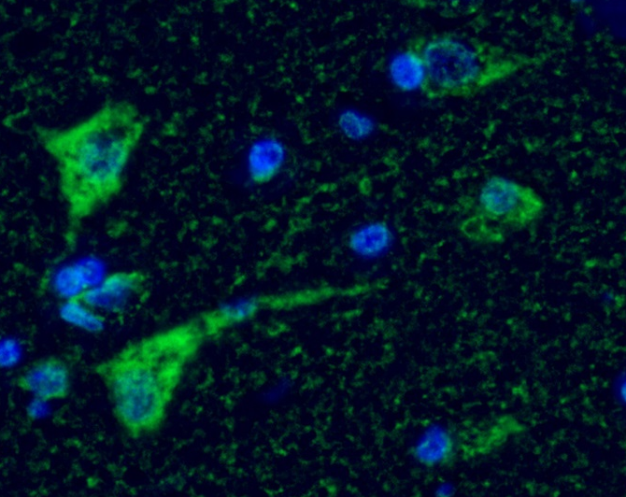
The capacity of autophagy decreases with age human neurons
p62
DAPI
Identical exposure times
42 years
p62
DAPI
42
71
71 years

Slide 29
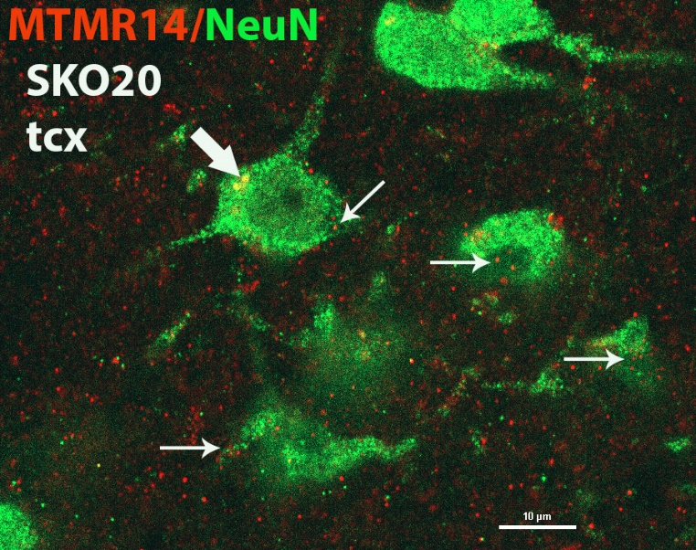
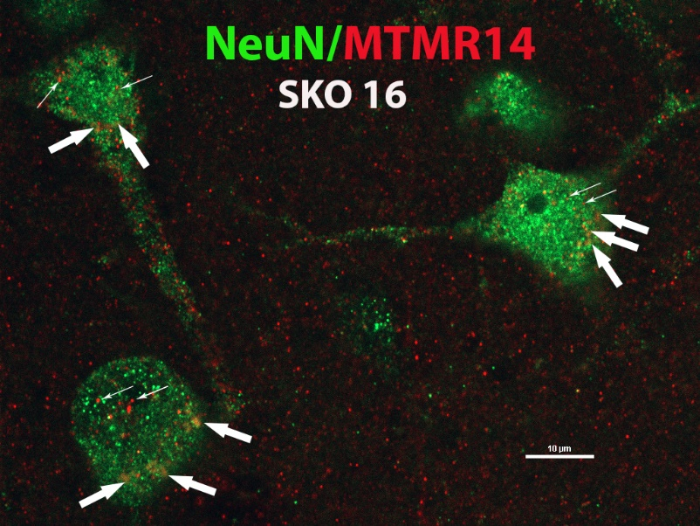
Autophagic capacity declines during aging upon a regulatory input
MTMR: myotubularine-related lipid phosphatase
6
5
6
5
P
1
4
P
1
4
2
3
2
3
P
EDTP/MTMR14; Hoechst
PI3K/Vps34
10 days
20 days
30 days
PI
PI3P
AUTOFÁGIA
EDTP/MTMR14
PIK
5’ phosphatases
PI5P
*
PI3,5P₂
*
*
*
*
*
EDTP/MTMR14
P
P
6
5
100 µm
6
5
P
1
4
P
1
4
2
3
40 days
2
3
50 days
60 days
P
*
*
*
*
*
*
27 years
73 years

Slide 30
The amount of EDTP/MTMR14 lipid phosphatases inhibiting autophagy increases with age –endogenous toxic (pro-aging) factors
EDTP
day 10
day 20
EDTP^{trojan} >myr-GFP expression levels
day 30
day 40
day 50
day 60
Rubicon is a similar regulatory protein: inhibits autophagy and its levels elevate during aging.

Slide 31
Age-related regulation of autophagic activity
Autophagic capacity
Relatíve activity
MTMR14/EDTP
Rubicon
Adult lifespan

Slide 32
The mechanism of aging

Slide 33
The mechanism of aging remains unresolved
Extreme longevity: 6x
But, these long-lived animals still age and die.
Arantes-Oliveria N, et al., Science 302:611 (2003).
Kenyon C. Nature 464:752-761 (2010)
„Some aspects of ageing remain particularly enigmatic. One of these is the all-important question of what actually causes ageing.”

Slide 34
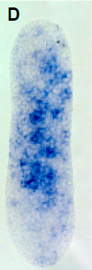
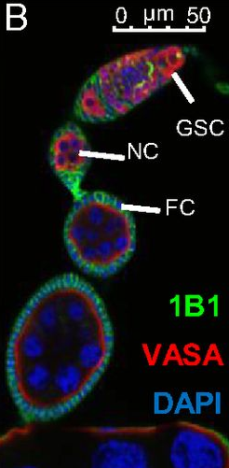


Non-aging cells (replicative immortality)
germline
Planaria
Hydras
Cancer stem cells
Piwi proteins (the Piwi-piRNA pathway)

Slide 35

The Piwi-piRNA pathway: inhibits the mobility of transposable elements (TEs) – genomic stability
PIWI protein

Slide 36


TEs: biological mutagens
TE
gene
enzyme
insertion
(disrupted gene)
B. McClintock

Slide 37



Large parts of the human genome consist of TEs (repetitive elements)

Slide 38

TEs are active in somatic cells!!!
ENCODE (2012)
80% of the human genome posess a biochemical activity.

Slide 39


TEs
LTR: long terminal repeat

Slide 40

C. elegans genome: low levels (12%) of TEs, only a few active families
31/haploid genome
29/haploid genome

Slide 41

Downregulation of active TE families extends lifespan in C. elegans
***
Élő állatok aránya
Tc1
Tc3
Tc14
Életkor (napok)

Slide 42

Ectopic expression of Piwi/PRG-1 in the soma promotes longevity
Transgene:
hsp-16.2 promoter
prg-1

Slide 43
Az adenin metiláció szintje progresszíven nő MGE szekvenciák mentén
2
DAMT-1
(C18A3.1)
CH₃
NMAD-1
(F09F7.7)
DNA
DNA
Cele14
1-day-old adults
11-day-old adults
PvuII M DpnI
PvuII M DpnI
(control) (6mA)
(control) (6mA)
30 34 38 30 34 38 30 34 38 30 34 38 PCR cycle

Slide 44
wild-type
Adult age (days)
1 4 7 9 12
6mA levels at TE sequences
M
control
Tc1
Tc3
control
Tc14
control
cep-1

Slide 45
daf-2(-)
Adult age (days)
1 7 12 16 20
M
control
Tc1
Tc3
Tc14

Slide 46
The rate of N6-adenine methylation in wild-type vs. daf-2(-) mutants

Slide 47
Model
Young adulthood
Advanced ages
6mA
chromosome
TE
chromosome
TE
TE transcripts
TE transcripts
No/minimal transposition
transposition
Genomic integrity
Genomic instability
Non-aging
Aging

Slide 48
Integrated aging model
Stochastic factors
TEs
Regulatory factors
(e.g., MTMR14; Rubicon, …)
Maitenance systems
Autophagy
DNA repair pathways
Chaperones
Proteasome system
Cellular damage
Aging

