Slide 1
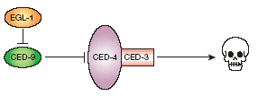
To die or not to die:
Cell death in development
M. Hengartner: „As important as cell division and cell migration, regulated (or programmed) cell death allows the organim to tightly control cell numbers and tissue size, and to protect itself from rogue cells that threaten homeostasis.”
2018.03.14

Slide 2
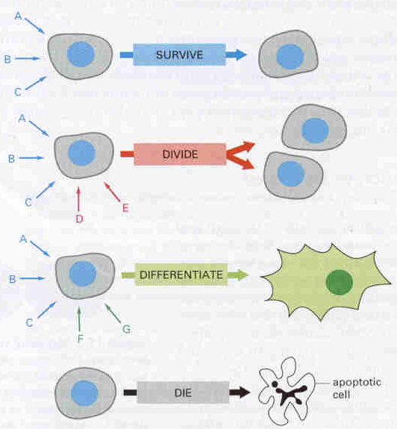
Cell fate determination
survival
loss

Slide 3
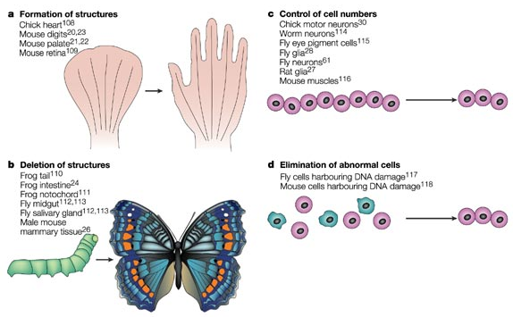
The major functions of programmed cell death in development

Slide 4
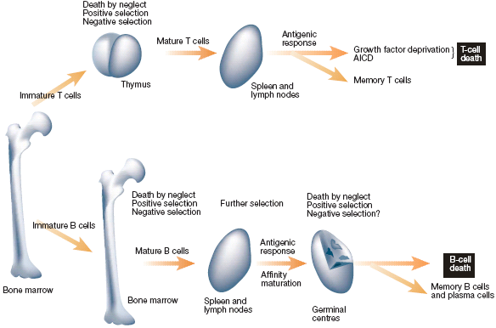
T- and B-lymphocyte development
Defects: autoimmunity

Slide 5
Apoptosis in the immune system
The immune system is a society of interacting cells: T and B lymphocytes, Natural Killer (NK) cells, macrophages and professional antigen presenting cells (APCs).
B cells express cell membrane receptors (ANTIGENS) with a single antigen specificity. The cells with high affinity for proteins derived from self tissues are eliminated.
T cells have T cell antigen receptors for self major histocompatibility (MHC) antigens. T cells with high affinity for self MHC molecules are eliminated.

Slide 6
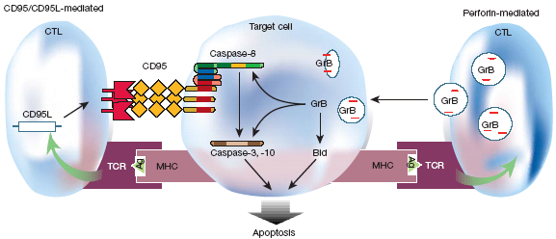
cytotoxic T lymphocytes (CTLs) kill target cells

Slide 7
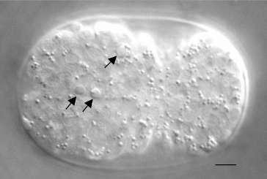
(Apoptotic) cell death during development
C. elegans
5 μm

Slide 8
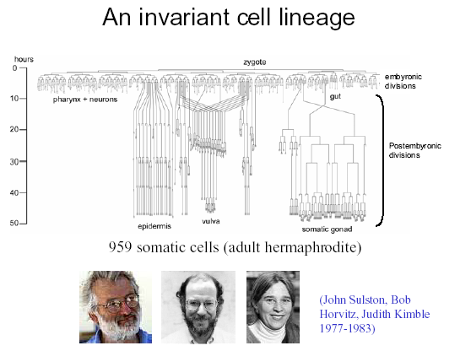
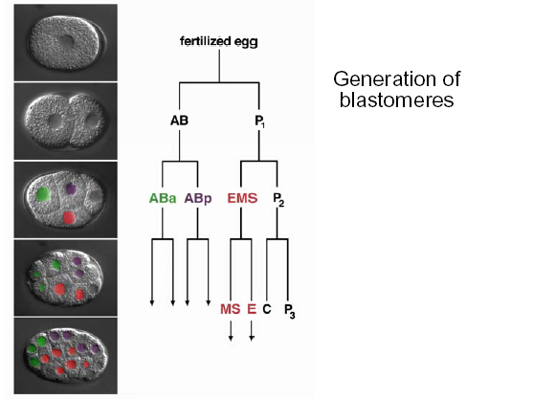
Of the 1090 somatic cells, 131 die by apoptosis during development

Slide 9
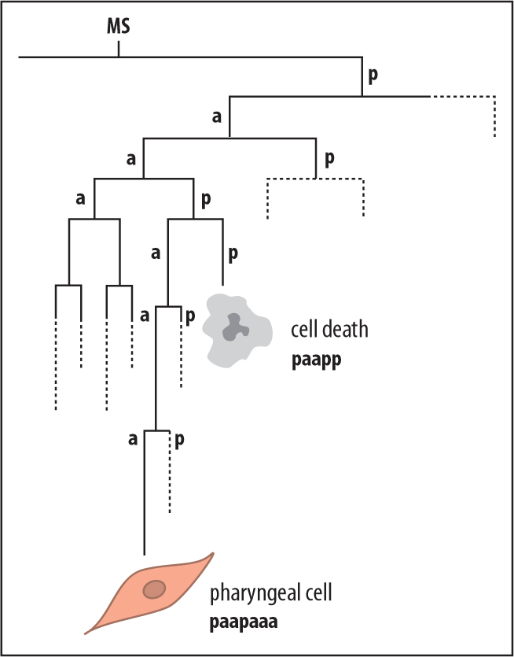
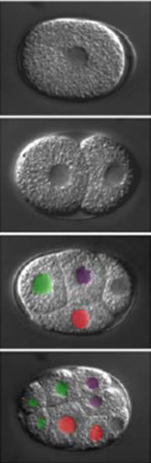
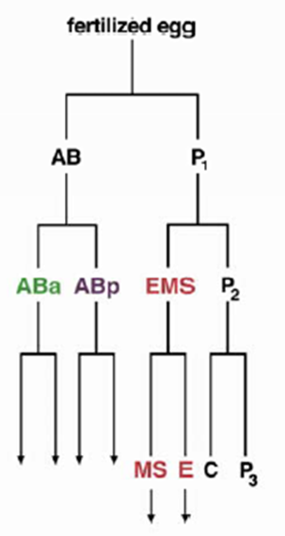
An example …

Slide 10
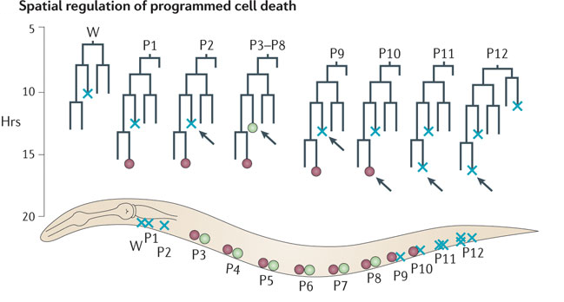
Another example …

Slide 11
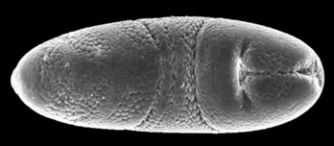
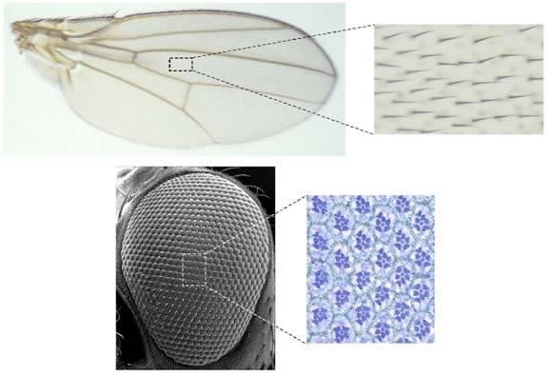
And in Drosophila

Slide 12
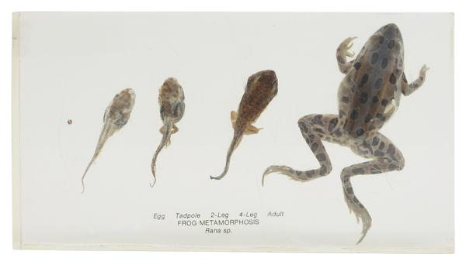
In frogs …

Slide 13
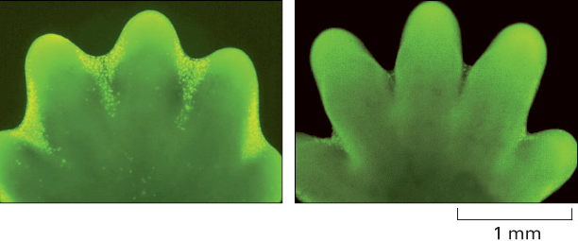
In mammals …

Slide 14
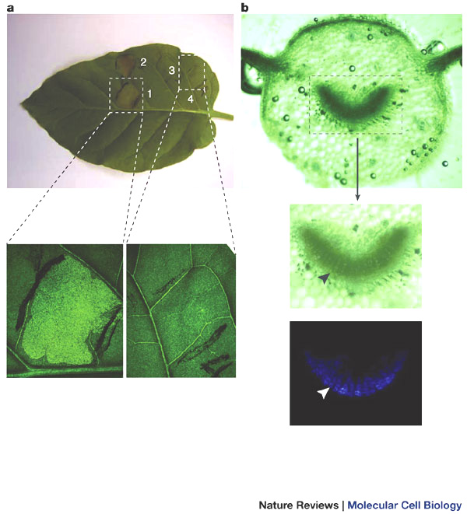
In plants …

Slide 15
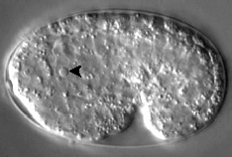
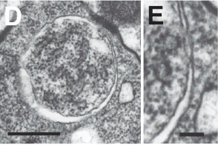

(Programmed) cell death in development –
are the cell death pathways coordinately regulated?
Apoptosis (Type I)
Autophagy (Type II)
Necrosis

Slide 17
2009:

Slide 18
2012:
extrinsic apoptosis (induced by extracellular stress signals that are sensed and propagated by specific transmembrane receptors)
caspase-dependent or -independent intrinsic apoptosis
regulated necrosis
autophagic cell death
mitotic catastrophe

Slide 19
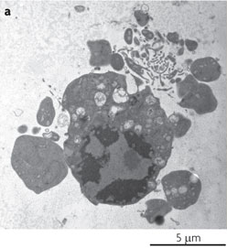
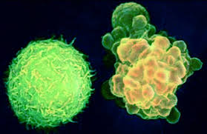
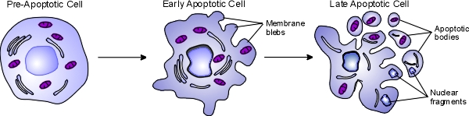
I. Apoptosis

Slide 20
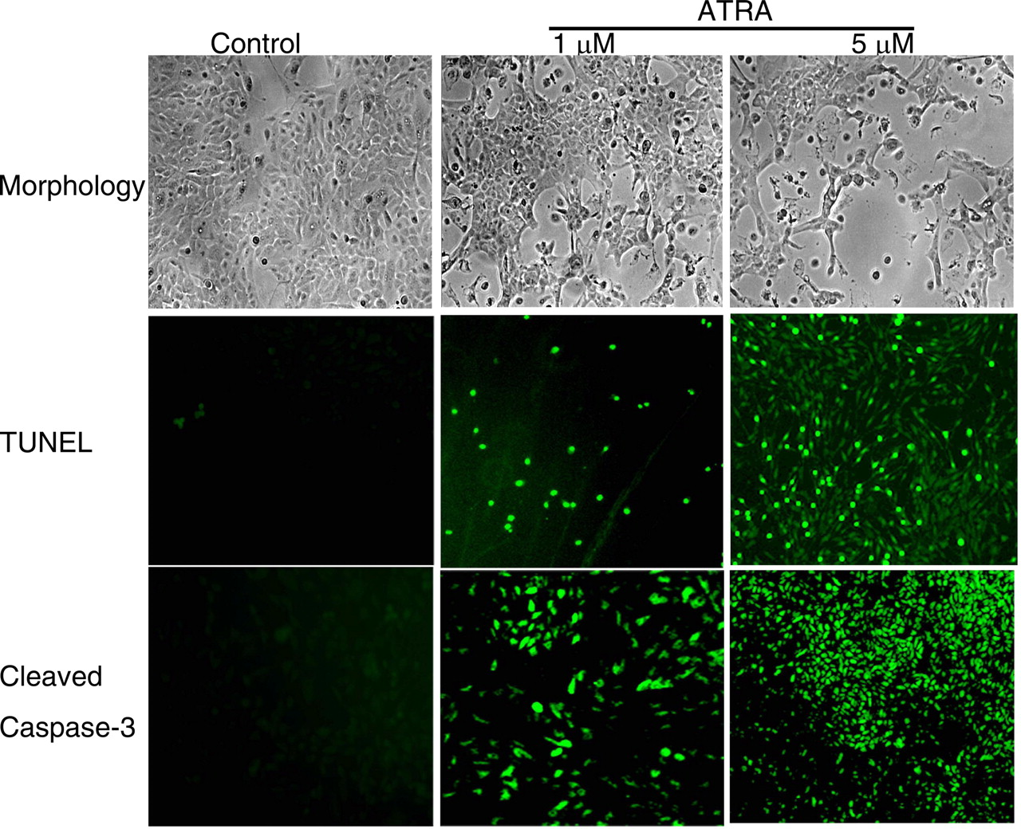
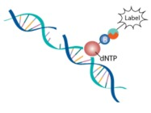
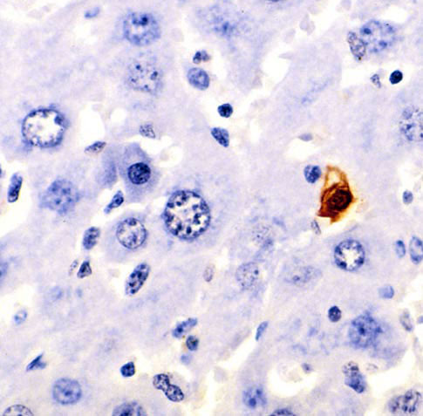
DNA fragmentation – TUNEL (Terminal deoxynucleotidyl transferase dUTP nick end labeling)

Slide 21
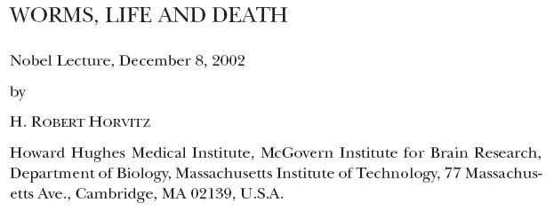

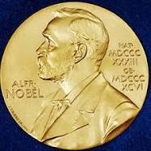
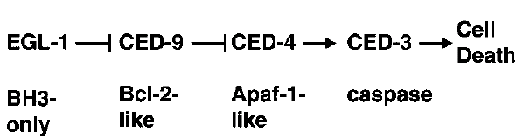
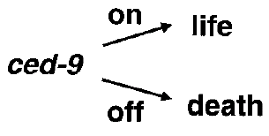

Slide 22
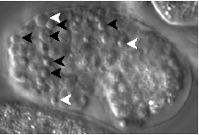
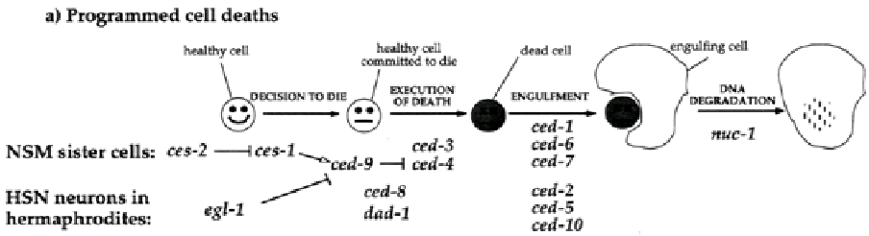
Apoptosis
Wild-type
ced-9(-)

Slide 24
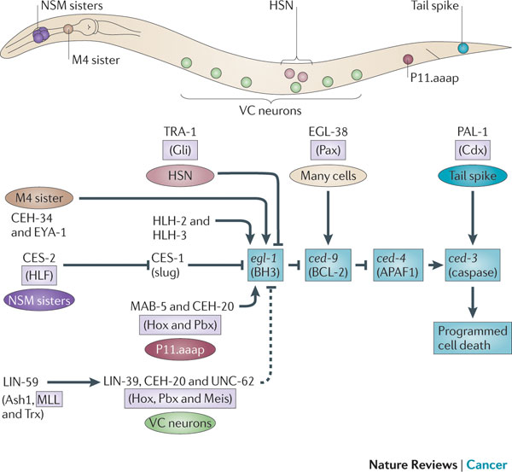

Slide 25
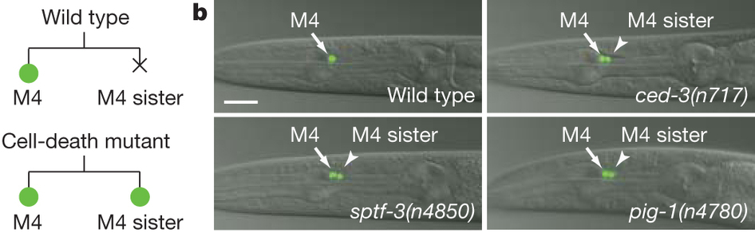
M4 sister

Slide 26
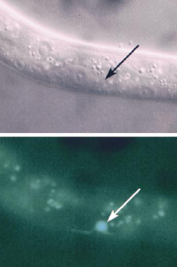
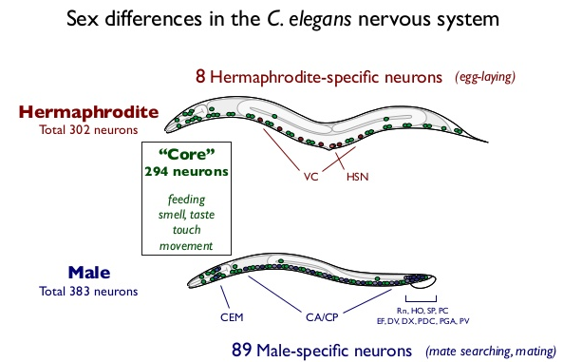
HSN: hermaphrodite specific neuron
In males, HSN expresses EGL-1 and undergoes apoptosis
male
HSN
male
pegl-1::gfp

Slide 27
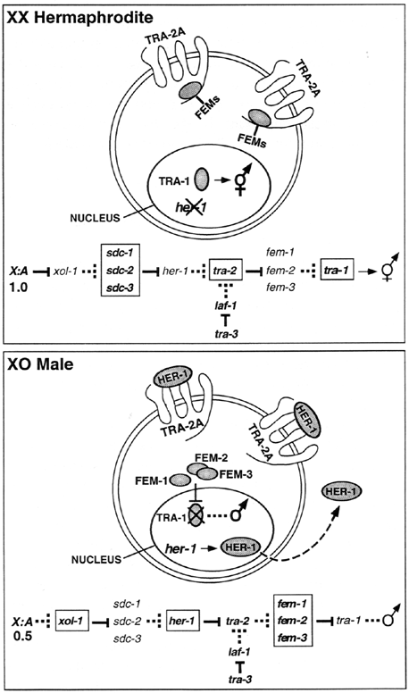
The C. elegans sex-determination pathway
TRA-1 is similar to the human GLI and Drosophila Ci proteins that are the downstream effectors of the Hedgehog signalling pathway.

Slide 28
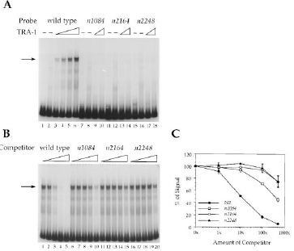
TRA-1 binds to egl-1 promoter
egl-1 alleles
EMSA: Electro Mobility Shift Assay
egl-1 alleles

Slide 29
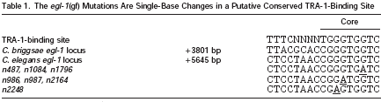
TRA-1/GLI/Ci regulates apoptosis

Slide 30
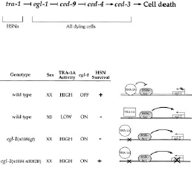
TRA-1 is a direct negative regulator of egl-1
gf
lf

Slide 31
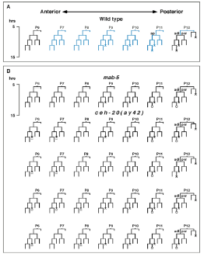
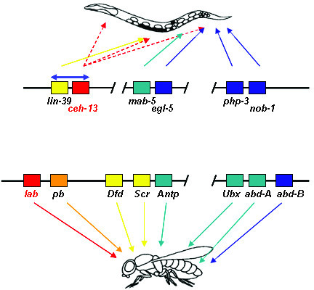
P11.aaap and VC neurons
Hox genes regulate apoptosis
mab-5 and lin-39 mutants have defects in PCD

Slide 32
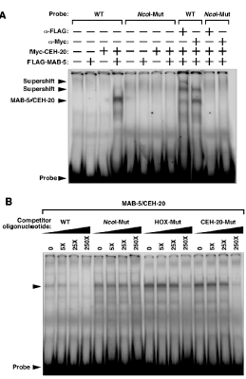
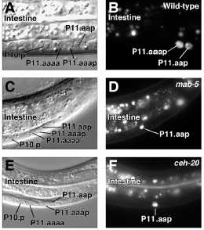
Transcription of egl-1 correlates with MAB-5/CEH-20 activity
EMSA: MAB-5 binds egl-1 promoter
egl-1::gfp

Slide 33
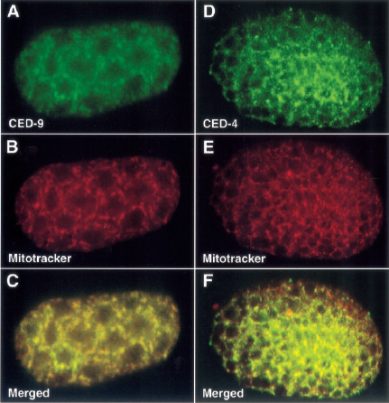
CED-9 and CED-4 localize to mitochondria
Antibody staining
Mitochondrial marker
merged

Slide 34
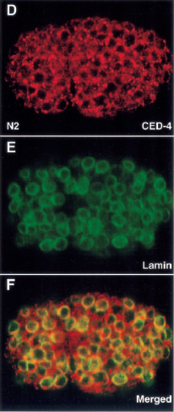
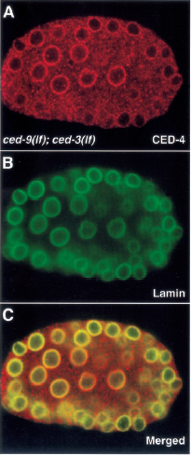
CED-9 is required for CED-4 localization to mitochondria
Antibody staining
Mitochondrial marker
merged

Slide 35
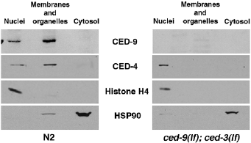
CED-9 is required for CED-4 localization to mitochondria
antibody
(mag)
(citoszól)

Slide 36
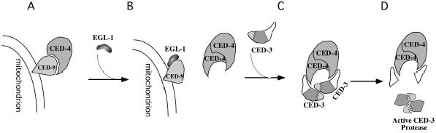
Bichemistry of apoptosis in C. elegans

Slide 37
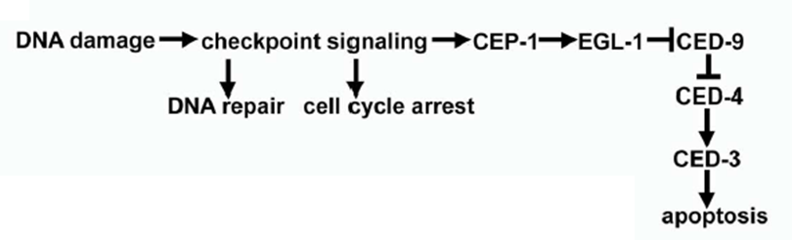
The tumor suppressor p53 directly upregulates egl-1 upon genotoxic stress
p53

Slide 38
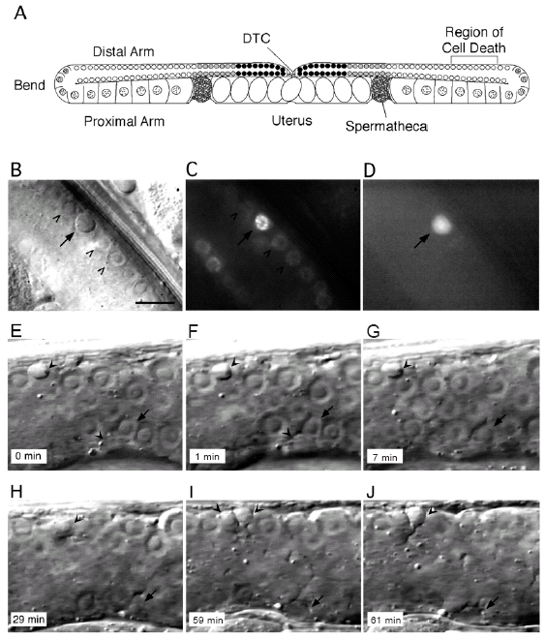

Germ-line apoptosis: in C. elegans, half of the germ cells die by apoptosis

Slide 39


Removal of cell corpses: engulfment

Slide 40

Cell death proteins are conserved in different organisms

Slide 41

Cell death genes are conserved in different organisms

Slide 42

Two major apoptotic pathways in mammalian cells

Slide 43
Wild-type
Apaf1 mutant
Apoptosis in mouse development
Apaf1 mutant mouse

Slide 44

A second set of apoptotic regulators:
Bcl-2 (bcl: B-cell lymphoma) family members
Anti
Pro(mote)
Pro(mote)
BH: Bcl2 homology domains
TM: transmembrane domain

Slide 45

Mitochondria – the forum of death

Slide 46
II. Necrosis

Slide 47

Neuronal degeneration in C. elegans

Slide 48

Necrotic cell death:
Vacuolization
ER fragmentation

Slide 49

The mid degeneration state of a necrotic cell

Slide 50


Necrosis

Slide 51


The genetics of necrosis in C. elegans: ion channels
Marty Chalfie

Slide 52

Monitoring necrotic cell death in C. elegans
MEC-4::GFP
Wild-type
MEC-4::GFP
mec-4(gf)

Slide 53




The genetics of necrosis in C. elegans: calpain and aspartyl proteases
N. Tavernarakis

Slide 54

Model
calpains, aspartyl proteases

Slide 55


The genetics of necrosis in C. elegans: autophagy genes
pmec-7::GFP::LGG-1
unc-51: Atg1
lgg-1: Atg8
vha-2: vacuolar H
ATPase

Slide 56

Autophagy genes are required for the degeneration of dopaminerg neurons
non-treated control
6-OHDA (neurotoxin)
Wild-type
Wild-type
unc-51(-)
unc-51(-)
unc-51: Atg1
bec-1: Atg6

Slide 57

Model

Slide 58



Degeneration of the fly eye by necrotic cell death

Slide 59
The genetics of necrosis in C. elegans: „apoptotic” engulfment

Slide 60
III. Autophagy

Slide 61


Autophagy in Drosophila fat body: degradation of larval tissues during metamorphosis

Slide 62
Autophagy in animal development
Elimination of the nucleus from erytrocytes
Elimination of paternal mitochondria
Differentiation (selective autophagy)
Soma-germline separation
Elimination of maternal effect factors
and many more …

Slide 63

Autophagic pathways

Slide 64

Macroautophagy

Slide 65


Slide 66


Autophagic structures
Bar; 1 um

Slide 67

Hyperactivation of autophagy: caspase independent cell death –
Drosophila salivary gland
tGPH: tubulin-GFP-Pleckstrin Homology – shows PI3K activity (growth signalling)
tGPH
tGPH
tGPH
wandering
GFP-LC3
GFP-LC3
GFP-LC3
Loss of cortical tGPH coincides with growth arrest and the induction of autophagy.

Slide 68

Maintenance of growth prevents autophagy induction in Drosophila salivary gland (SG)
13,5 hrs larvae
SG is degraded
Massive autophagy
SG is NOT degraded
No autophagy
Maintenance of growth prevents induction of autophagy and inhibits salivary gland
degradation.

Slide 69


Defects in autophagy inhibit salivary gland cell degradation even in the presence of caspases
degradation
NO degradation
TUNEL

Slide 70

Expression of Atg1 induces caspase-independent degradation of salivary glands

Slide 71

Model

Slide 72

A molecular link between apoptosis and autophagy

Slide 73

Bcl-2 inhibits Beclin1-dependent autophagy in MCF7 human breast carcinoma cells

Slide 74

Bcl-2 inhibits Beclin1-dependent autophagy in HT-29 human colon carcinoma cells

Slide 75




CoIP: co-immunoprecipitation

Slide 76



Apptosis and autophagy are redundantly required for the development of C. elegans embryo
Vad típus
ced-4(n1162); atg-18(gk378)
ced-4(n1162); atg-7(tm2976)
P
A
A
V
P
A
V
P
apoptózis(-) vagy
autofágia(-)
apoptózis(-); autofágia(-)
apoptózis(-); autofágia(-)
A: anterior, P: poszterior, V: vakuóla

Slide 77

Defects in autophagy induces apoptosis in C. elegans
bec-1: Atg6

Slide 78

Lysosome-specific activation of apoptosis

Slide 79


Slide 80

necrosis
apoptosis
autophagy

