Slide 1
Browser with Ensembl
Nóra bana, Balázs Bohár
25. 10. 2018

Slide 2
Core data
Genome sequences
Gene/ transcript / protein modells
External references
Mapped cDNAs, proteins, microarray probes, BAC clones, cytogenetic band repeats, markers etc.
Comparative data: orthologists and paralogs, protein families, whole genome joints, lonely regions
Variant data: sequence variations, structural variations, linkage disequilibrium
Regulatory data: a set of "best guess" (best estimates) regulatory elements

Slide 3


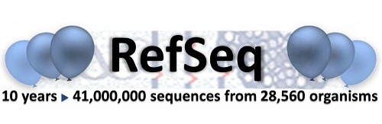

References

Slide 4
Proccess of gene annotation
Targeted build method
  They are inserted species-specific proteins and cDNA into the genome to make initial transcript models
Similarity build method
  To annotate the genes, they align relative proteins and cDNAs. The unknown transcripts are not mapped to species-specific proteins. It converts the redundant transcripts into the clusters and adds the alternative transcripts to the corresponding genes.

Slide 5
What good is Ensembl for?
Available the annotation of the genes
Show us the alternativ transcripts of the gene
You can upload your own files
You can use the BLAST or BLAT against any sequence of Ensembl
You can find all of the SNP’s on the chromosomes
You can see the SNP’s between species, populations and types
Etc…

Slide 6
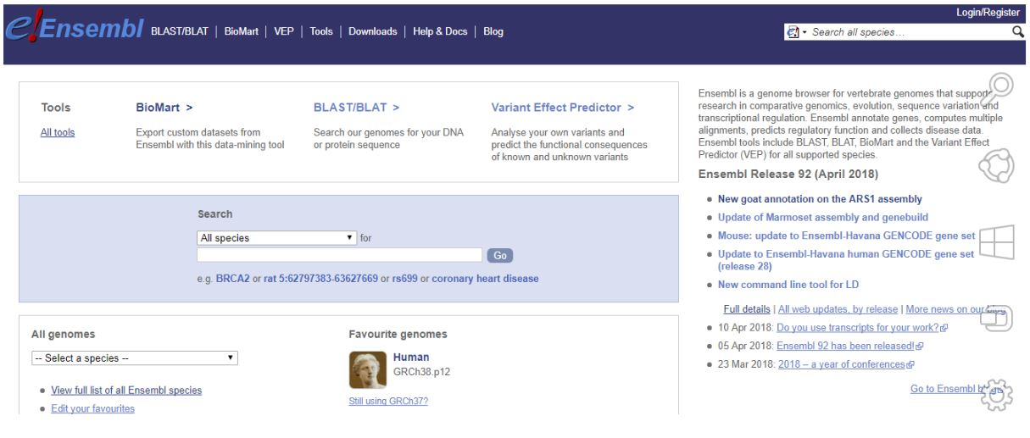
Website

Slide 7
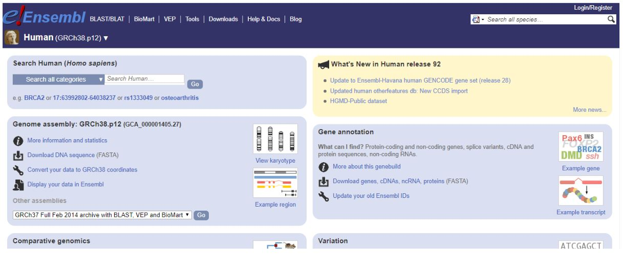
Page of the human genome

Slide 8
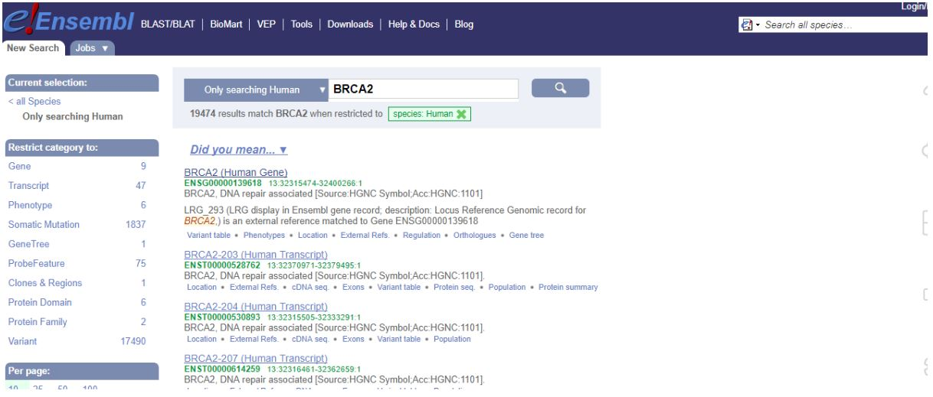
BRCA2

Slide 9
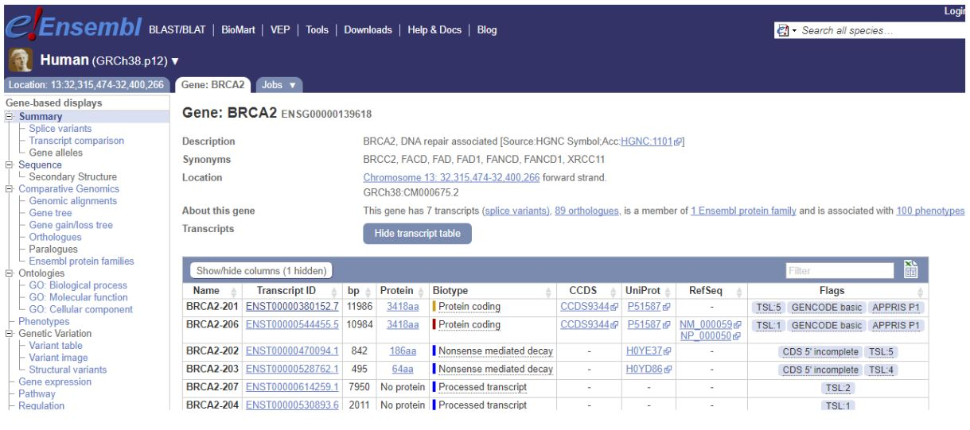
Informations about this gene

Slide 10
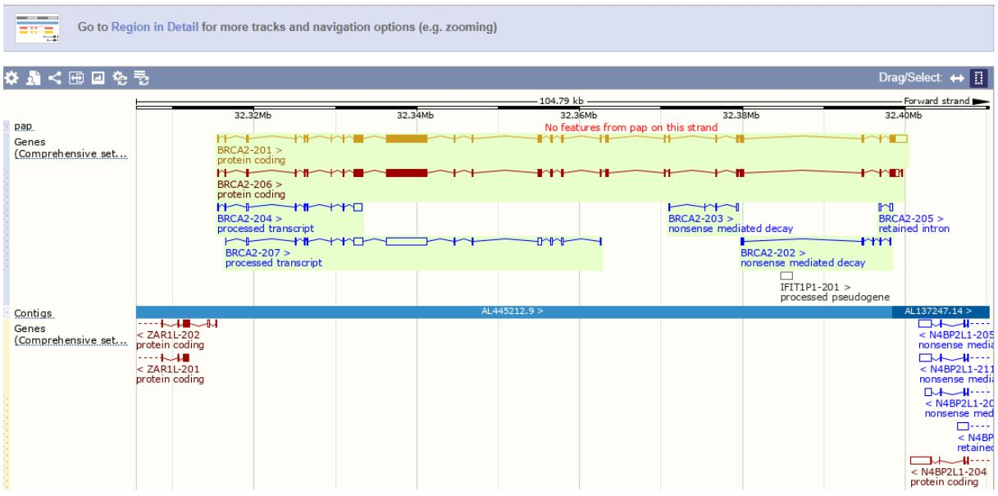
Annotation of transcripts

Slide 11
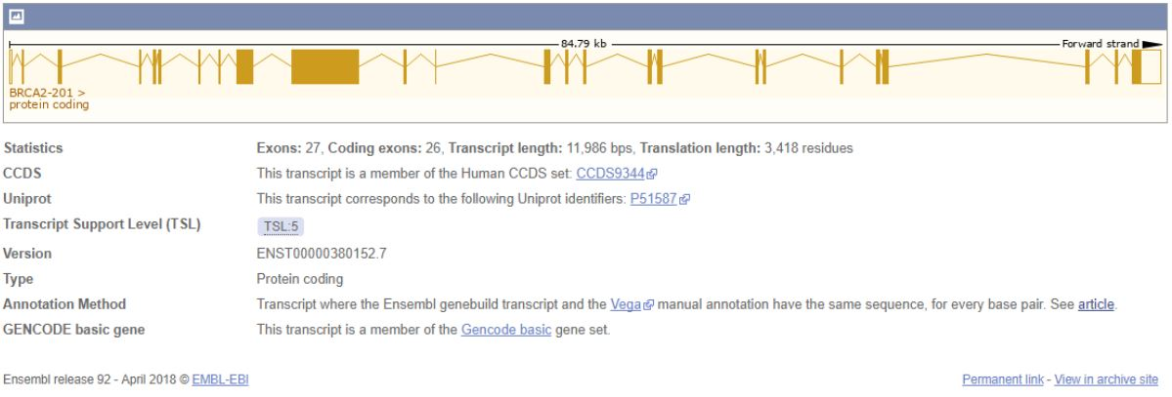
More informations

Slide 12
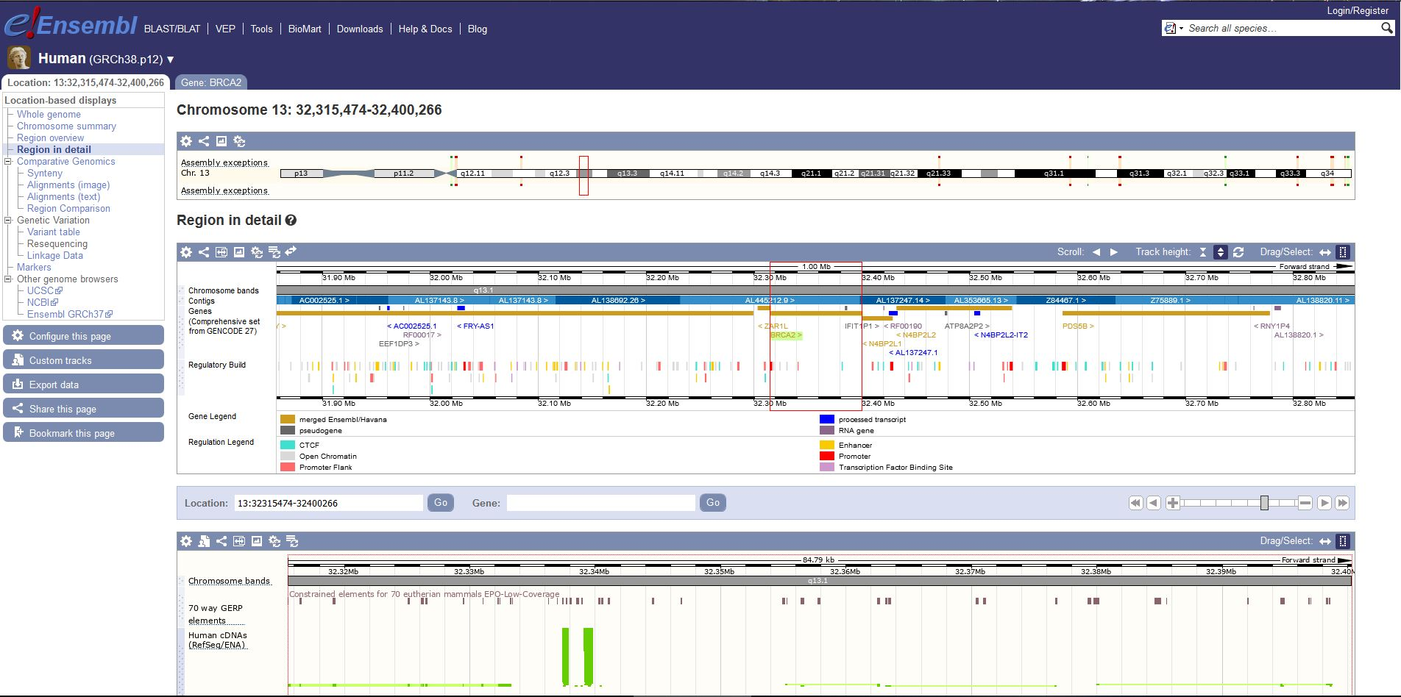
Location near to the gene

Slide 13
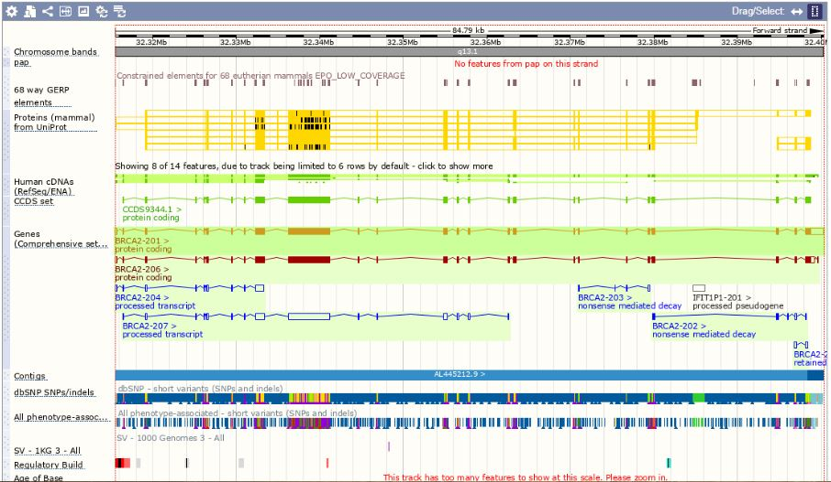

Slide 14
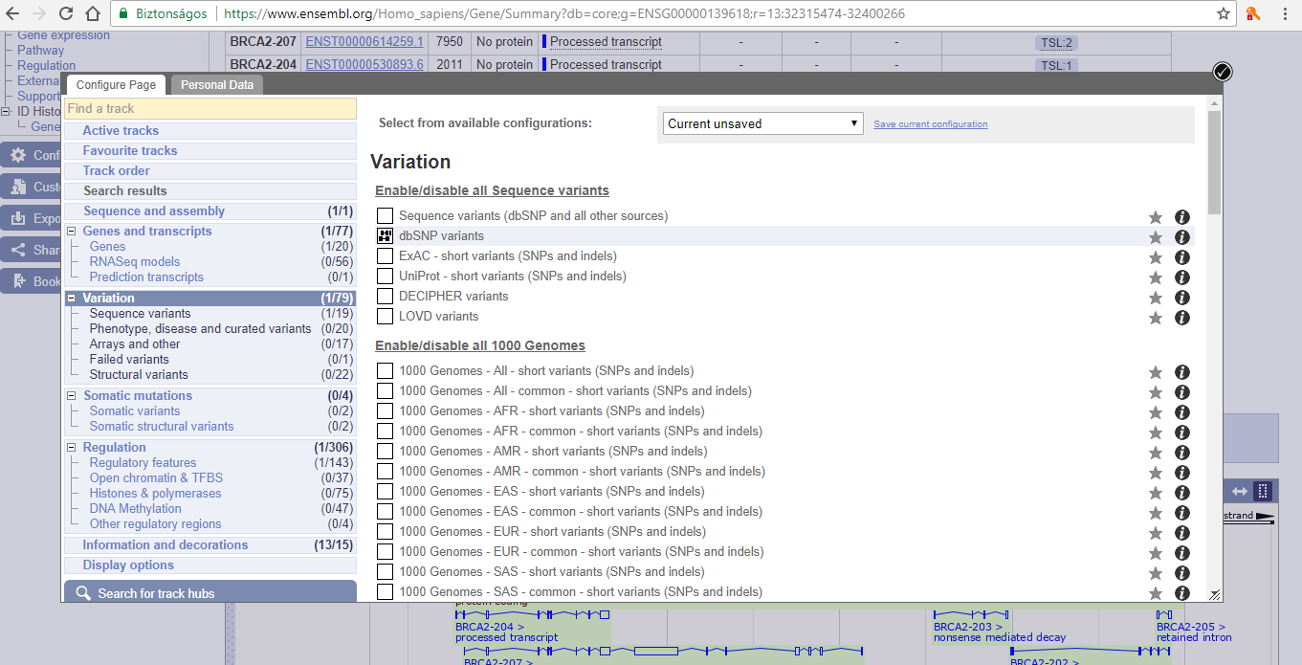
Configure this page-dbSNP variants

Slide 15
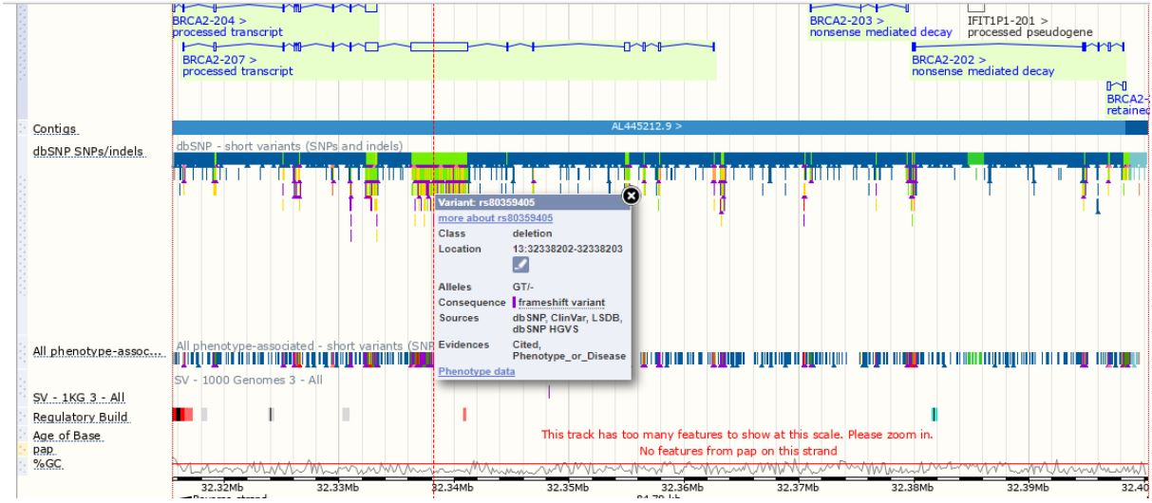
Information about the variant

Slide 16
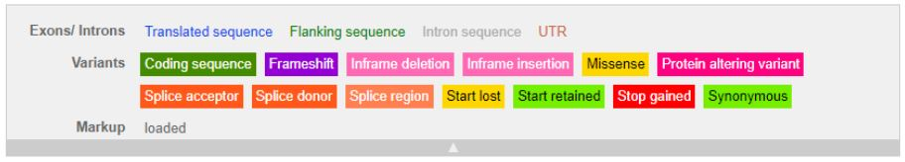
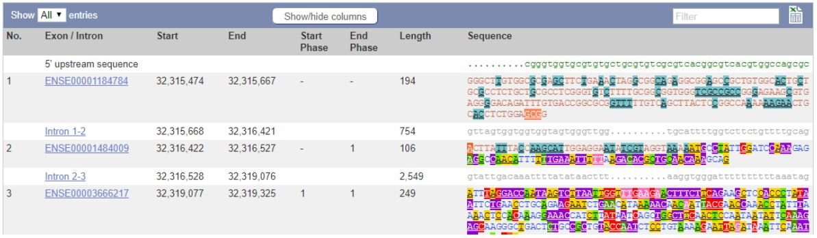
Exon-intron

Slide 17
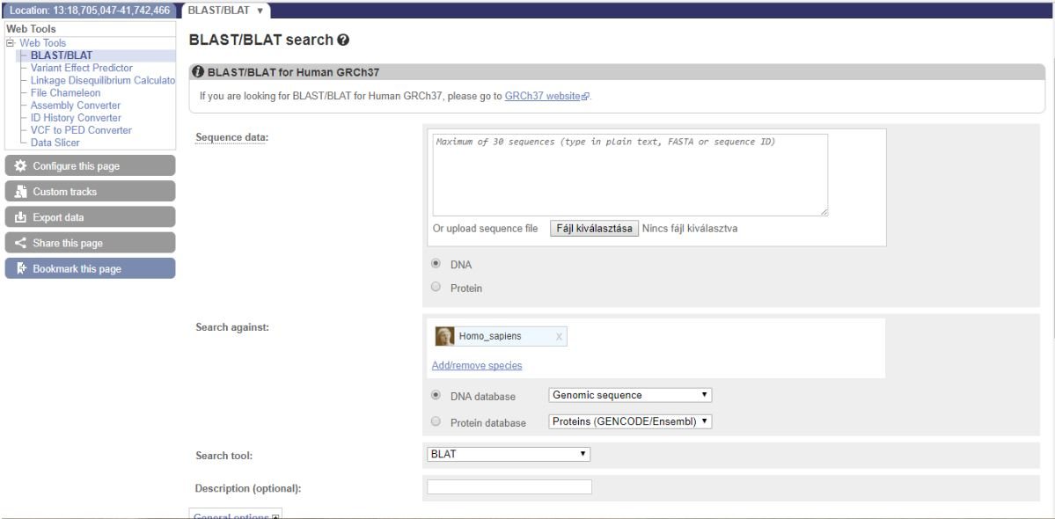
BLAST/BLAT

Slide 18
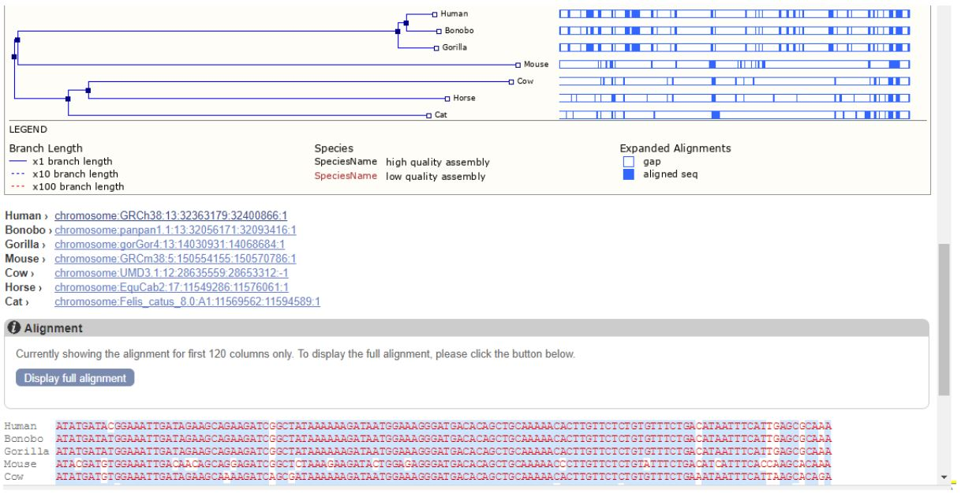
BRCA2 gene comparison between human and other species

Slide 19
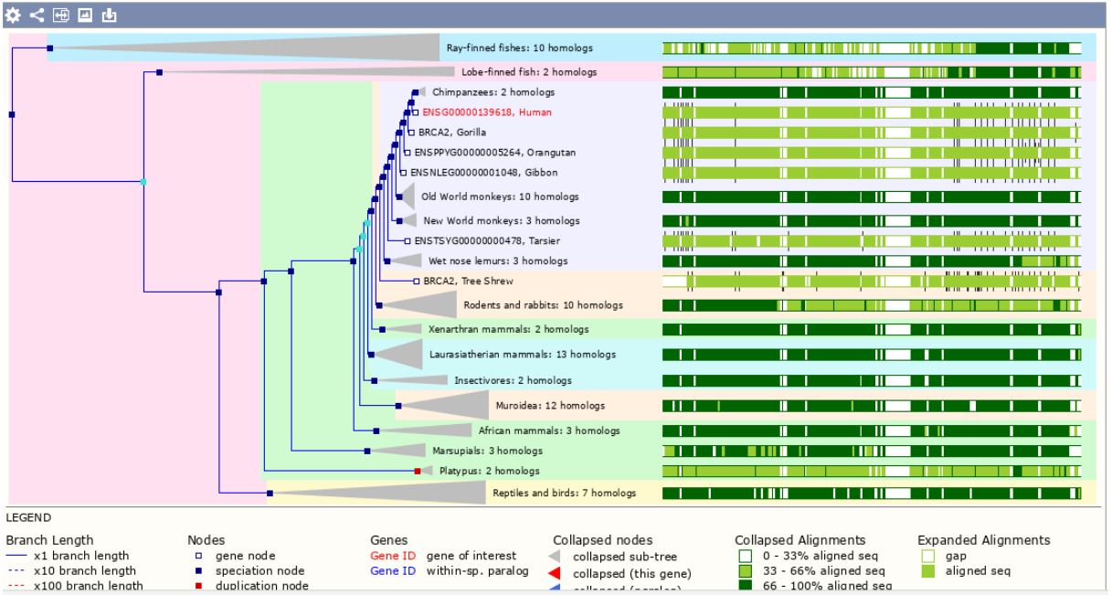
BRCA2 gene comparison between human and other species

Slide 20
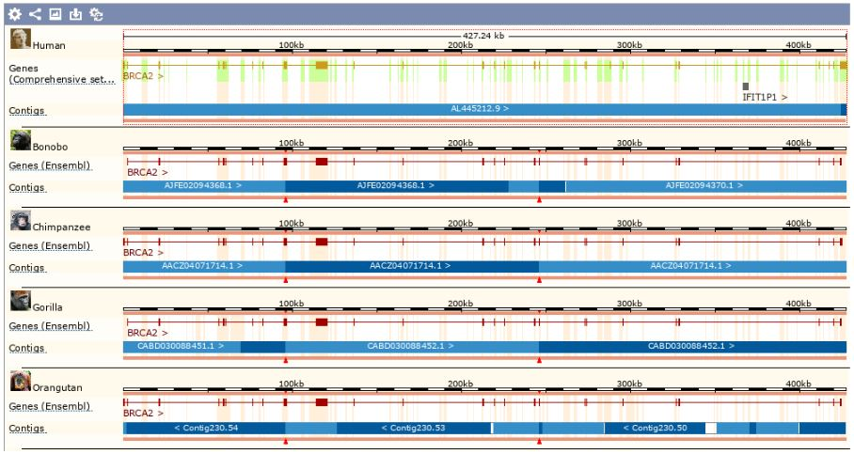

Slide 21
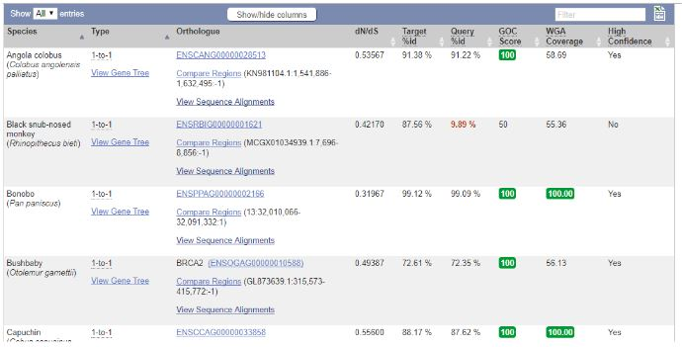
Homology relationship-orthologs

Slide 22
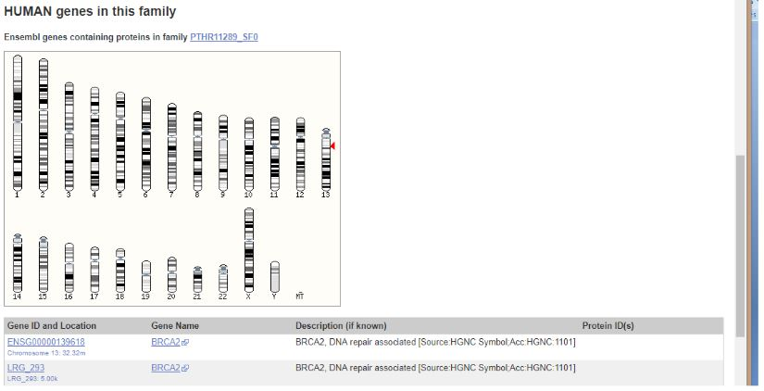
Chromosome view

Slide 23
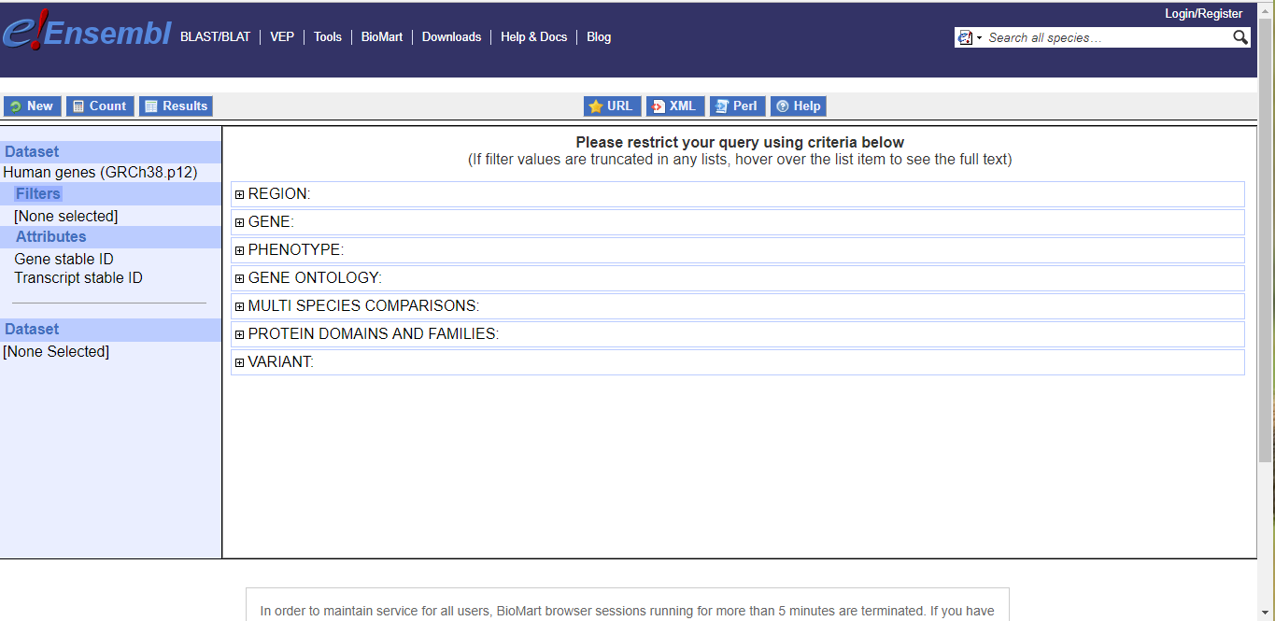
Biomart

Slide 24
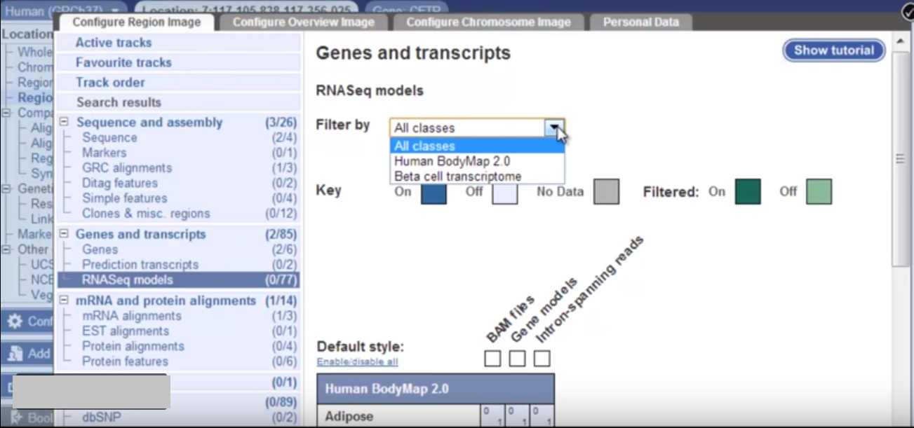
Configure this page-RNASeq models

Slide 25
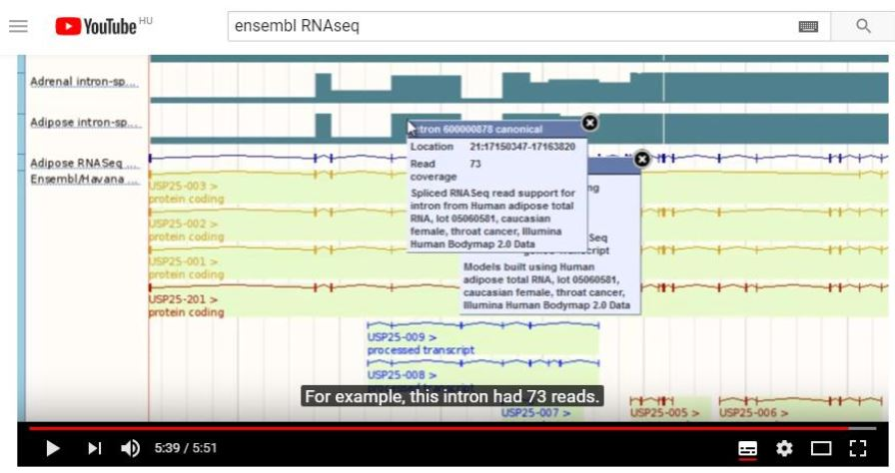
Intron models

