Slide 1
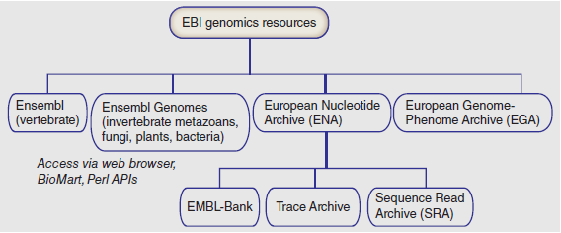
European Bioinformatics Institute (EBI)

Slide 2
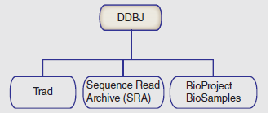
DNA Database of Japan (DDBJ)

Slide 3
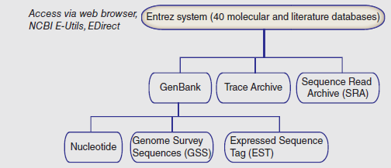
National Center for Biotechnology Information (NCBI)

