Slide 1


The ENCODE project:
ENCyclopedia Of DNA Elements (2012)
To gain insight into how genomic information is translated into cellular and developmental programs.

Slide 2
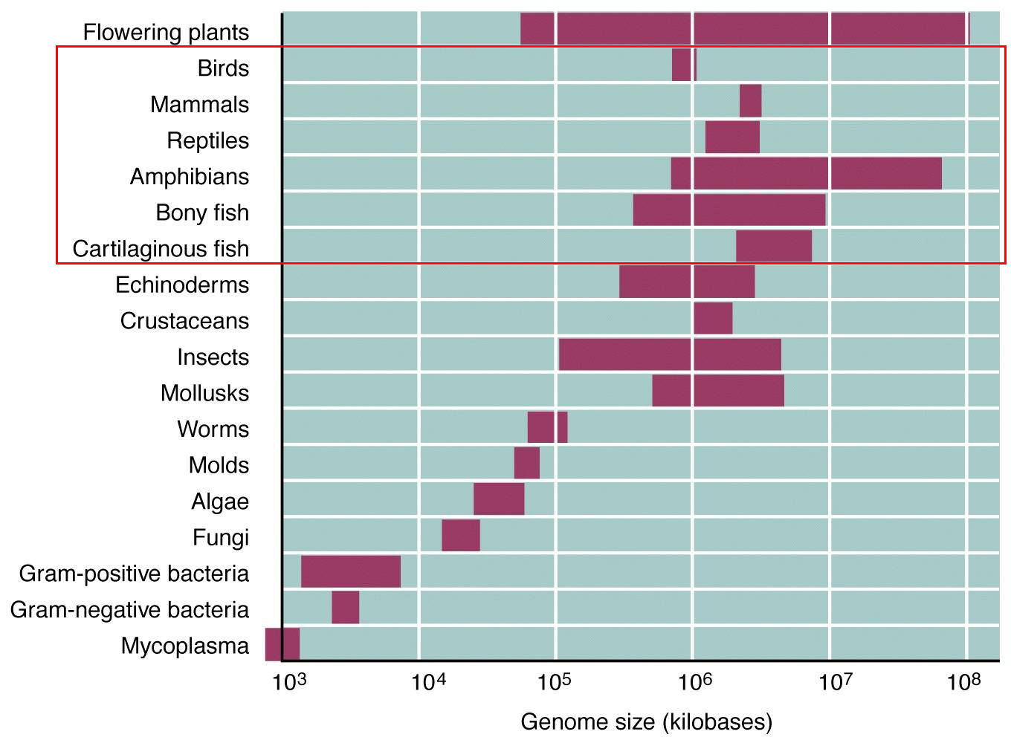
The C-value paradox
In higher organisms, the biological complexity and genome size are not correlated with each other.

Slide 3
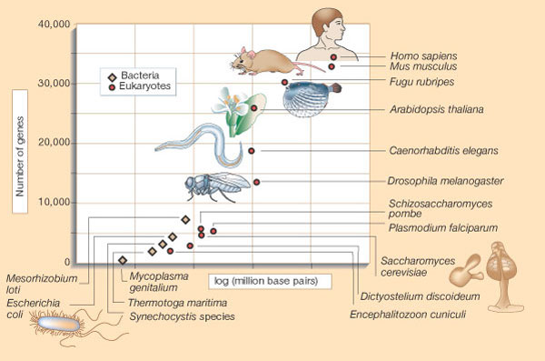
The C-value paradox:
Gene number and organismal complexity
In higher organisms, the biological complexity and gene number are not correlated with each other.

Slide 4
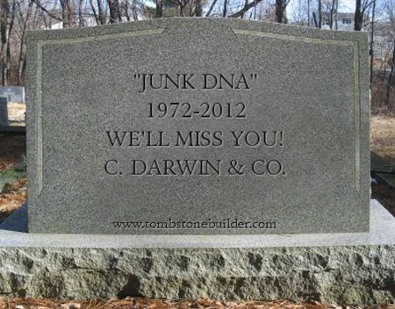
The ENCODE project (2012): 80% of the human genome display biochemical activity (coding or regulatory function)

Slide 5
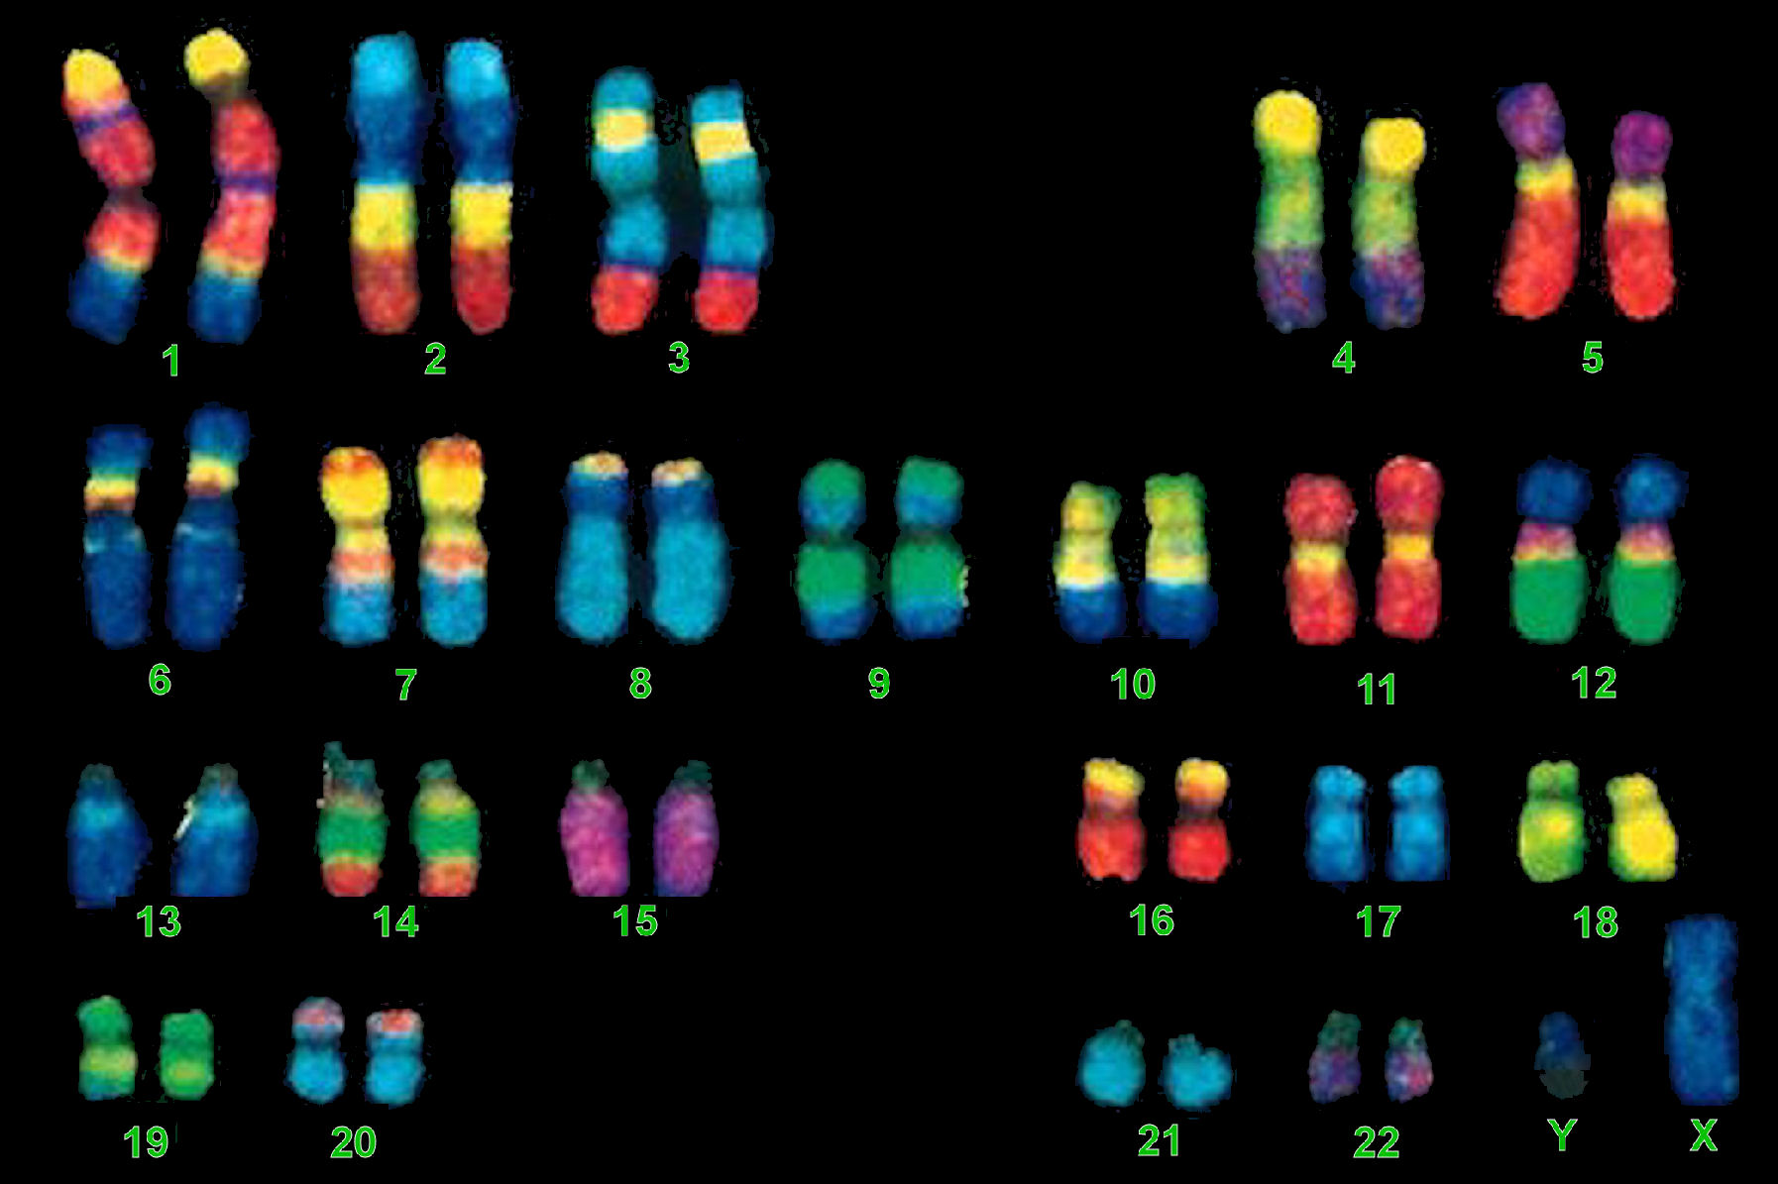
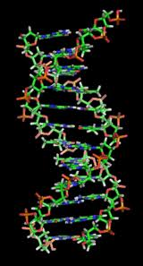
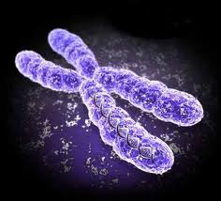
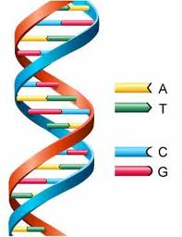
Human (male) chromosome set
Organization of the genetic material
Emberi (férfi) kromoszóma szett
DNA – the molecule of life
chromosome

Slide 6
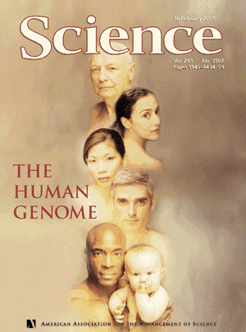
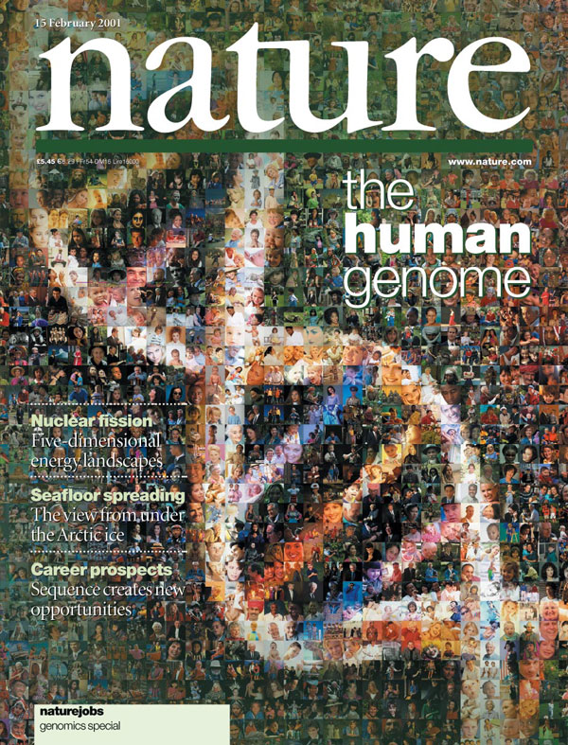
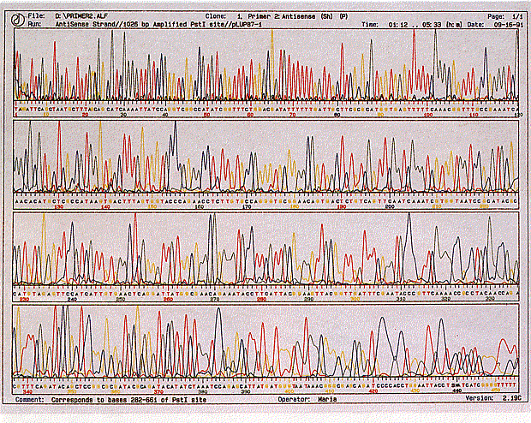
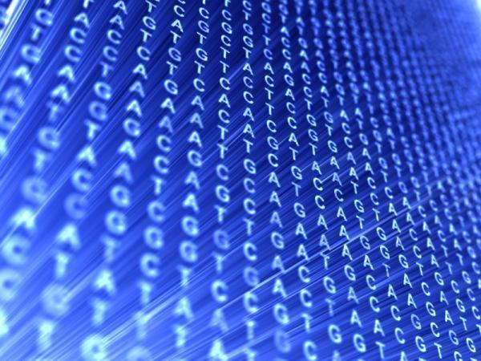
From the 90’s: The era of genomics
Genome sequencing – the human genome consists of 3 billions of base pairs

Slide 7
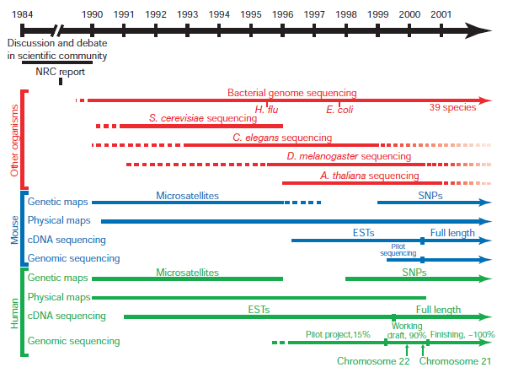

Slide 8
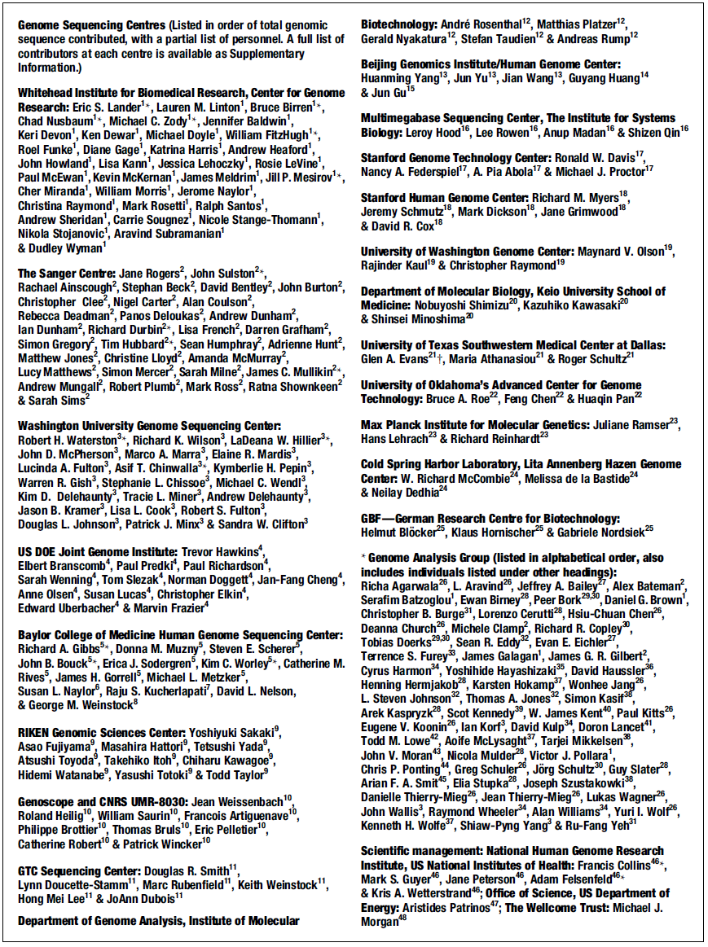
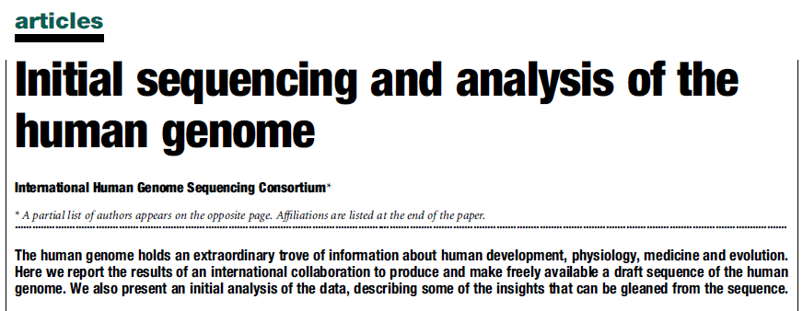

Slide 9
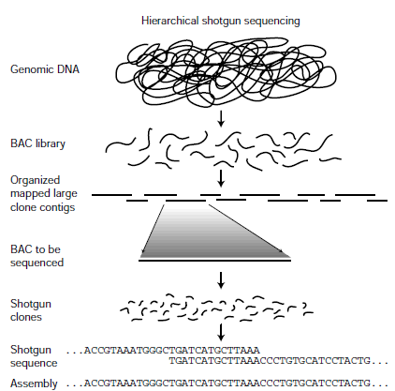
BAC (bacterial artificial chromosome) Sequencing …

Slide 10
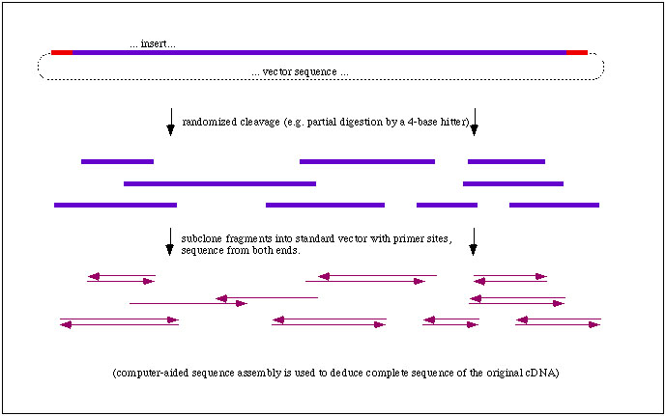
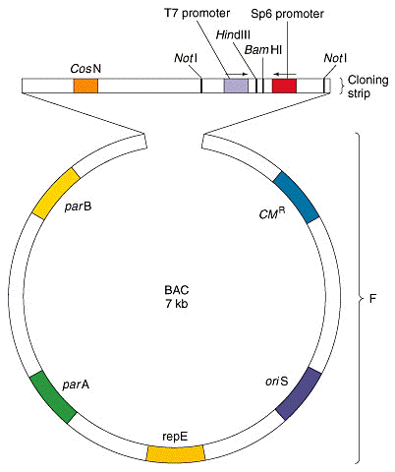
BAC

Slide 11
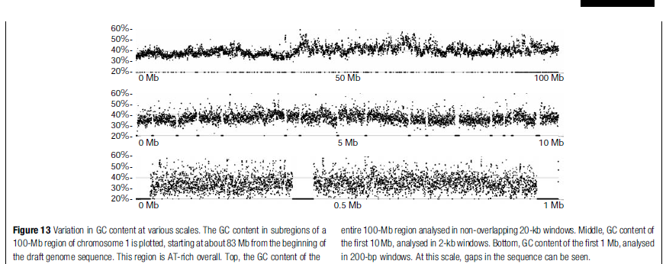
Outcome: average CG content

Slide 12
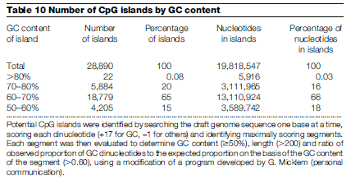
Outcome: CpG islands

Slide 13
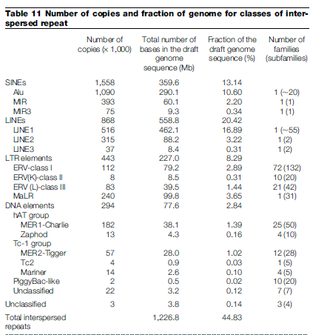
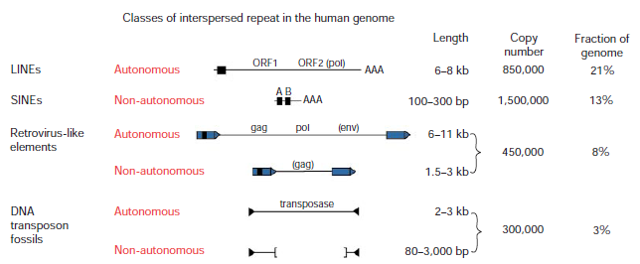
Outcome: repetitive elements

Slide 14
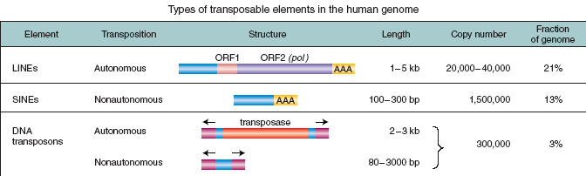
Nearly half (47%) of the human genome consists of mobile DNA sequences (transposable elements)! – most of them have protein coding capacity!!!
Retrotr.
Retrotr.
DNS tr.
Mobile genome!!!

Slide 15
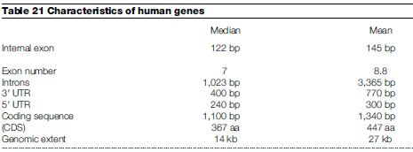
Outcome: genes

Slide 16
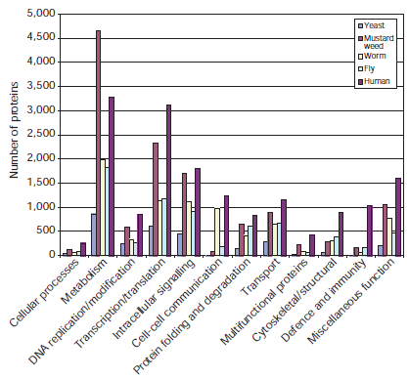
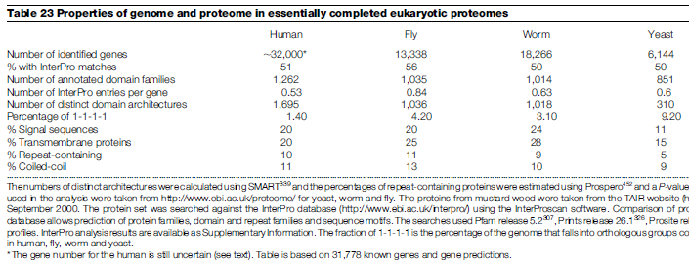
Outcome: genes (coding sequences)

Slide 17
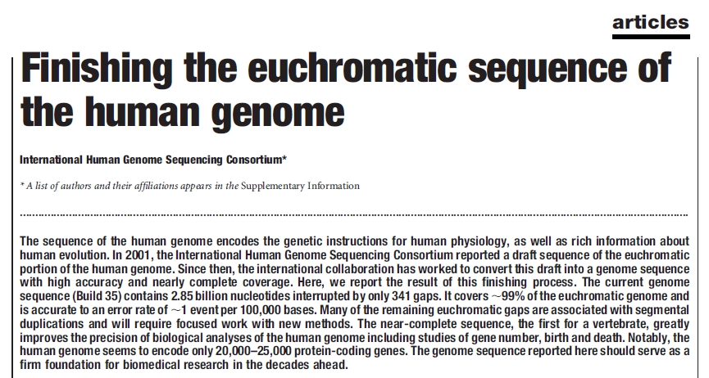
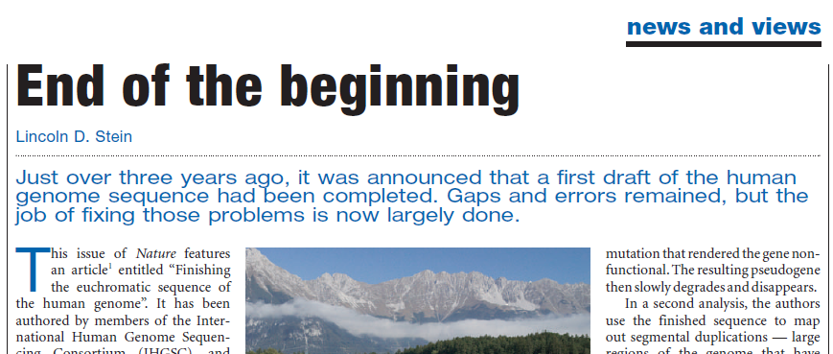

Slide 18
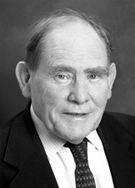
The sequence is not the end of the project, rather it is the beginning of the project
PERSPECTIVE GENOMICS
„End of the Beginning”
Sydney Brenner, 2000

Slide 19

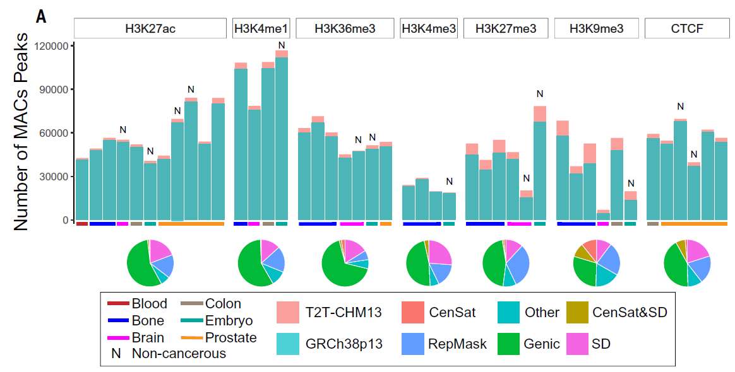
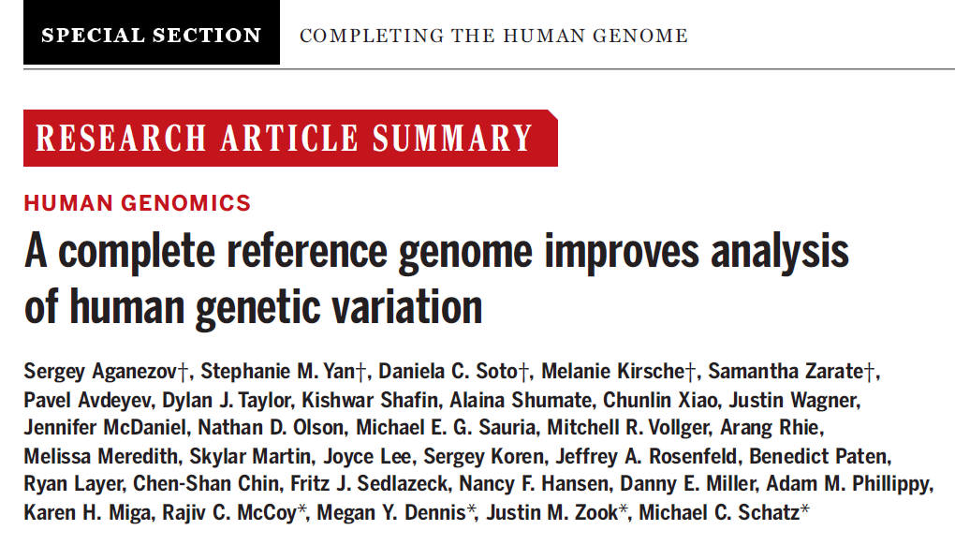
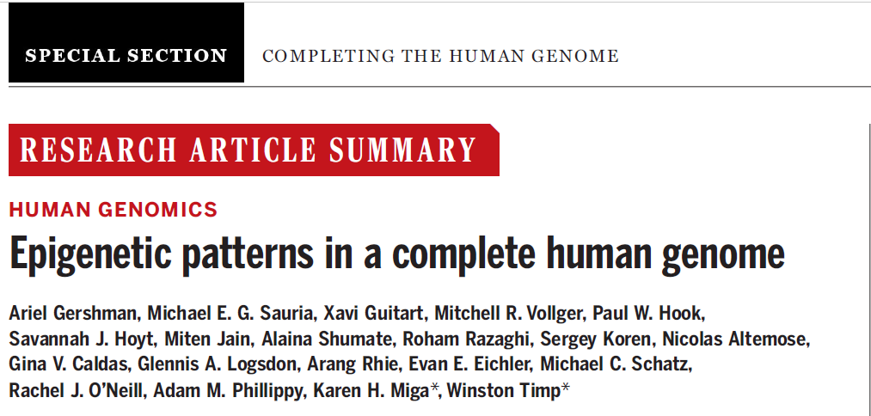

Slide 20
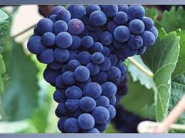
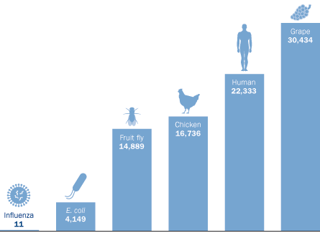
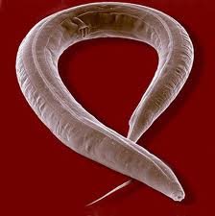
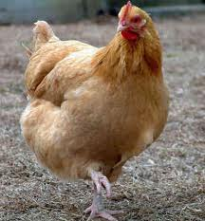
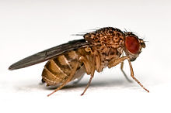
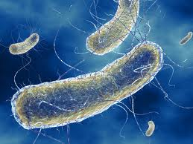
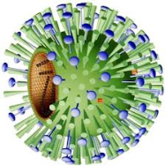
The number of human protein-coding genes is surprisingly low
Caenorhabditis elegans (1 mm)
19.700 gene („almost human”)

Slide 21
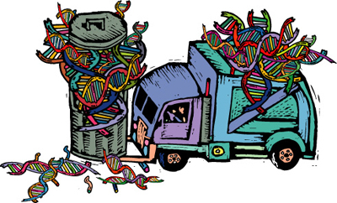
Earlier view: the majority of human genome consists of „junk DNA”
Only 1% of the genome have coding (genes) or regulatory capacity.

Slide 22
The lack of evidence is not the evidence of lack!!!

Slide 23
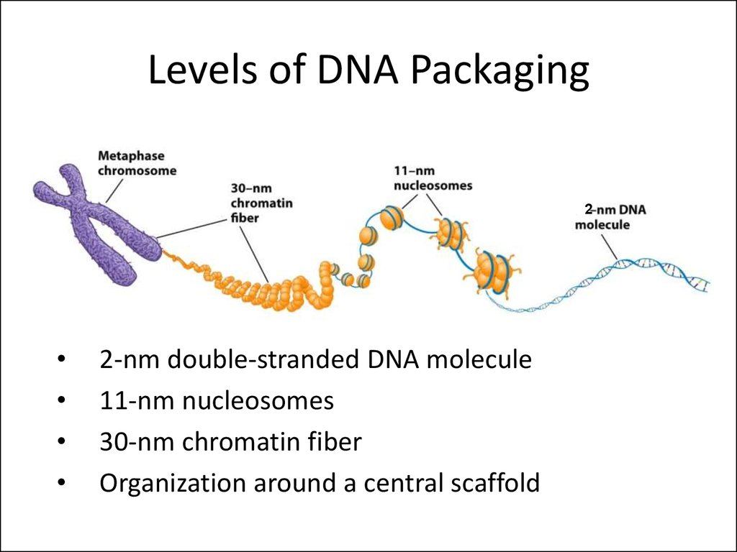
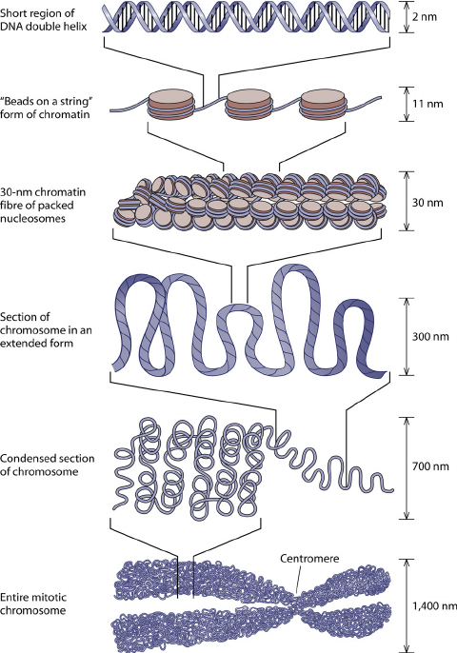

Slide 24
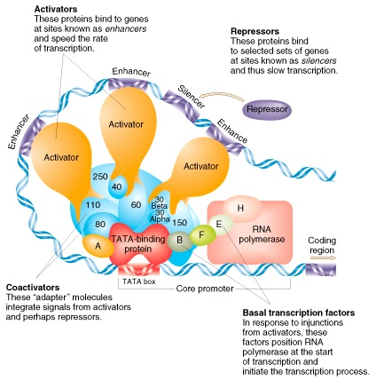
The regulation of transcription in eukaryotes
Transcription factors can be divided into 4 major classes:
1, Basic transcription factors, which are responsible for binding RNA polymerase mediating transcription
2, Co-activators, which mediate the message of enhancers to RNA polym.
3, Activators, which specifically bind to enhancer elements
4, Repressors, which bind to silencers
Gene activity is a combined result of these regulatory imputs.

Slide 25
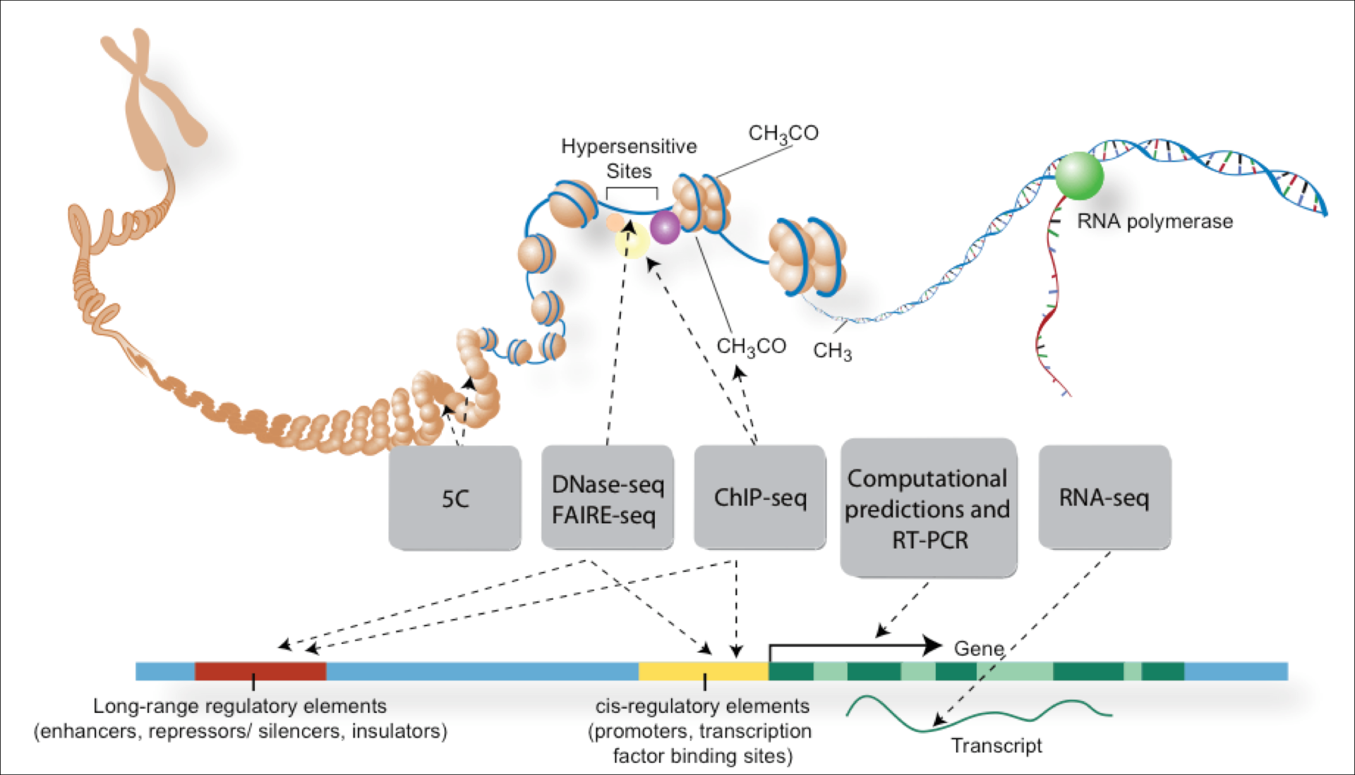
Uncovering functional DNA streches at the genomic level
(RT-PCR: reverse transcription-based PCR (it detects transcripts levels)

Slide 26
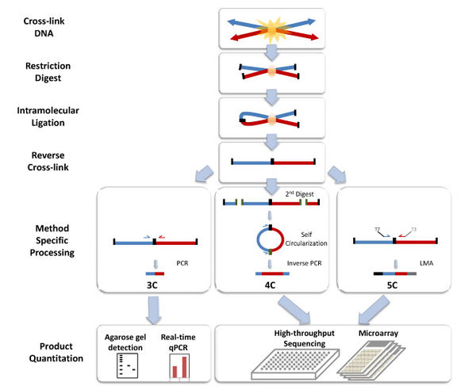
Chromosome conformation capture techniques (often abbreviated to 3C technologies or 3C-based methods) are a set of molecular biology methods used to analyze the organization of chromatin in a cell. They quantify the number of interactions between genomic loci that are nearby in 3-D space, but may be separated by many nucleotides in the linear genome.

Slide 27
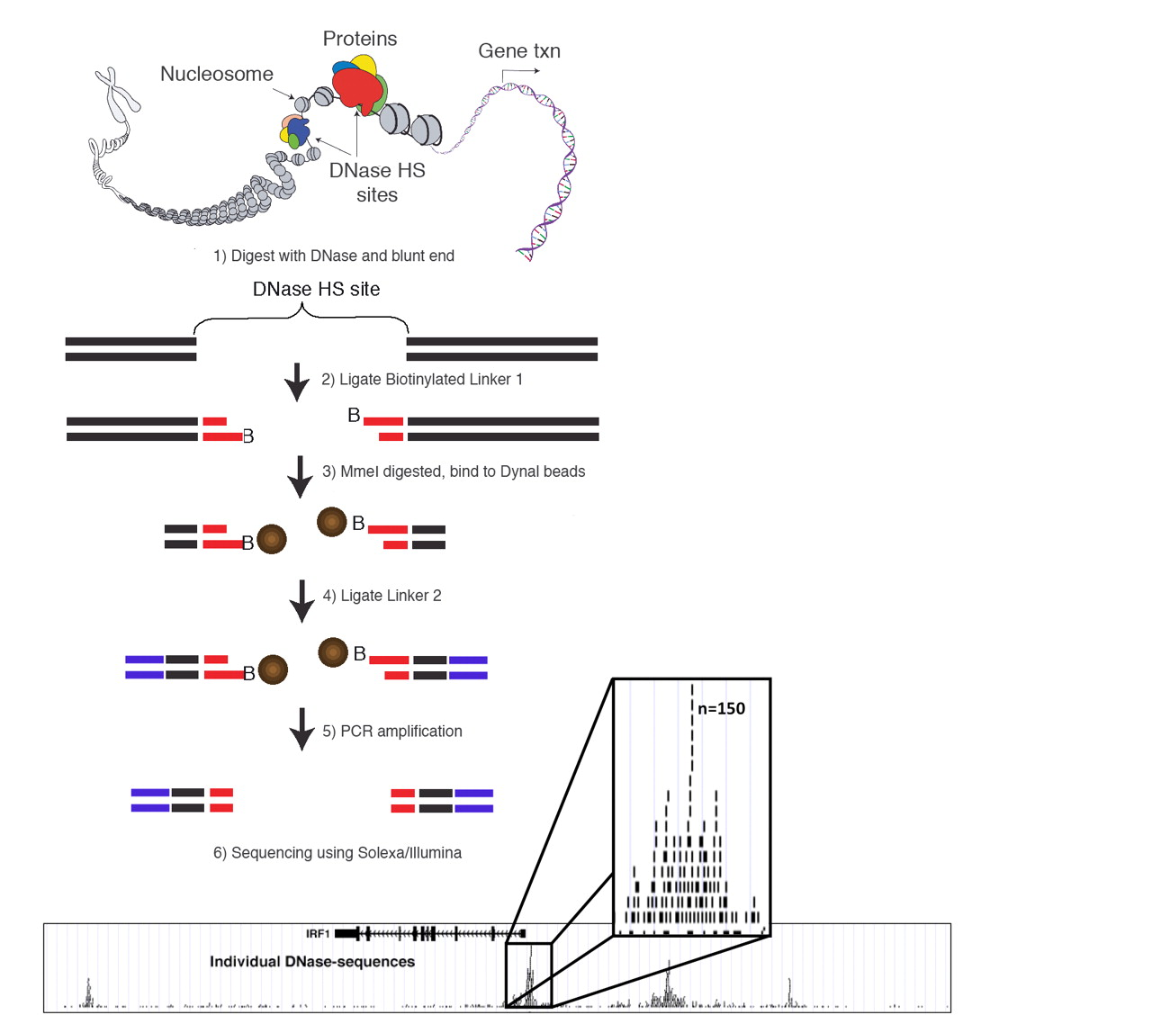
DNase-seq (DNase I hypersensitive sites sequencing) is a method used to identify the location of regulatory regions, based on the genome-wide sequencing of regions sensitive to cleavage by DNase I. FAIRE-Seq (Formaldehyde-Assisted Isolation of Regulatory Elements) is a successor of DNase-seq for the genome-wide identification of accessible DNA regions in the genome.

Slide 28
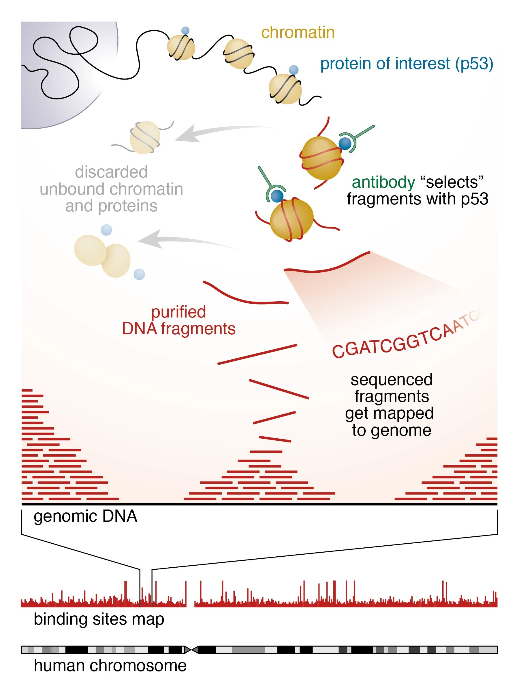
ChIP-sequencing, also known as ChIP-seq, is a method used to analyze protein interactions with DNA. ChIP-seq combines chromatin immunoprecipitation (ChIP) with massively parallel DNA sequencing to identify the binding sites of DNA-associated proteins.

Slide 29
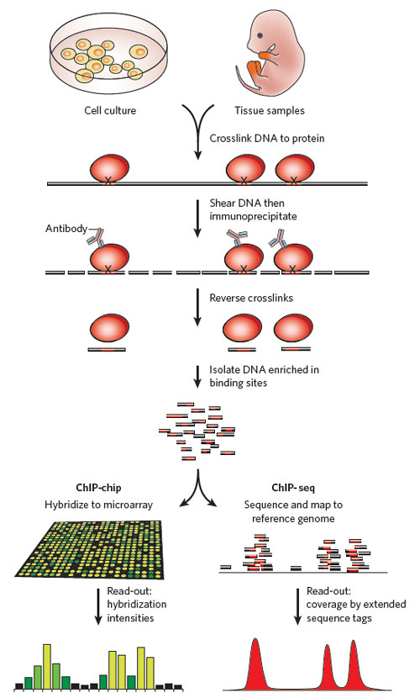
ChIP: chromatin-immunoprecipitation
(formaldehyde treatment)
(sonication)

Slide 30
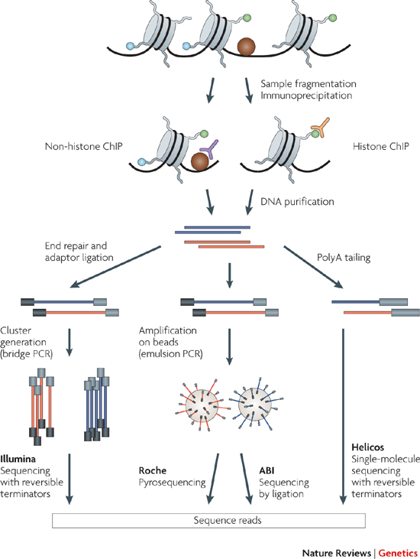

Slide 31
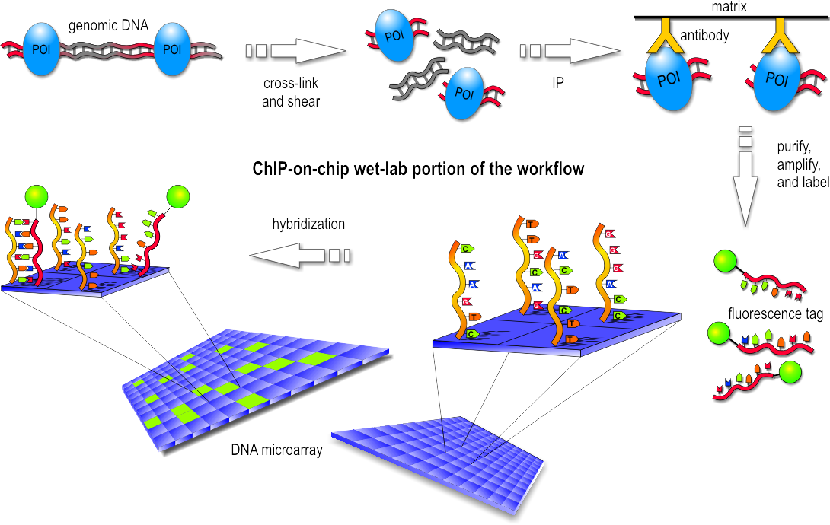
ChIP-on-chip

Slide 32
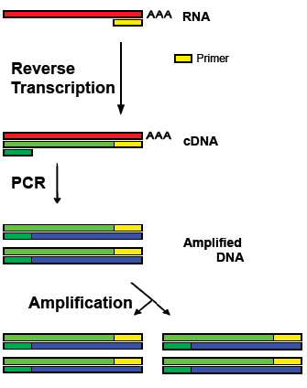
Reverse transcription polymerase chain reaction (RT-PCR), a variant of polymerase chain reaction (PCR), is a technique commonly used to detect RNA expression.

Slide 33

RNA-Seq (RNA sequencing), also called whole transcriptome shotgun sequencing, uses next-generation sequencing to reveal the presence and quantity of RNA in a biological sample at a given moment in time.

Slide 34



The ENCODE Consortium is an international collaboration of research groups funded by the National Human Genome Research Institute (NHGRI).
The goal of ENCODE is to build a comprehensive list of functional elements in the human genome, including elements that act at the protein and RNA levels, and regulatory elements that control cells and circumstances in which a gene is active.
ENCODE data are now available for the entire human genome (from 2012).
All ENCODE data are free:
http://genome-mirror.duhs.duke.edu/ENCODE/

Slide 35


To complement the human ENCODE data, Mouse ENCODE experiments are currently underway. Early access to this data is available on the Mouse mm9/NCBI37 browser at the UCSC preview site.
The Mouse ENCODE Data Summary lists experiments that are planned or in progress.

Slide 36



modENCODE
(Model Organism Encyclopedia of DNA Elements)
alternative exon usage of let-2 across stages

Slide 37


Analysis of alternative splicing

Slide 38



Promoter architecture at Transcription Start Sites (TSS)

Slide 39


2010:
beginnings
methodology

Slide 40
Goal
Comprehensively mapping transcripts, histone modifications, chromosomal proteins, transcription factors, replication proteins, and nucleosome properties accross a developmental time in multiple cell lines.
Discovering protein-coding, non-coding, RNA regulatory, replication and chromatin elements.

Slide 41
Generation of large-scale data sets:
transcriptome profiling across a developmental time course
genome-wide identification of transcription factor–binding sites
maps of chromatin organization

Slide 42
Methods (genome-wide)
Experimental assays include:
high-throughput RNA sequencing (RNA-seq)
capturing small and large RNAs and splice variants
chromatine immunoprecipitation (ChIP)
ChIP followed by high throughput sequencing (ChIP-seq)
profiling chromosomal and RNA binding or processing proteins
tiling-arrays

Slide 43


RNA-seq
exon
intron
exon
intron
exon

Slide 44

Transcription factor complexes

Slide 45

ChIP
(formaldehyde)

Slide 46



ChIP-seq: immunoprecipitation of a protein-DNA complex
Formaldehyde – UV light; sonication
Protein-specific
antibody

Slide 47

ChIP-on-chip

Slide 48

Tiling array: is a subtype of microarray chips.
Digest chromatin with DNaseI
(Genome array)

Slide 49

Stages at which samples should be taken

Slide 50

Chromatin-based annotation of functional elements
Example of a transcript predicted by chromatin signatures associated with promoter (red trace) and gene bodies (blue box) and supported by cDNA evidence.

Slide 51
Intergenic H3K36me1 chromatin signatures predict replication activity.
Enrichment of multiple chromatin marks were used to identify putative large (>10 kbp) intergenic H3K36me1/H3K18ac domains located outside of annotated genes.

Slide 52


Slide 53


Slide 54


Slide 55

CAGE
MmeI: cuts DNA 20 bases from its recognition sequence and modifies just one DNA strand for host protection

Slide 56

RNA-PET

Slide 57


Slide 58

FAIRE-seq
Formaldehyde-Associated Isolation of Regulatory Elements

Slide 59
RRBS
MspI: When the external C in the sequence CCGG is methylated, MspI cannot cleave. However, MspI can cleave the sequence when the internal C residue is methylated.

Slide 60

Bisulfite (bisulphite) sequencing is the use of bisulfite treatment of DNA to determine its pattern of methylation.

Slide 61


Slide 62

GENECODE gene annotation
Collection and interpretaqtion of different results

Slide 63

Experimental validation: how a newly identified coding region works in vivo
mouse
fish

Slide 64


DNA variation: Allele-specific ENCODE elements

Slide 65



Slide 66

Chromosome
Conformation
Capture

Slide 67

5C: chromosome conformation carbon capture copy
ChIA-PET

Slide 68

ChIA-PET
Chromatin Interaction Analysis by Paired-End Tag Sequencing (ChIA-PET) is a technique that incorporates chromatin immunoprecipitation (ChIP)-based enrichment, chromatin proximity ligation,Paired-End Tags, and High-throughput sequencing to determine de novo long-range chromatininteractions genome-wide (Fullwood & Yijun, 2009).

Slide 69

TSS: transcriptional start site

Slide 70


Slide 71


Slide 72


Slide 73


Slide 74


Slide 75




Slide 76


Slide 77



Slide 78

TF: transcription factor

Slide 79




Slide 80



A C. elegans example

Slide 81

1 2 3 4 5 6 7 8 9 10 11
Lines:
front control (goa-1 oligo)
xol-1 oligo (reticulocyta lysate)
xol-1 oligo + TRA-1 (positive control)
goa-1 oligo
goa-1 oligo + TRA-1
mut goa-1 oligo
mut goa-1 oligo + TRA-1
gpa-16 oligo
gpa-16 oligo + TRA-1
rest gpa-16 oligo
rest gpa-16 oligo + TRA-1
TRA-1
lysate
1 2 3 4 5 6 7 8 9 10 11

Slide 82


