Slide 1


Knock out, knock down, knock in
Genetic engeneering –
genome editing
Nobel prize in Chemistry, 2020
Emmanuelle Charpentier
Jennifer A. Doudna
“for the development of a method for genome editing.”

Slide 2
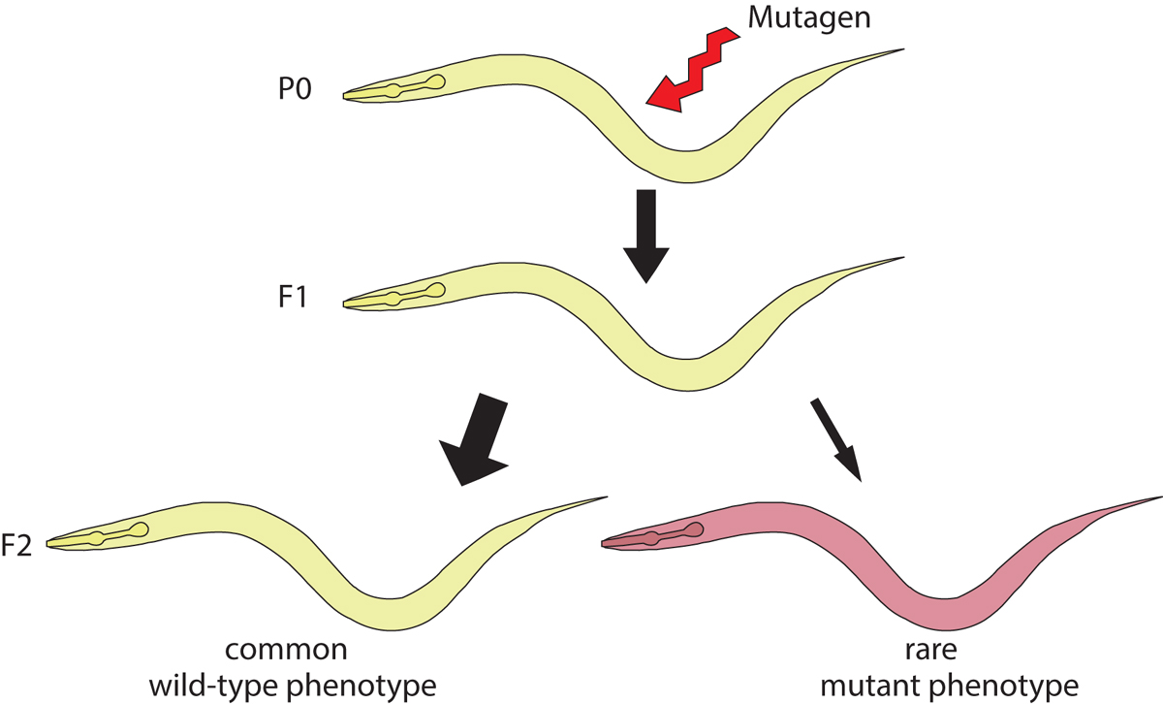
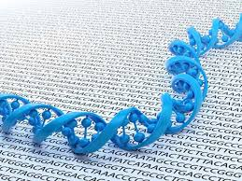
Problems with classical mutagenesis (forward genetics):
laborious
paralogous gene families (functional redundancy) – the function of several genes remains undetectable by random mutations.
Genomics – allele generation, starting from nucleotide sequence information: RNA interference (reverse genetics)
Forward genetics
Reverse genetics
From 1995

Slide 3
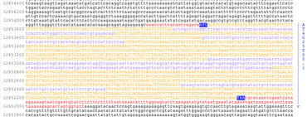


Slide 4
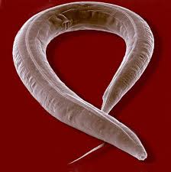
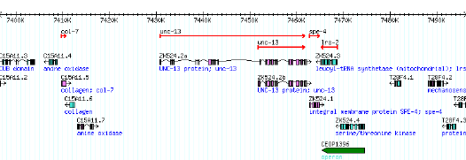
C. elegans Gene Knockout Consortium
Konck out
Mutant (deletional) allele for every gene
-PCR-based mutagenesis
-using specific primers, „screening for short” (deleted) fragments – PCR preferable ampl
Ifies short fragments rather than long ones.

Slide 5
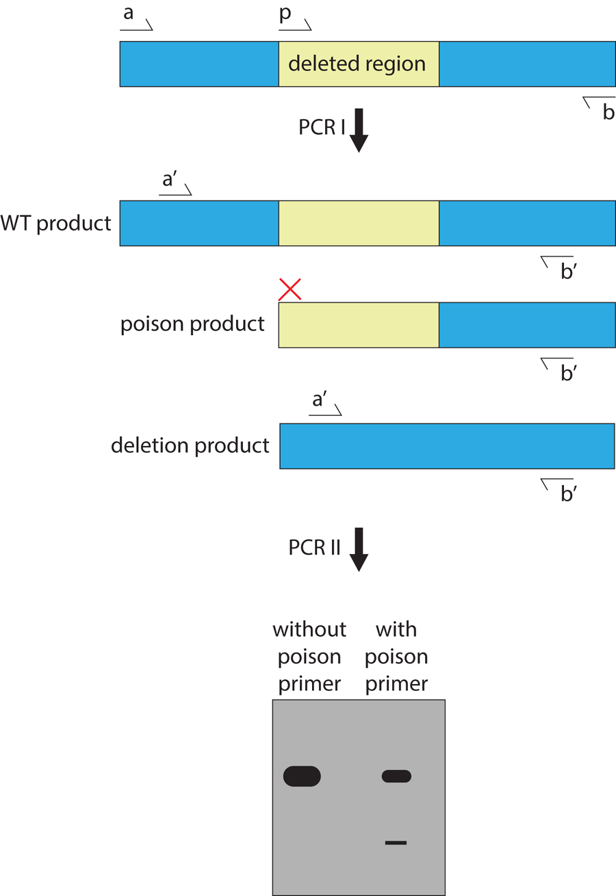
Random mutagenesis (EMS)
Directed screen for PCR deletions
Isolation of homozygous mutants
Phenotype chracterization

Slide 6
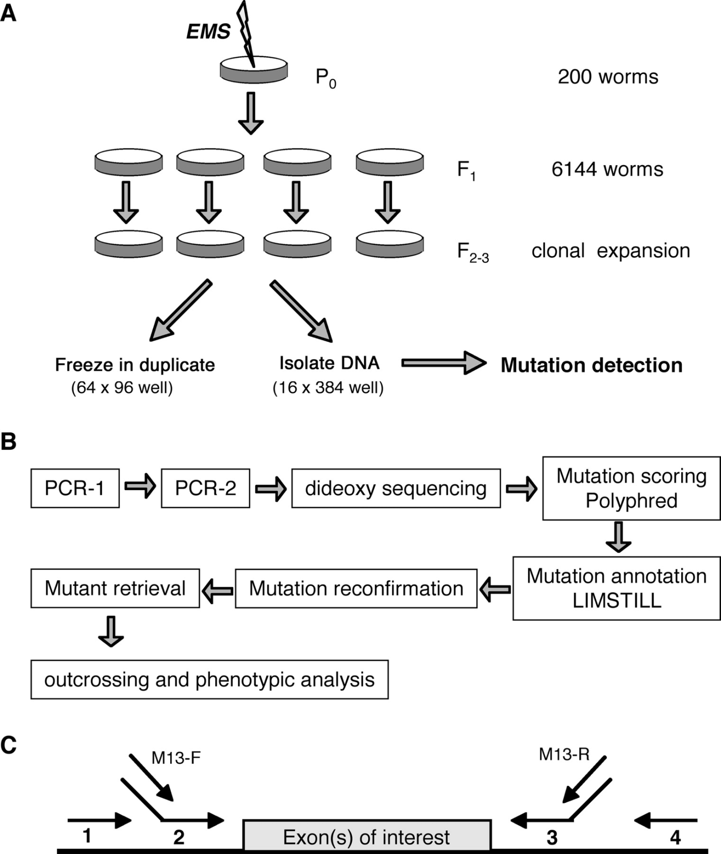
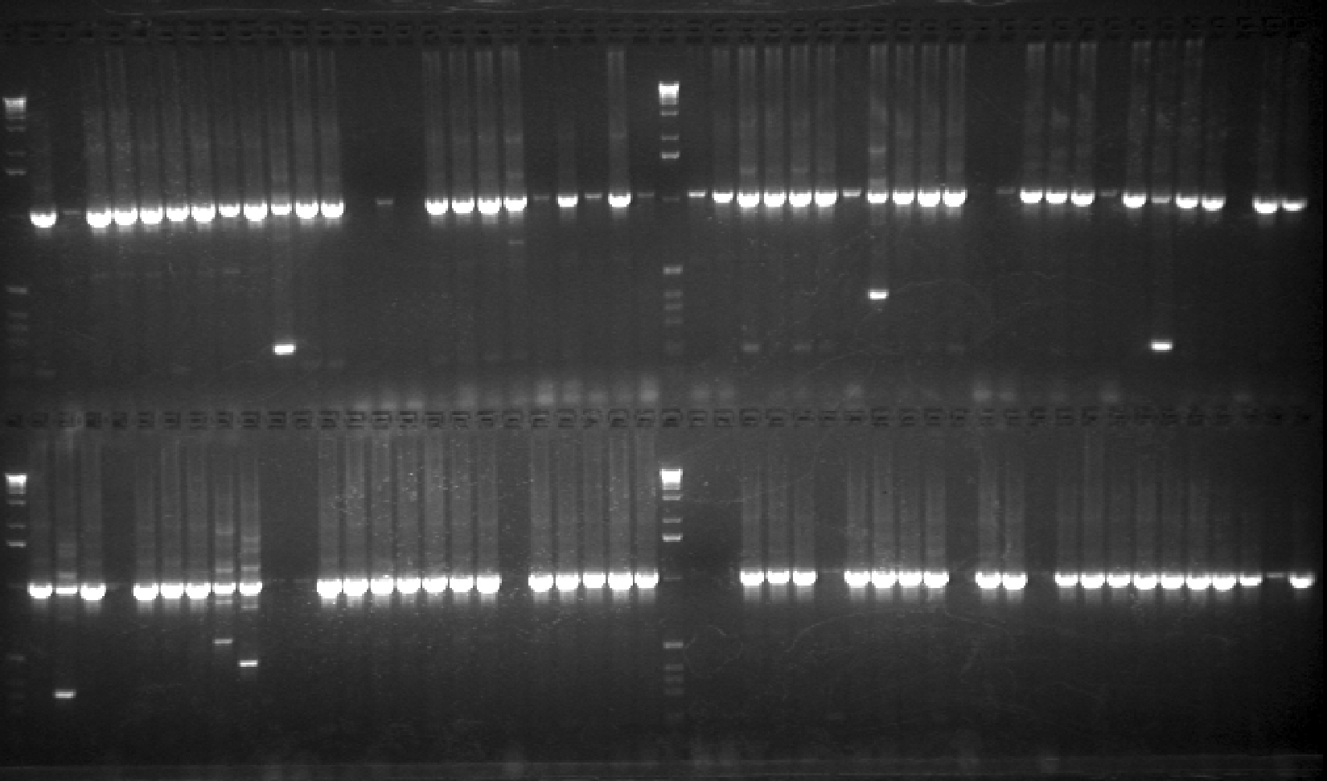

Slide 7
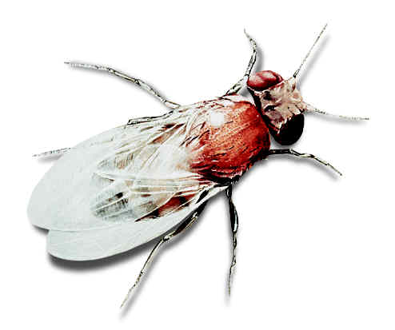
Drosophila mutagenesis:
a P element-based approach (knock in)
31 bp IR
31 bp IR
CATGATGAAATAACATAAGGTGGTCCCGTCG
CGACGGGACCACCTTATGTTATTTCATCATG
1
31
2877
2907
Genetika
11 bp IR
11 bp IR
ATTAACCCTTA
TAAGGGTTAAT
126
136
2763
2773
IR
ORF 0
ORF 1
ORF 2
ORF 3
IR
1
85
442
501
1168
1222
1947
2138
2706
2907
Intron 1
Intron 2
Intron 3

Slide 8
Generation of insertional alleles by P element mobilization
transposase
P element
target gene
Neighbouring gene
target gene
Neighbouring gene
PCR primer: sequencing

Slide 9
Generation of deletion by P element remobilization
transposase
P element
Gene of interest
Neighbouring gene
deletion

Slide 10
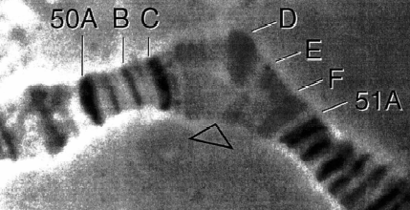
Identification of deletional mutants
Based on phenotype: in essential genes (causing lethality)
PCR: the size of the deleted region can be determined
PCR primer
Wild-type
mutant
P element
vizsgált gén
deletion
PCR primer
loop in the heterozygote

Slide 11
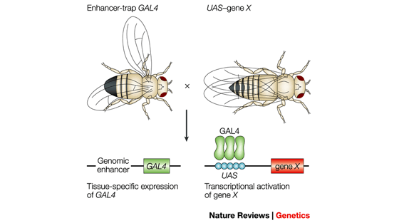
Gal4-UAS system in Drosophila
Own (endogenous) promoters in Drosophila usually have a weak (undetectable) activity. In C. elegans, however, promoters are strong enough to provide detectable levels of expression – there is no need for a Gal4-UAS system.
The importance of genomic environment.

Slide 12
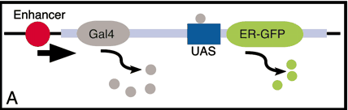
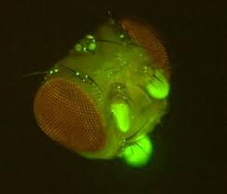
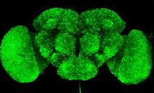
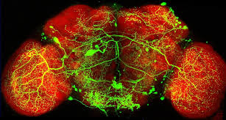
Drosophila brain stem

Slide 13
Generation of transgenic flies by P element microinjection
DNA region destined for cloning is inserted between two inverted repeats of P element in a plasmid, which is injected in the presence of a transposase-encoding sequence into a M cytotype embryo at the pre-blastema stage.
EcoRI, KpnI, BamHI, XbaI, HpaI, XhoI, PstI
Cloning site
Bacterial sequence
white
5’-end
Hsp70
3’-end
Transposase can be derived from:
- purified transosase protein linked to a plasmid
- co-injecting with a „helper” plasmid
- injecting into a fly containing endogenous transposase

Slide 14
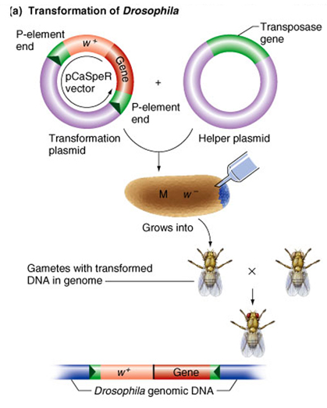
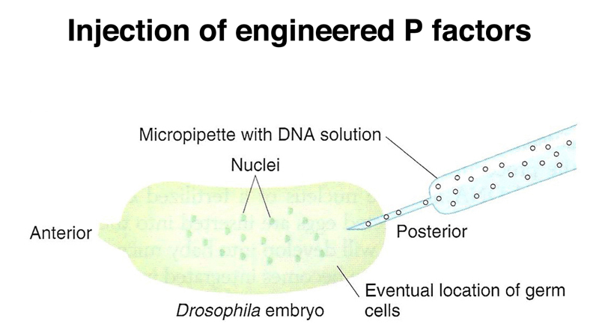
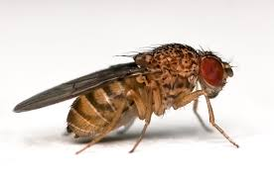
Transformation
Knock in
Sensory neurons in Drosophila larva, reporter GFP gene

Slide 15

RNA interference libraries - Drosophila
Eyeless RNAi

Slide 16
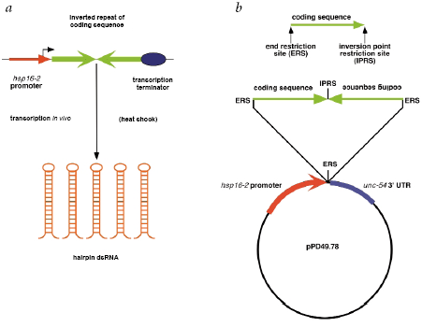
Knock down: RNA interference libraries – C. elegans, Drosophila

Slide 17
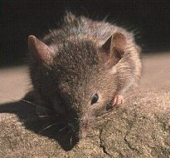
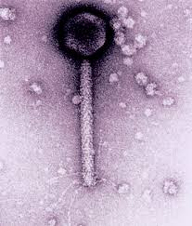
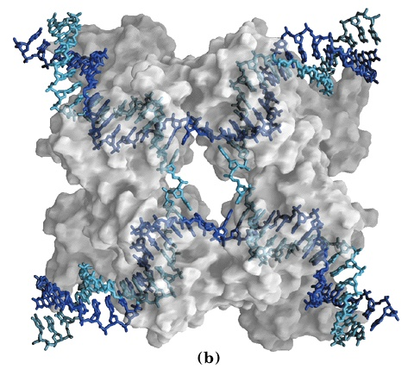
Mutagenesis in mice: Cre-loxP system
Relies on P1 phage homologous recombination system: (Cyclization of REcombination)
Mus musculus
palindrom spacer palindrom
Cre recombinase

Slide 18
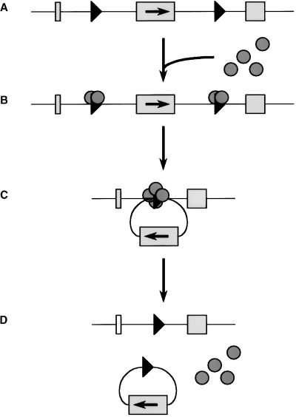
Cre-loxP system
loxP
loxP
Cre recombinase
deletion

Slide 19
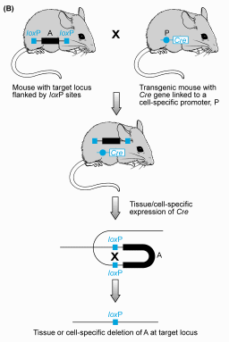
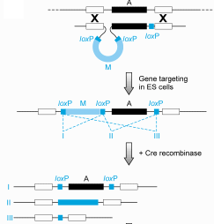
Cre-loxP system: knock out mice

Slide 20
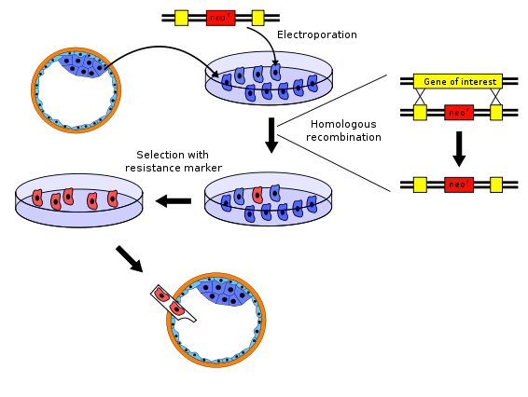
Transgenesis in mice I.
Vector DNA
blastocyst
Chromosomal DNA

Slide 21
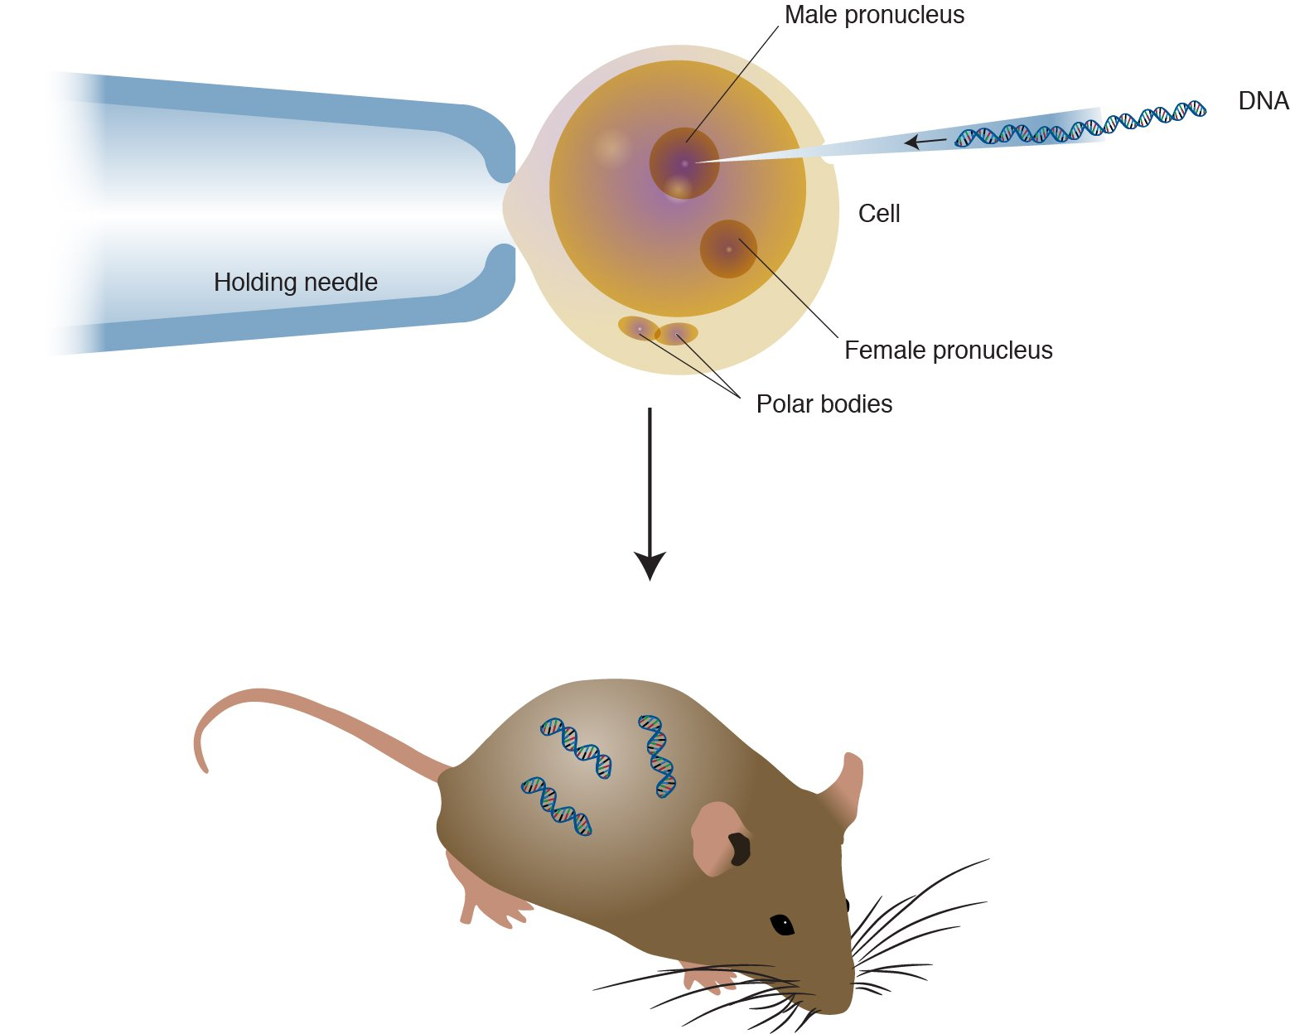
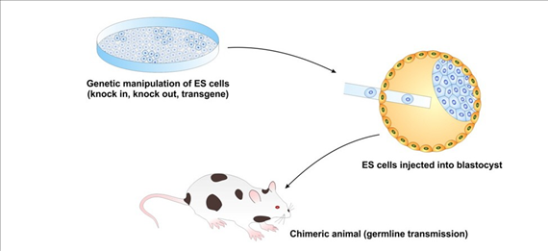

Slide 22
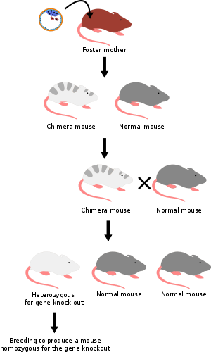
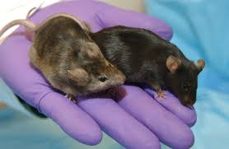
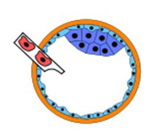
Transgenesis in mice II.
F1
(transformation not in zygote)

Slide 23
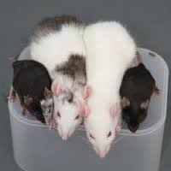
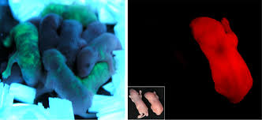
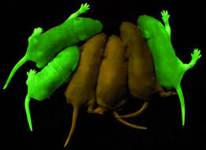
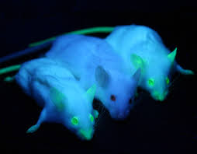
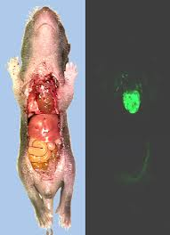
Homozygous transgenic mice

Slide 24
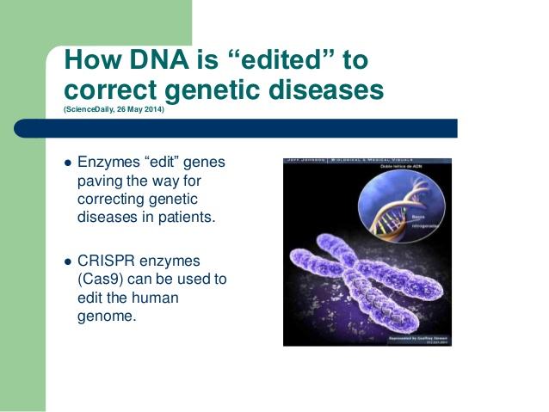
DNA editing: major goals

Slide 25
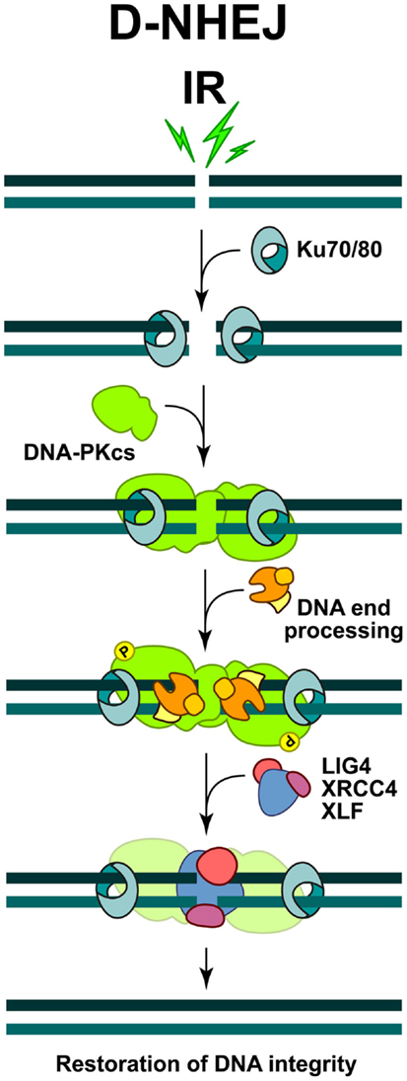
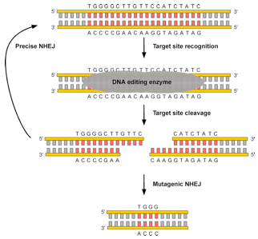
Targeted knock out - DNA editing with enzymes
NHEJ: non-homologuous end joining

Slide 26

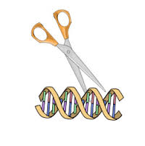
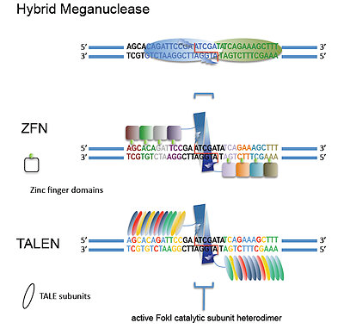
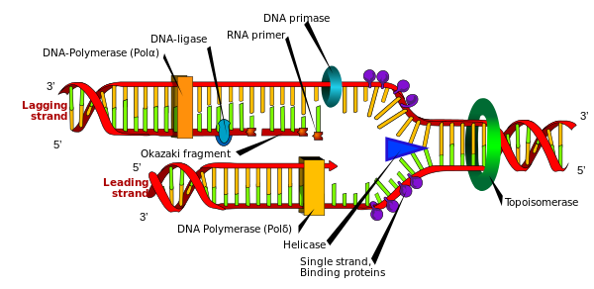
DNA editing enzymes
Transcription activator-like effector nuclease

Slide 27
Programmable nucleases
zinc-finger nucleases (ZFNs)
transcription activator-like effector nucleases (TALENs)
RNA-guided engineered nucleases (RGENs) derived from the bacterial clustered regularly interspaced short palindromic repeat (CRISPR)–Cas (CRISPR-associated) system

Slide 28
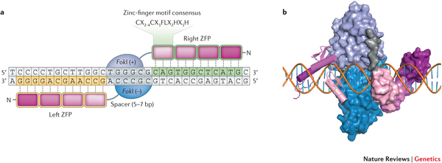
Each ZFN is composed of a zinc-finger protein (ZFP) at the amino terminus and the FokI nuclease domain
ZFNs typically contain between three and six individual zinc finger repeats and can each recognize between 9 and 18 basepairs. A zinc finger domain perfectly recognizes a 3 basepair long DNA sequence.

Slide 29
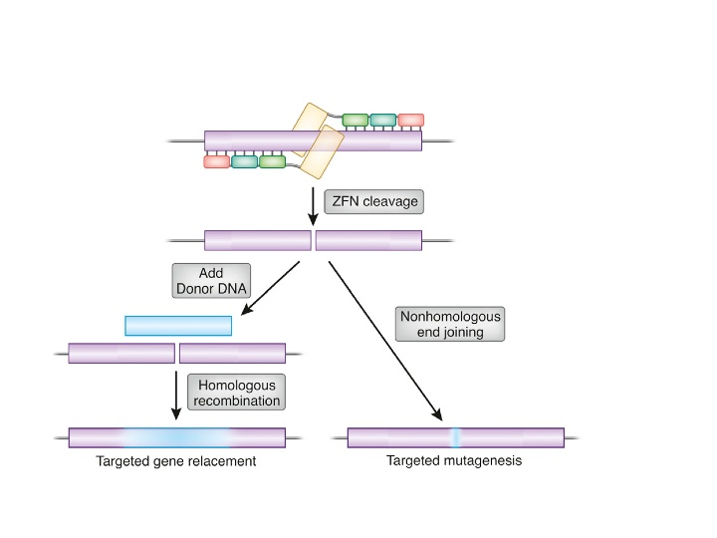

Slide 30
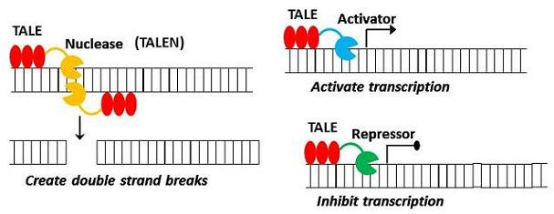
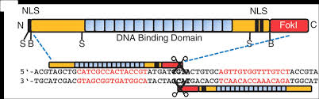
Transcription activator-like effector nucleases (TALEN)

Slide 31
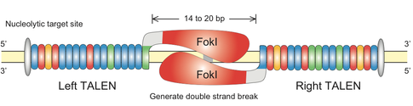
TALEN
TAL effectors are proteins that are secreted by Xanthomonas bacteria when they infect plants.

Slide 32
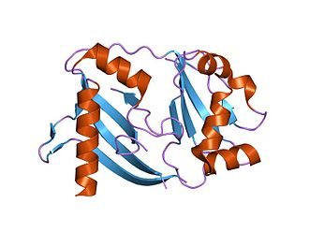

The CRISPR (clustered regularly interspaced short palindromic repeats) system
Cas (CRISPR-associated sequences) proteins
CRISPR
Cas9
DNA loci containing short repeats, which are separeted by spacer sequences. These loci are frenquently closely linked with Cas genes.
CRISPR loci can be found in 90% of Archaea and in 40% of Bacteria.

Slide 33
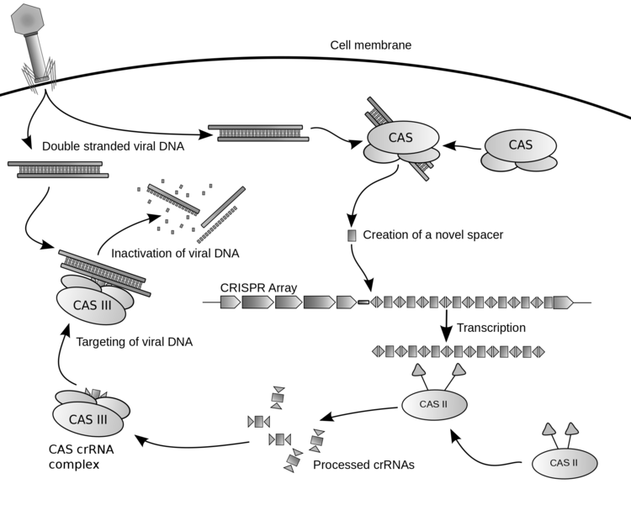
Bacterial
cell
Virális DNS

Slide 34
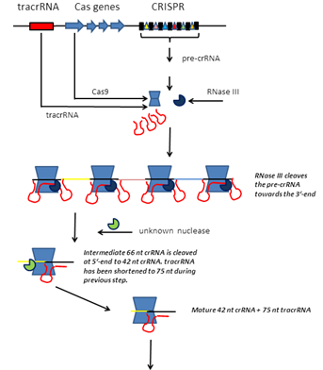

Endogenous defense against viral (phage) elements

Slide 35

Emmanuelle Charpentier and Jennifer Doudna

Slide 36


Slide 37

PAM: Protospacer adjacent motif (behing DNA sequence targeted by Cas9)
crRNA: CRISPR RNA
tracrRNA: trans-activating crRNA, a small trans-encoded RNA

Slide 38


Generation of deletional alleles by the CRISPR-Cas9 system
Cas9

Slide 39


Slide 40

Cas9 homologues

Slide 41

Genome-editing knockout kit using CRISPR/CAS9

Slide 42


Slide 43



Slide 44
An autocloning system
No need for enzymatic reactions

Slide 45
Cheking

Slide 46
Test

Slide 47


Slide 48


Slide 49

Isothermal PCR + nicase enzyme

Slide 50

Solution: home DNA diagnosis

